Slide 1


Emerging from lockdown: How tech can help you?
Richard Lane
Assistant Professor, Institute of Coding

Slide 2
Todays session
Introduction to the IoC
Bridging the Digital Skills Gap
Digital Literacy
Digital Transformation
What technology should I engage with?
Conclusion
Questions

Slide 3
Lockdown
The impact the current state of emergency has had varies drastically dependent on a number of factors
It has shone a indiscriminate light on digital skills and technical adoption
How digitally ready are you and your business?

Slide 4

Introduction to the IoC - https://instituteofcoding.org/
Conglomerate of 33 Universities and 100 employers
Funded by the Department of Education through the Office for Students
Uniquely placed between education and industry

Slide 5
Objectives
To equip the UK with the key skills needed to compete in a global digital economy
To make a lasting and measurable impact on digital skills provision at a national level
12.6 million adults in the UK do not have basic digital skills¹
85% of “hard-to-fill” positions are those requiring digital skills¹
To develop tailored programmes through co-creation with industry
“many graduates leave university without up-to-date technical skills, or the softer skills required to be effective in the workplace”³
To explore innovative teaching methods to meet the needs of the evolving industry landscape
90% of all jobs will require "digital skills“¹
35% of jobs in the UK are likely to be obsolete due to automation within decades²
Increased demand for data science, AI, cybersecurity threats or Industry 4.0 in multiple domains
1: Digital Skills for the UK Economy, Department for Business Innovation & Skills, Department for Culture Media & Sport, 2016
2: Agiletown: the relentless march of technology and London’s response. Deloitte 2014
3: Sector insights: skills and performance challenges in the digital and creative sector. UK Commission for Employment and Skills, 2015

Slide 6

75% of executives are experiencing challenges in digital recruitment
Ignite digital, 2018

Slide 7

Lack of skilled workers is
costing UK companies £2.2Bn
Open University, 2018

Slide 8

26% of small businesses lack confidence in their digital skills
FSB, 2018

Slide 9

90% of jobs in 20 years time will require digital skills
Department for Digital, Culture, Media and Sport, 2017

Slide 10


Digital Skills Gap
Awareness
Mastery
Engage
Experience
Comprehend
Apply

Slide 11


Slide 12
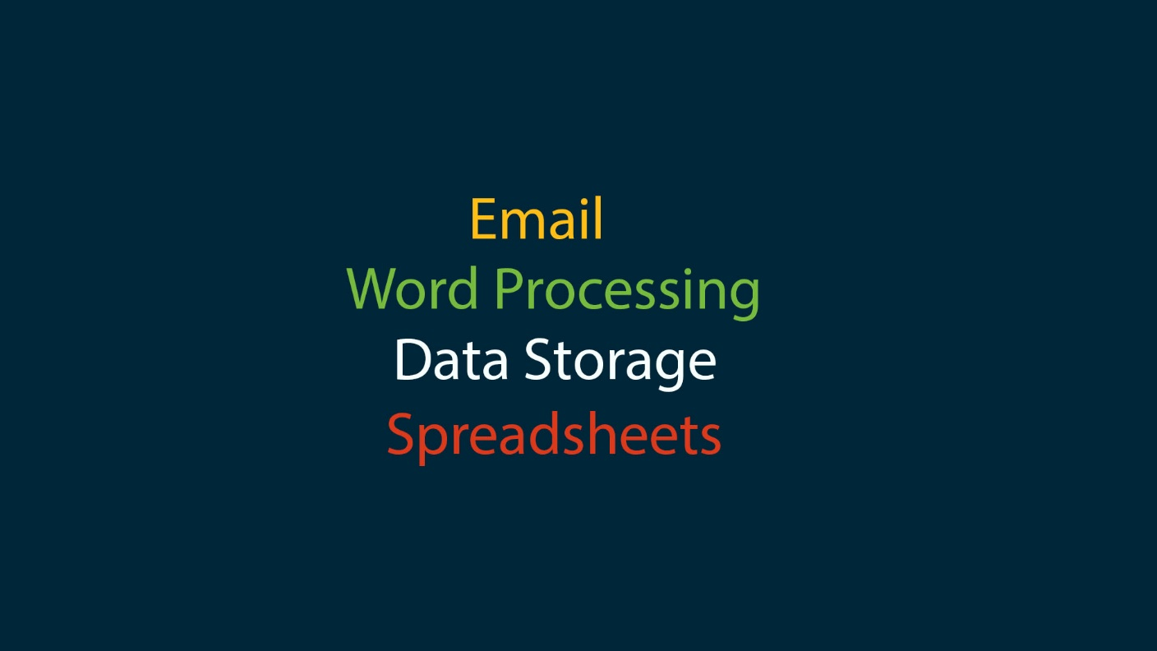
Digital Literacy

Slide 13
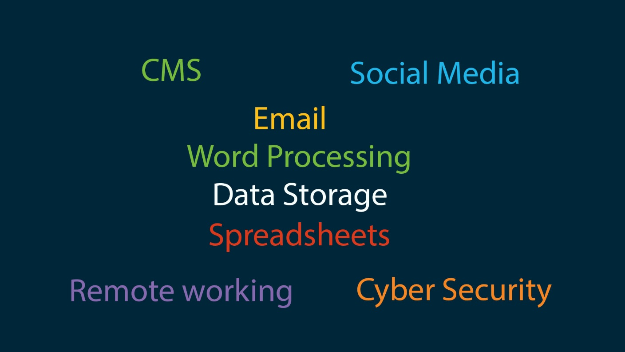

Slide 14
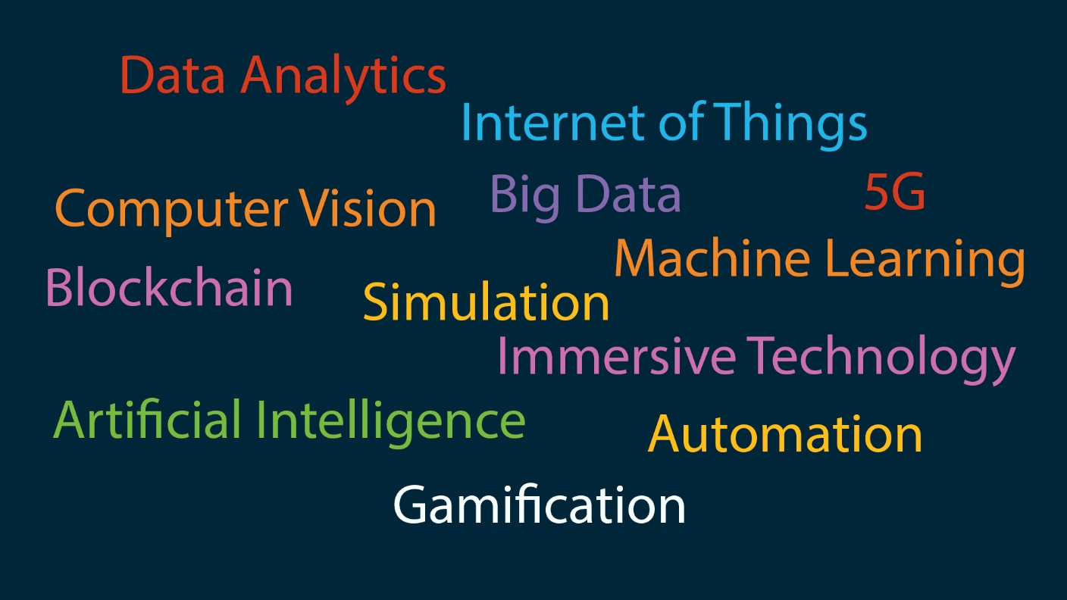

Slide 15

Digital Leadership

Slide 16

Paths to Digital Skills

Slide 17


Slide 18
Digital Transformation
No one size fits all solution
Dependent on what the end goal is as a business
Risks involved
Who is equipped to lead this?

Slide 19


Slide 20
Digital Disruption New technologies create space for innovation to the point of disruption in established industries.
PayPal
Tesla
Airbnb
Uber
Amazon
Google
Monzo
Netflix

Slide 21
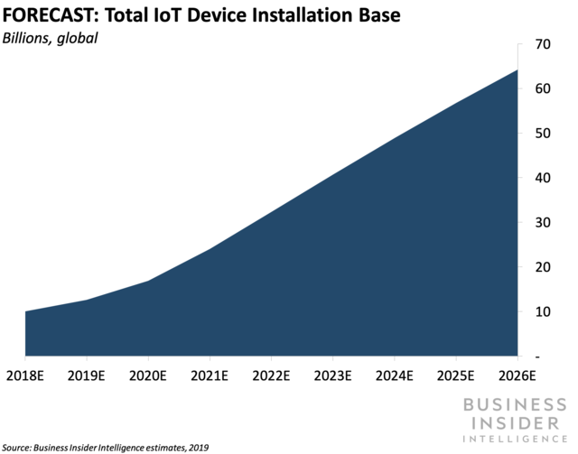
Internet of Things (IoT)
How do I know it -
Smart Homes, Fitness bracelets
Why is it useful -
Understanding customers, Overview of operations, new revenue models, Productivity gains, Smart Cities
Business use -
Used in logistics to accurately track products in transit in real time.

Slide 22
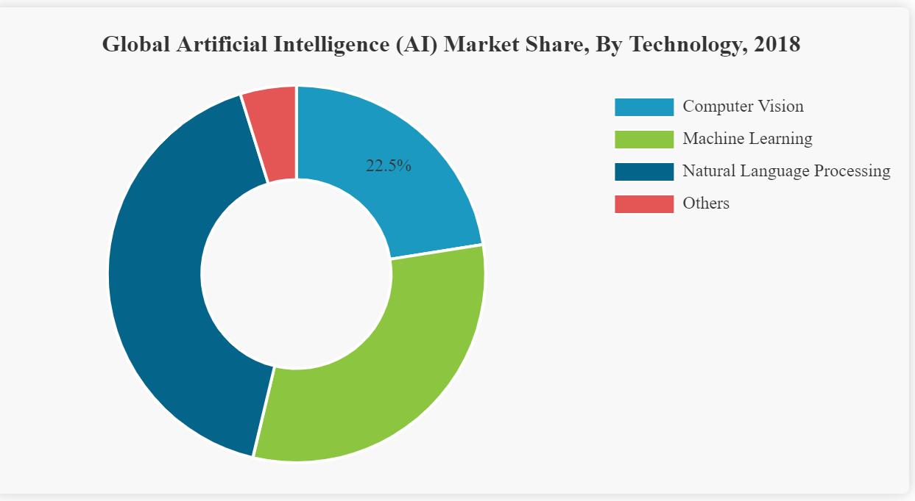
Artificial Intelligence
How do I know it -
Siri, Google Assistant, Alexa, Netflix recommendations
Why is it useful -
Customer service, Smart predictions, Market Adjustments, Cyber Security, Tailored Marketing, Autonomous Vehicles
Business use -
Smart predictions of scheduling, repairs and upkeep of machinery
Fortunebusinessinsights,2018

Slide 23
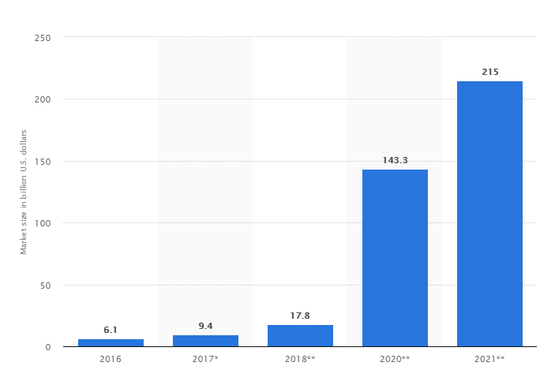
Immersive Technologies
How do I know it -
Virtual Reality headsets, Gaming, Pokémon Go, Snapchat Filters
Why is it useful -
Design, Simulation, Visualisation, Augmented Intelligence
Business use -
The IKEA app allows you to see digital furniture at correct scale in the place you would put it.
Statista, 2018

Slide 24

Cloud Computing
How do I know it -
iCloud, Google Docs, One Drive, Amazon AWS
Why is it useful -
Decentralised storage, Remote Working, Software as a service, Process tasks offsite
Business use -
Use real time data from multiple sources concurrently

Slide 25
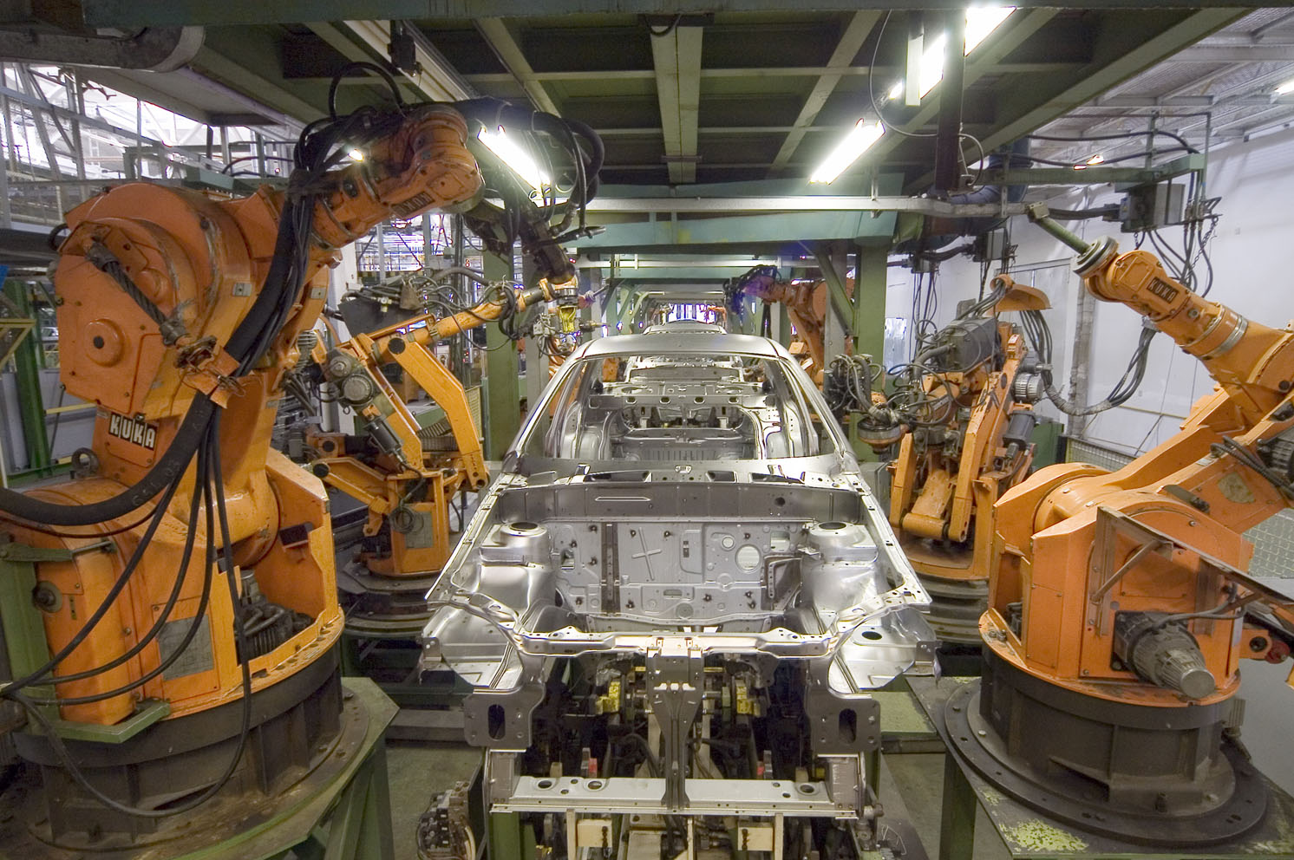
Automation
How do I know it –
Robots building cars, Marketing that follows you
Why is it useful –
RPA, BPA and BPM can drastically improve efficiency, Higher resilience to outside influence, Error reduction
Business use -
In sales operations, software is able to update and generate documentation such as invoices, CRM inputs and accounting records.

Slide 26

Blockchain
How do I know it –
Bitcoin
Why is it useful –
Secure, de-centralised, Fully traceable
Business use -
Smart-Ledger technology for smart contracts. Providing higher visibility of product and financial history.

Slide 27

Open Innovation Platforms
How do I know it –
A form of cross disciplinary focus group looking at an industry challenge
Why is it useful –
Prototyping, Crowd source solutions, Prioritise innovation
Business use -
Litecar challenge, open source vehicle design

Slide 28
Embedded Digital Culture
Digital Leadership
Technology maturity
Develop a digital culture in staff at all levels and positions
Adopting new technologies is critical given today’s challenging business climate, but the key to getting real value is by using them in combination.
Contextual understanding of technology in your sector
Mechanisms to innovate from within

Slide 29


Slide 30


Slide 31
Any Questions?
https://tinyurl.com/IoC-Webinar-April

Slide 32


Thank You!
Please get in touch directly if you would like to comment, learn more about our courses or get involved with the Institute of Coding at Coventry University.
Deepak Farmah: E. Dfarmah@cueltd.co.uk | T. 07392 096215
Louise Phipps: E. LPhipps@cueltd.co.uk | T. 07392 096318
@IoC_CovUni
#digitalskillsmatter
Institute of Coding (Coventry University)
https://tinyurl.com/IoC-Webinar-April

