Slide 1
7058CEM – Embedded Systems Programming
Analog Inputs and Outputs with the ST Nucleo F072RB board
Chris Bass

Slide 2
Today
Analog Input and Output
Analog-to-Digital Converter (ADC)
Digital-to-Analog Converter (DAC)
Generating different types of waves
Generating sound waves
Analog sensors

Slide 3
Overview of Analog Input and Output
Most signals in the real world are analog signals.
Processors are digital devices. To interface with analog signals, these have to be converted to digital signals and vice versa.
Analog-to-Digital Convertor (ADC):
  Converts the amplitude of physical analog signals to discrete digital numbers
  Involves signal sampling and quantization
Digital-to-Analog convertor (DAC):
  Converts digital data into analog signals, such as current, voltage or electric charge
  For example, a DAC could be used to drive an earphone or speaker amplifier so that sound (analog air pressure waves) can be produced.
Notes:
To be readable by a processor, an analog real-world-signal needs to be converted into a digital signal. This means that a sensor’s first step is to convert the physical signal into an electrical one.
After sampling with a sample-and-hold-stage (time-discretization), the signal it is converted, via an analog-to-digital-converter (ADC), into time- and value-discrete digital samples.
In the inverse operation, a digital-to-analog-converter converts the samples into real-world analog type values. The values can only be analog because the sampling and quantization is a real loss of information which cannot be recovered or substituted.

Slide 4
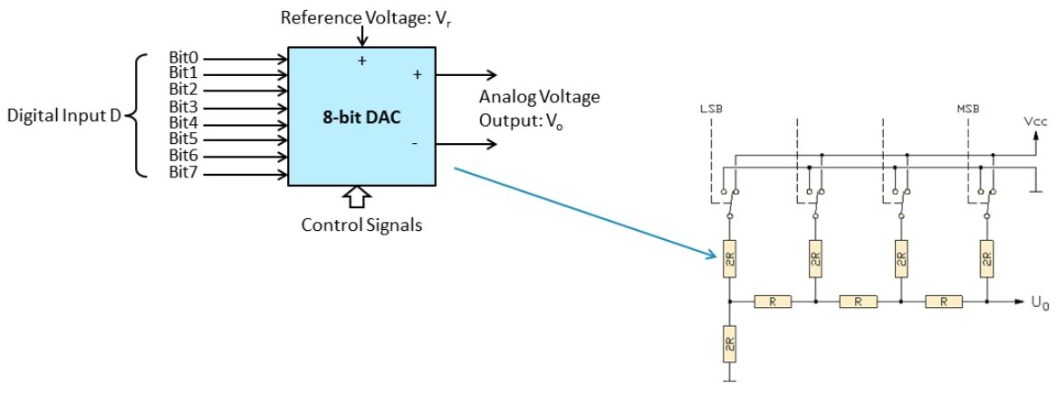
Digital-to-Analog Converter (DAC)
Input: discrete finite-precision number (usually in binary)
Output: continually varying physical signals, such as voltage or pressure
The following picture gives an example of an 8-bit DAC:
Notes:
A DAC transmits the digital input values to a resistor network, in which the input voltage of the according bits is binary weighted. This is usually done with a R-2R-resistor network. The output voltage is the analog equivalent to the digital input number, weighted with the reference voltage.

Slide 5
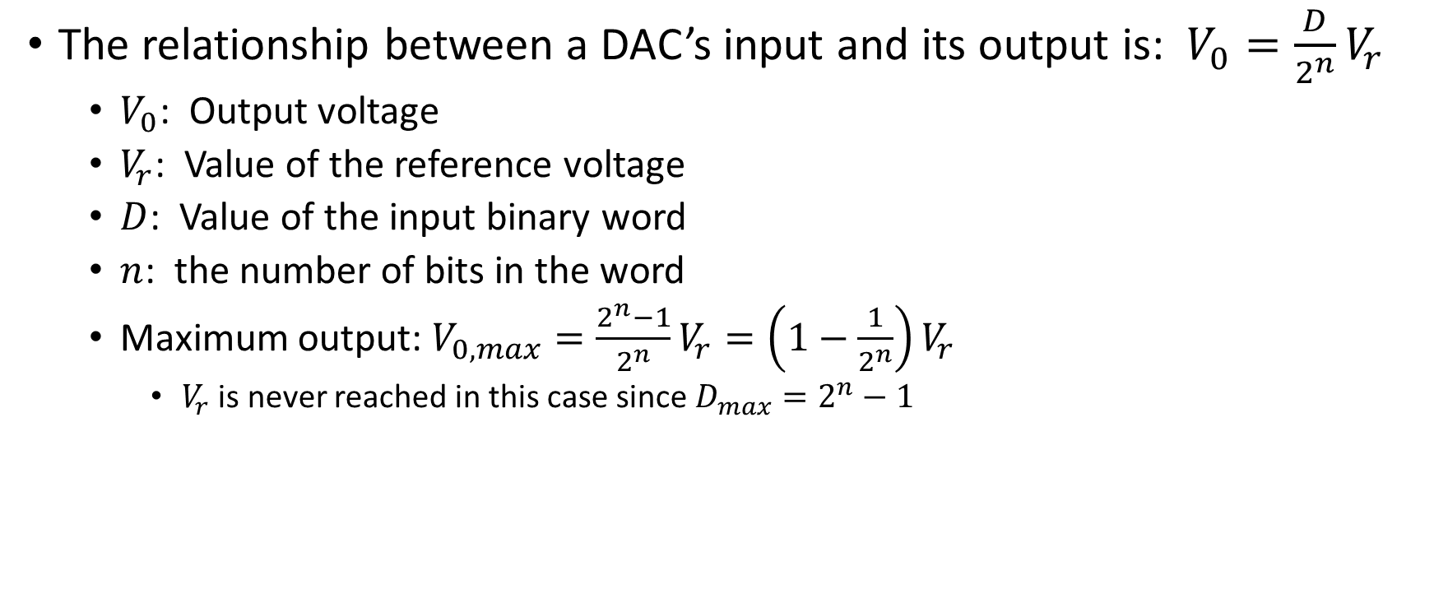
Digital-to-Analog Converter (DAC)
The relationship between a DAC’s input and its output is: $V_{0}=\frac{D}{2^{n}}V_{r}$
  $V_{0}$: Output voltage
  $V_{r}$: Value of the reference voltage
  $D$: Value of the input binary word
  $n$: the number of bits in the word
  Maximum output: $V_{0,max}=\frac{2^{n}−1}{2^{n}}V_{r}=\left(1−\frac{1}{2^{n}}\right)V_{r}$
    $V_{r}$ is never reached in this case since $D_{max}=2^{n}−1$

Slide 6
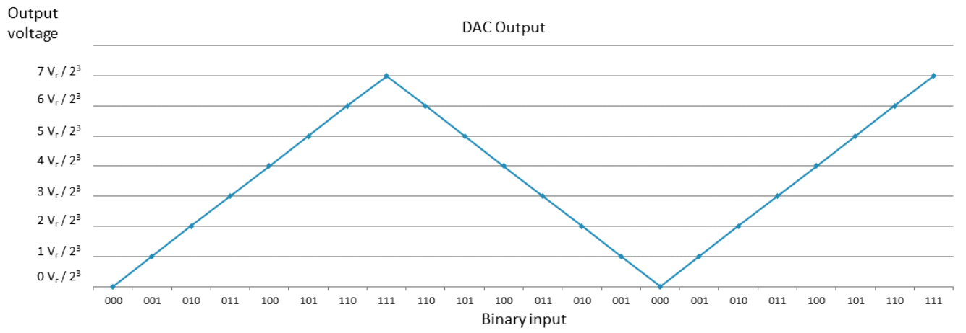
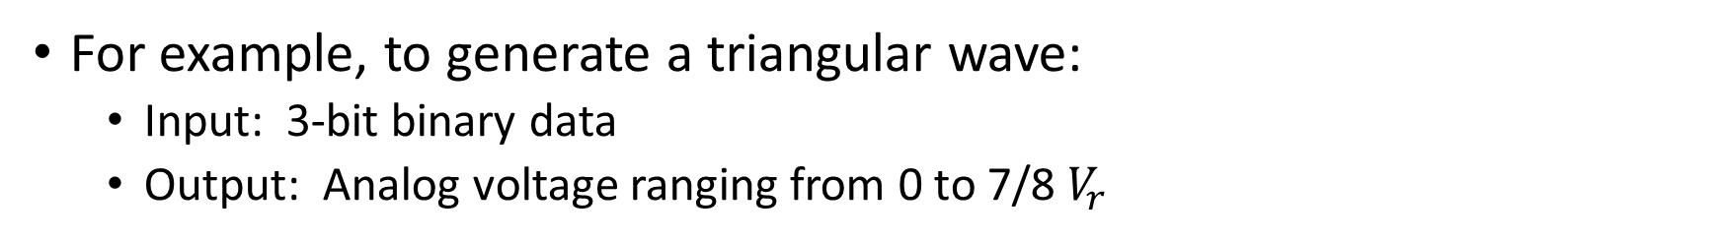
Digital-to-Analog Converter (DAC)
For example, to generate a triangular wave:
  Input: 3-bit binary data
  Output: Analog voltage ranging from 0 to 7/8 $V_{r}$
Notes:
This means that the output of a 3-bit value (0...7) triangular waveform behind a DAC is the curve shown in the figure.

Slide 7
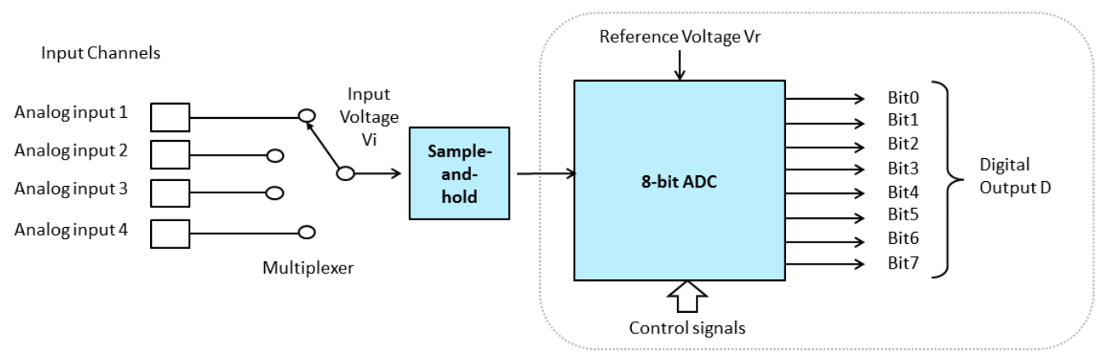
Analog-to-Digital Converter (ADC)
An ADC system usually consists of three stages:
  Multiplexer: reduces the number of required ADC components at the expense of conversion speed
  Sample-and-hold: keeps the analog signal during the conversion constant – time discretization.
  ADC: converts the analog into digital signal
Notes:
There are usually three steps in an analog to digital conversion:
First, select the input line to be converted (multiplexer). Because an ADC-stage consumes the chip area and is complex to build, due to its need for precision, the number of ADCs must be kept to a minimum. An upstream multiplexer switches the analog line to the respective multiplexer and makes it available for a conversion.
Next, the sample-and-hold is usually a switched capacitor, which is loaded with the actual voltage of the analog signal and keeps it constant during the conversion time.
Finally, the ADC converts the analog signal into a digital signal.

Slide 8
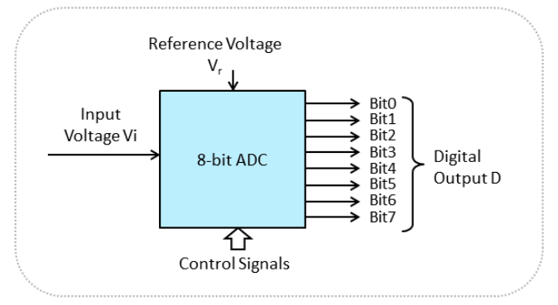
Analog-to-Digital Converter (ADC)
Input: time-discrete due to the prior sample and hold stage physical signals
Output: discrete numbers that is proportional to the analog input amplitude
The following picture give an example of an 8-bit ADC.
Notes:
The main task of an ADC is to create the digital values of an analog input voltage. The signal is already time-discrete, as a result of the previous S+H-stage.
Different types of converters are available, as shown on the next slide.

Slide 9
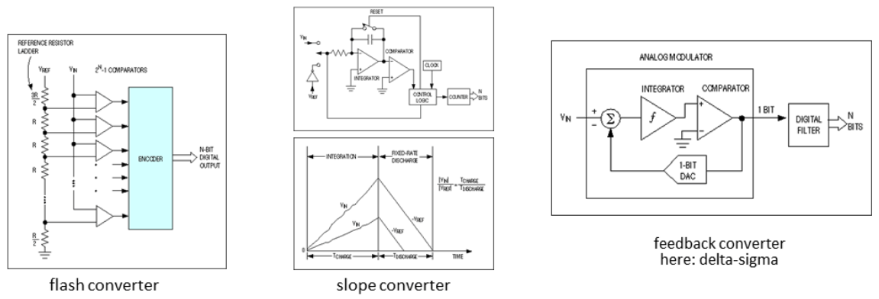
ADC Types
There are 3 common types for ADC:
  Flash converters, comparing the input voltage with different reference voltage levels
  Slope converters, converting the voltage into a charge capacitor and measuring the time for charging and discharging
  Feedback converters, trying to generate a signal proportional to the input voltage.
Notes:
All the different types of ADC have advantages and disadvantages:
The flash converter is very fast, but needs as many comparators as digital values to be represented; for example, an 8 bit converter need 256 comparators.
The slope converter is quite fast and easy to set up, but it needs to be very stable during and between different measurements. Additionally, a very stable and fast clock has to be designed, as the resolution of the clock defines the resolution.
A feedback converter (such as delta-sigma, successive approximation, etc.) is often the best trade-off. The analysis of different feedback converters’ precision and resolution is beyond the scope of this module.

Slide 10
ADC Range
ADCs have a minimum and maximum permissible input values, which determine the range of an ADC.
The range and the resolution of the ADC are linked to the reference voltage and the physical principle of the ADC.

Slide 11
ADC Resolution and Quantization
The resolution of the ADC refers to the number of discrete data that can be produced over the range of the analog values.
Resolution determines the minimum magnitude of the quantization and the quantization error.
Can be expressed in bits, e.g. an 8-bit ADC has a resolution of 256 values.
Can also be expressed in volts: the minimum changes in the digital output is called the Least Significant Bit (LSB) voltage, e.g. an 8-bit ADC with a range of 10V has a resolution of 10/256V.
Resolution also determines the maximum possible average Signal to Noise Ration (SNR).
Notes:
The resolution (= quantization step) depends on a physical principle of an ADC, which is the reference voltage.
Because the resolution represents discrete values, there is a so-called ‘resolution error’. This is the difference between a minimum resolution step and the real value:
error = V_input – digital Value * V_reference/2^n
The error can be reduced with a higher resolution, but a countermeasure against the resolution is noise. Because no conversion principle is perfectly stable, the output value for the same input voltage may differ slightly between single conversions. This is the resolution noise. The higher the resolution, the higher the noise.

Slide 12
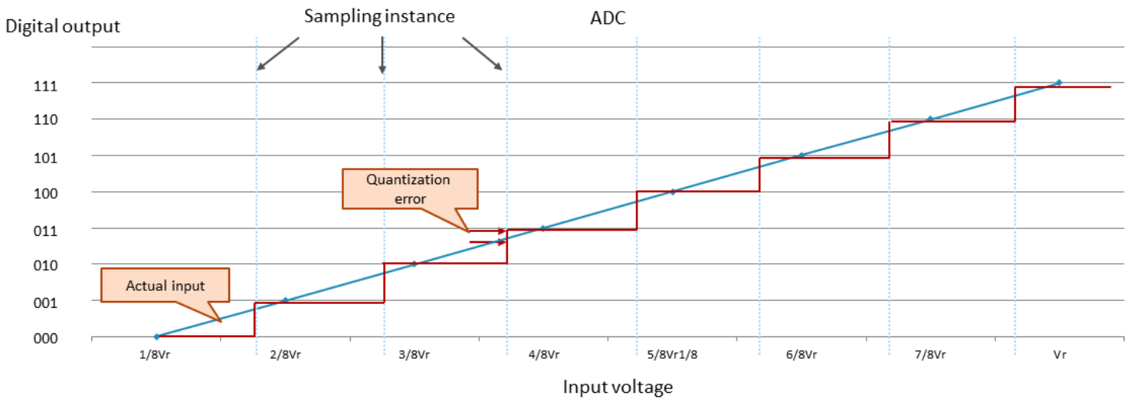
ADC Quantization Error
Quantization error is the noise introduced by quantization in an ideal ADC.
Rounding error between the actual analog input and the digitized value.

Slide 13
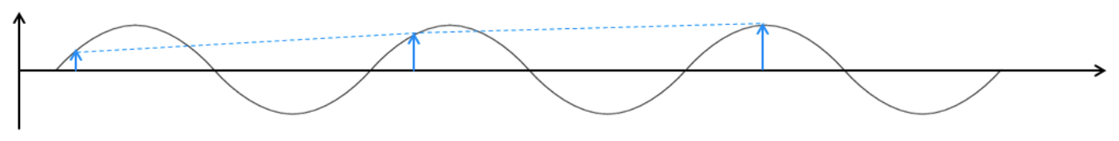
ADC Sampling Frequency
In ADC, the sampling rate refers to the rate of collecting new values.
  The analog signal is continuous in time.
  Digital data is discrete.
  The sampling rate has to be high enough to reproduce the original signal.
According to the Shannon-Nyquist sampling theorem, the sampling frequency must be at least double that of the highest frequency in the incoming signal.
  For example, the accepted standard range of audible frequencies is in the range of 20 to 20,000 Hz, so standard audio CDs are sampled and played at 44.1kHz.
  Reduced sampling frequency will result in signal aliasing effect as shown below:
Notes:
The sampling rate is a combination of the total system’s time constants. It must be slow enough for the S+H and the multiplexer to follow, and fast enough for the S+H not to lose its values. You can see that there is always a trade-off among all system components.
The Shannon theorem can be explained in the frequency domain. Sampling leads to repeating spectra with the frequency distance of the sampling frequency. They need double the bandwidth compared to the ‘useful signal’ in the frequency domain, because they are represented by their positive AND negative values. This means that they need double the distance between the repeating spectra, in order to avoid overlapping of parts of the repeating spectra.
Therefore, as previously noted, this distance between the repeating spectra is defined by the sampling rate, so the sampling rate has to be at least double the signal bandwidth. In practice, this should be between factor 5 and 10, because sampling is not ideal on infinitely steep slopes.
The effect of overlapping spectra is called ‘aliasing’. Anti-aliasing filters cut the signal above the maximum Shannon-frequency to avoid aliasing; however, the signal above the Shannon frequency is lost.

Slide 14
Create a new PlatformIO project
Create a new PlatformIO project.
I have named my project: ‘Nucleo-F072RB-mbed-AnalogIO’
Nucleo F072RB board
mbed platform

Slide 15
PlatformIO.ini
[platformio]​
build_cache_dir = .pio/mycache
[env:nucleo_f072rb]
platform = ststm32
board = nucleo_f072rb
framework = mbed
upload_protocol = stlink
platform_packages = framework-mbed @ ~5

Slide 16
What are the IO pins for the Nucleo F072RB Discovery?
One method to find the pin names is to look inside the: ‘PinNames.h’ and ‘PeripheralPins.c’ library files.
You can find this file for your specific board by looking through the installed packages on your PC.
You can also find online ‘PeripheralPins.c’:
  https://os.mbed.com/users/mbed_official/code/mbed-dev/file/9c2029bfadbe/targets/TARGET_STM/TARGET_STM32F0/TARGET_NUCLEO_F072RB/PeripheralPins.c/
Or ‘PinNames.h’:
  https://os.mbed.com/users/mbed_official/code/mbed-dev/file/9c2029bfadbe/targets/TARGET_STM/TARGET_STM32F0/TARGET_NUCLEO_F072RB/PinNames.h/

Slide 17
mbed handbook
AnalogIn
  https://docs.mbed.com/docs/mbed-os-api-reference/en/latest/APIs/io/AnalogIn/
AnalogOut
  https://docs.mbed.com/docs/mbed-os-api-reference/en/latest/APIs/io/AnalogOut/

Slide 18
Sawtooth
#include <mbed.h>
DigitalOut led(PA_5); // only 1 user led on Nucleo F072RB
AnalogOut aOut_PA_4(PA_4); // pin labelled A2 on arduino headers
// The ADC on the Nucleo F072RB is a 12-bit ADC with a conversion range: 0 to 3.6 V
AnalogIn aIn_PC_1(PC_1); // pin labelled A4 on arduino headers
AnalogIn aIn_PC_0(PC_0); // pin labelled A5 on arduino headers
Serial pc(USBTX, USBRX, 115200);
int main() {
led = 1;
pc.printf("Hello Analog World!");
float sensorValue1 = aIn_PC_1.read();
float voltage1 = sensorValue1 * 3.3;
pc.printf("raw PC_1 (A4) data is: %f convert to voltage is: %f \n", sensorValue1, voltage1);
float sensorValue0 = aIn_PC_0.read();
float voltage0 = sensorValue0 * 3.3;
pc.printf("raw PC_0 (A5) data is: %f convert to voltage is: %f \n", sensorValue0, voltage0);
while(1) {
// Hack a sawtooth wave
for (float i = 0; i < 1; i += 0.05) {
aOut_PA_4 = i * aIn_PC_1.read() / 4; // amplitude
wait(0.00001 + (0.001 * aIn_PC_0.read())); // frequency
}
}
}
This code takes an AnalogIn signal from two potentiometers and generates a sawtooth waveform at an audible frequency
Amplitude of the sawtooth can be changed by changing the potentiometer input 1
Frequency of the sawtooth can be changed by changing the potentiometer input 0
Output maybe difficult to hear on a speaker without some form of amplification, as the microcontroller has a limited output capability
Sawtooth can be viewed on oscilloscope

Slide 19
Activity 1 – Analog Output
Can you create an analog output which will output an audible triangular wave?
Can you create an analog output which will output an audible square wave?

Slide 20
Activity 2 – Music Notes and Chords
Can you create an analog output which will output an audible sinusoidal wave?
Can you create an analog output which will output an instrument note e.g. note A above middle C?
  These links may help:
  https://www.sscc.edu/home/jdavidso/music/musicnotes/musicnotes.html
  http://www-users.math.umn.edu/~rogness/math1155/soundwaves/
Can you create an analog output which will combine and output multiple notes to create a chord?

Slide 21
Activity 3 – Analog Sensor Input
Explore which analog sensors we have available in the lab.
Can you control the analog outputs with the analog sensors?

Slide 22
References
Using a speaker for audio output – covers PWM, AnalogOut, Audio Jack
todo: have a closer look at this later on:
  https://os.mbed.com/users/4180_1/notebook/using-a-speaker-for-audio-output/

