Slide 1


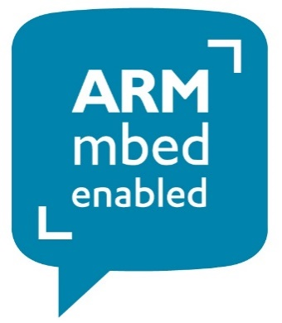
Embedded Systems Programming
Creating our first project with VSCode and PlatformIO targeting the mbed platform.
Chris Bass

Slide 2

Today
First look at the PlatformIO IDE – Extension to VSCode IDE for targeting embedded platforms
Targeting the ARM ‘mbed’ platform with PlatformIO IDE
Digital I/O with CMSIS and mbed
CU GitHub

Slide 3
Visual Studio Code IDE (VSCode)
Open VSCode.
VSCode also has a few important configuration files which store information such as ‘Project’ settings, IDE settings, Build Task settings, etc. Most of these files are written in .json format.
If you have not used VSCode before, then you can optionally have a play around with creating a basic C++ application (see hidden slides).
Alternatively, we can just skip to installing the 2x extensions we need, (C/C++ and PlatformIO) and then we can create our first embedded systems project using PlatformIO.

Slide 4
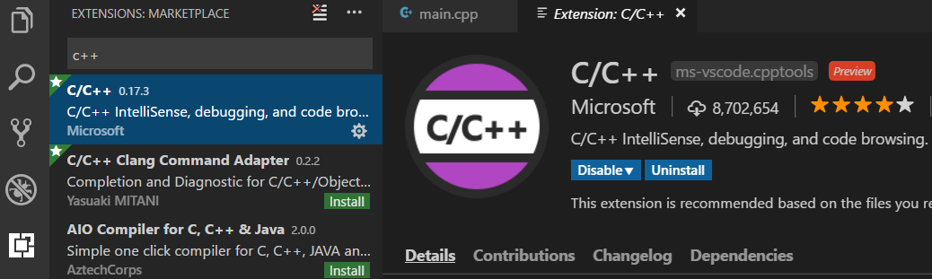
VSCode Extensions Tab
From the icons on the left pane in VSCode → Open ‘Extensions’ Tab
VSCode is a fully customisable IDE – programming languages, syntax highlighting, IntelliSense, autocomplete, build toolchain, debugger, documentation…
Check that C/C++ Extension from Microsoft is installed to enable some of these features.
Extensions tab

Slide 5


Our First VSCode C++ Project
Let’s start by creating and opening a folder for our first VSCode project.
Select ‘File’ → ‘Open Folder…’
Create a folder on a suitable storage drive and open it e.g. ‘C:\Users\Chris\Documents\VSCode\MyFirstProject’
From the icons on the left pane in VSCode → Open the ‘Explorer’ Tab
You should see the new folder ‘MyFirstProject’ in ‘Explorer’ Tab.
Under the folder you created Select the ‘New File’ icon.
Create a file called ‘main.cpp’ and open it.
Write a Hello World program in C++ in the empty file.
Explorer tab

Slide 6
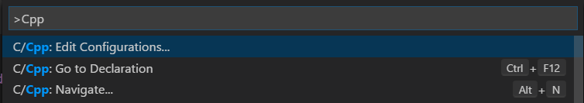
Selecting a C++ Compiler – c_cpp_properties.json
Open the Command Palette (Ctrl+Shift+P) → type ‘C/Cpp: Edit Configurations…’
This should generate a ‘c_cpp_properties.json’ in a .vscode folder
The ‘c_cpp_properties.json’ file contains settings and path variables such as the location of the default C++ compiler on our system and additional include paths.
Note that when we installed the C++ extension earlier, it did not include a C++ compiler.
Check that there is a suitable compilerPath to an installed C++ compiler
https://code.visualstudio.com/docs/languages/cpp

Slide 7
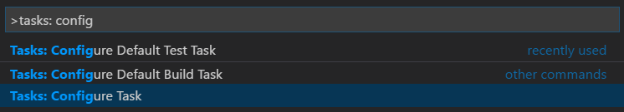

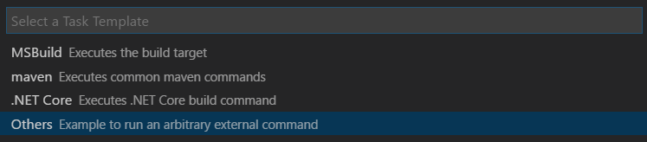
Configuring our Build Task - tasks.json
Open the Command Palette (Ctrl+Shift+P) → type ‘Tasks: Configure Tasks...’ → ‘Create tasks.json file’ → ‘Others’ → Check/enter the following code into tasks.json:
{
"version": "2.0.0",
"tasks": [
{
"label": "build hello world",
"type": "shell",
"command": "g++",
"args": [
"-g", "main.cpp"
],
"group": {
"kind": "build",
"isDefault": true
}
}
]
}

Slide 8
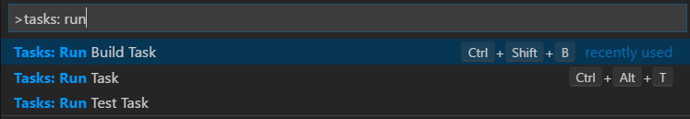
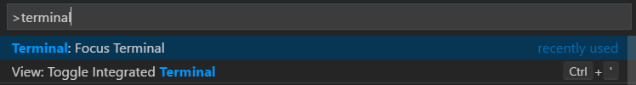
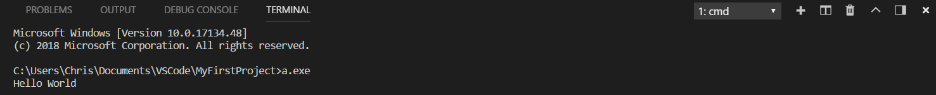
Run a Build Task
Open the Command Palette (Ctrl+Shift+P) → type ‘Tasks: Run Build Task’
This will compile our C++ program into an executable with the default name ‘a.exe’, of course you can configure the name of the output executable by editing the g++ command in the tasks.json file.
Open the Command Palette (Ctrl+Shift+P) → type ‘Terminal: Focus Terminal’ → type ‘a.exe’ into the terminal window to run the Hello World program.

Slide 9
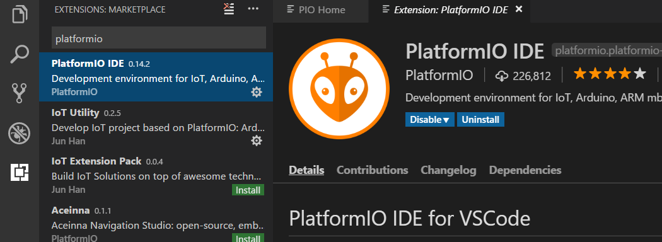
PlatformIO (PIO)
IDE built on top of VSCode as an extension
Open source ecosystem enables development of embedded applications targeting popular hardware platforms and frameworks such as Arduino, ESP8266, ARM mbed, Microchip PIC32, STM32, etc.
Extensions tab

Slide 10
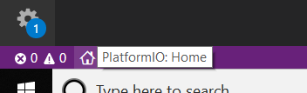
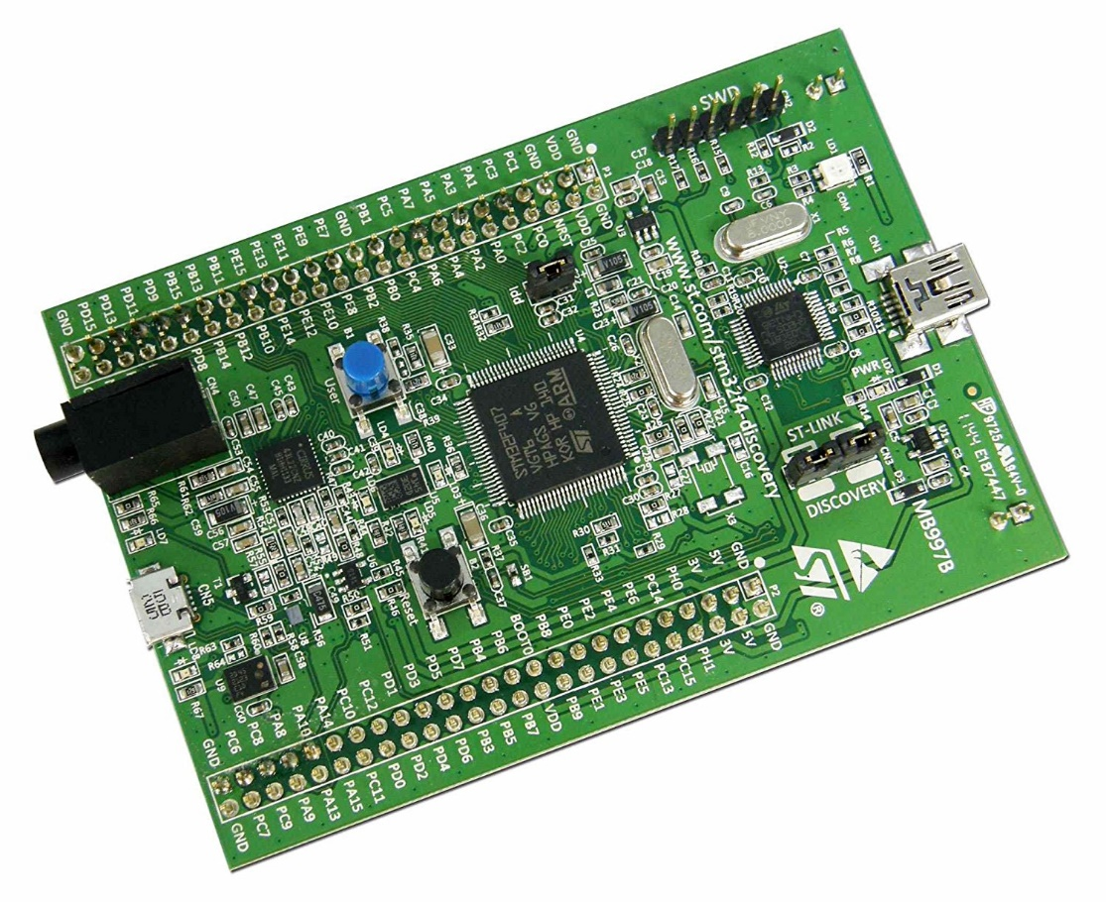
Creating a PlatformIO Project
When PlatformIO is installed, you should see the PlatformIO: Home icon which will take you to the Home Page.
On the PlatformIO Home Page select → New Project…
Let’s create a ‘Blinky’ project which just flashes lights on the STM32F4-Discovery board.
We will be using the CMSIS library to do this first.
Project Name – ‘CMSIS-Blinky’
Board – ‘STM32F4Discovery’
Library – ‘CMSIS’
Target board

Slide 11
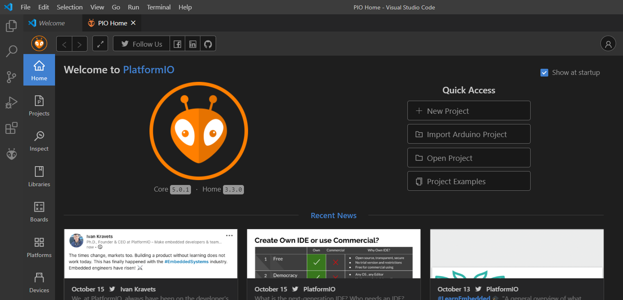

Slide 12
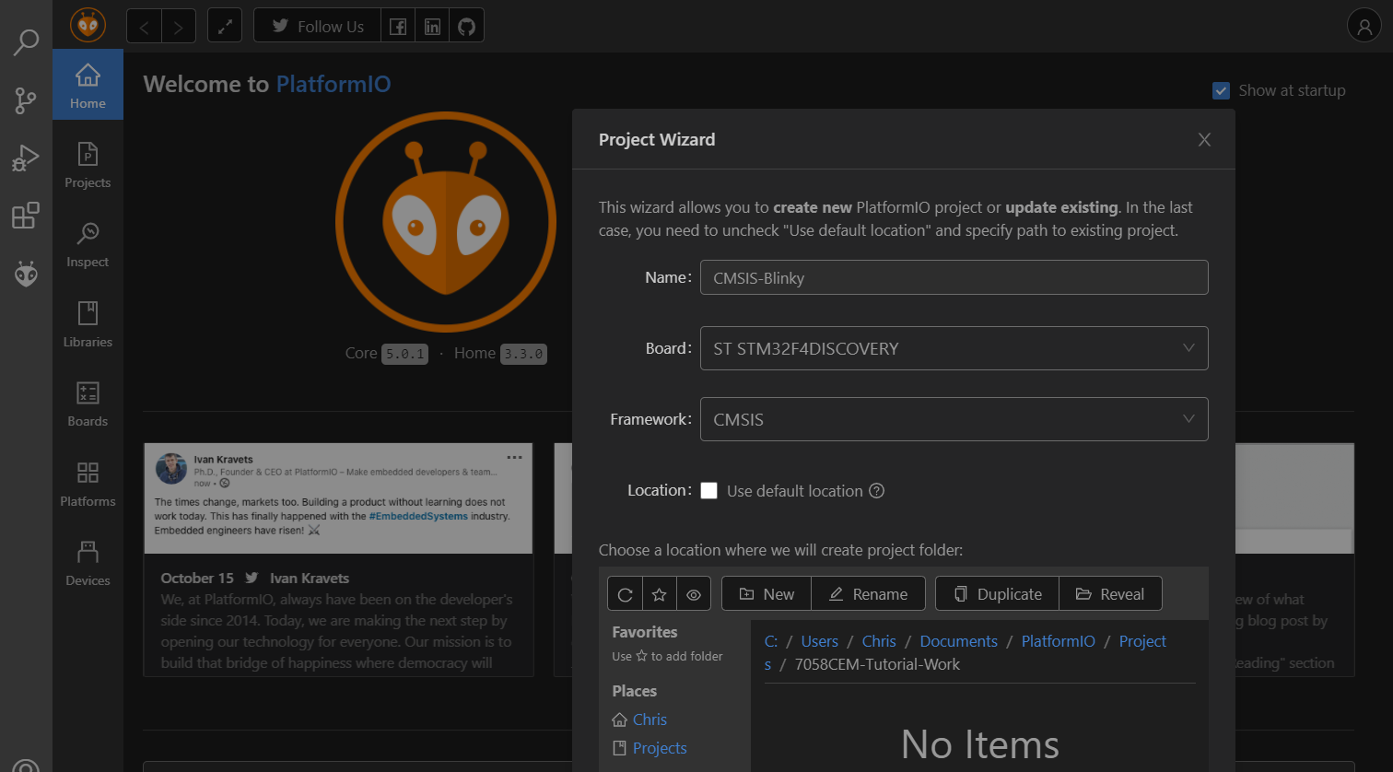
Create yourself a suitable folder structure for your tutorial work e.g.

Slide 13
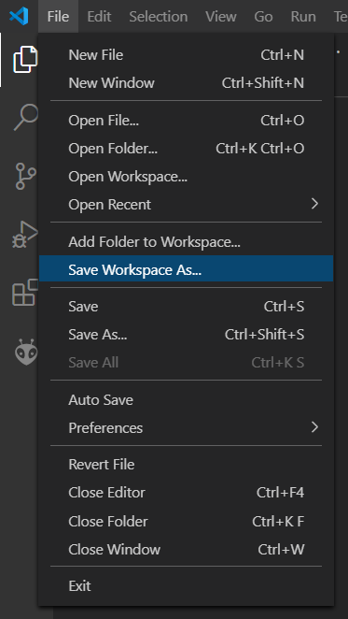
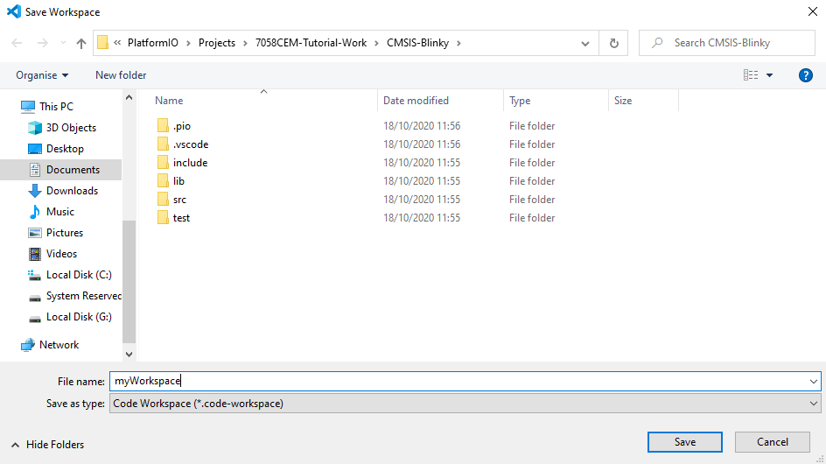
VSCode Workspace Settings
VSCode has added workspaces.
For the PlatformIO embedded project you have just created select File → Save Workspace As…
‘myWorkspace’ → Save

Slide 14
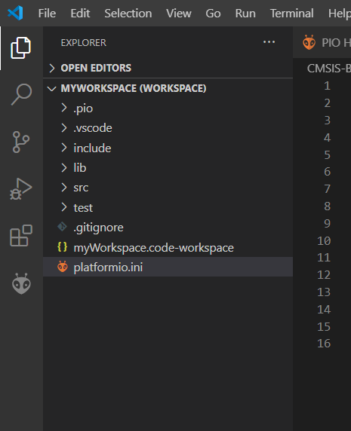
PlatformIO.ini file
Now we should have a PlatformIO project inside a VS Code workspace.
In addition we have the ‘platformio.ini’ file.
This is the PlatformIO Project Configuration File where we can store our Build, Upload, Library, and Advanced options for our project.
platformio.ini settings documentation:
  https://docs.platformio.org/en/latest/projectconf/index.html
Open the ‘platformio.ini’ file and make sure it contains the correct settings for your project

Slide 15
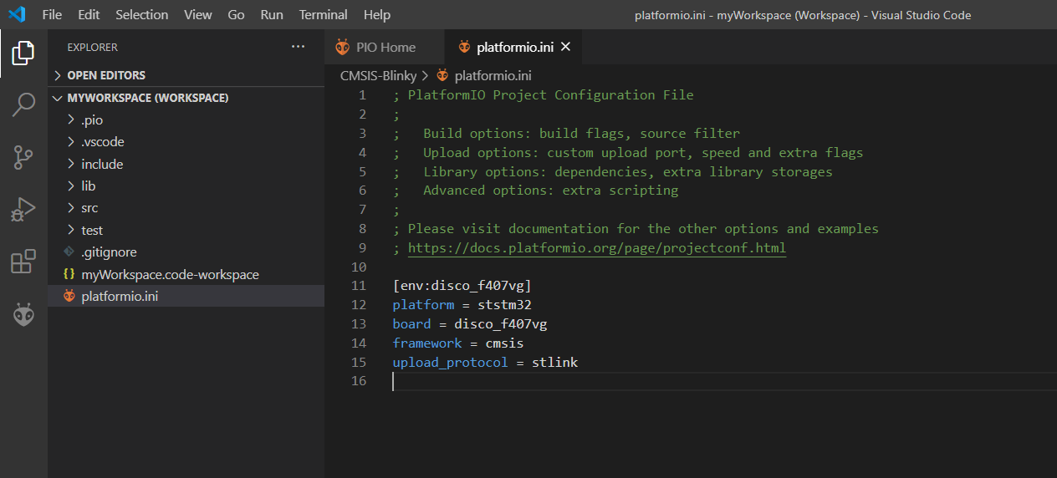
When we created the project we chose these settings for our board etc.
Please note that we could include multiple board settings in here if we wanted our project to be able to target multiple boards.
This is your selected development board
Do not forget to add the upload protocol
platformio.ini – This is the PlatformIO Project Configuration File where we can store our Build, Upload, Library, and Advanced options for our project

Slide 16
CMSIS Blinky
#include "stm32f4xx.h"
#define LED_GREEN (12)
#define LED_ORANGE (13)
#define LED_RED (14)
#define LED_BLUE (15)
void ms_delay(int ms);
int main()
{
// |= is a bitwise OR and assignment i.e. it sets the status of a bit, without changing the other bits
RCC->AHB1ENR |= RCC_AHB1ENR_GPIODEN; // enable the clock to GPIO
GPIOD->MODER |= GPIO_MODER_MODER12_0; // set pin 12 to be general purpose output
GPIOD->MODER |= GPIO_MODER_MODER13_0; // set pin 13 to be general purpose output
GPIOD->MODER |= GPIO_MODER_MODER14_0; // set pin 14 to be general purpose output
GPIOD->MODER |= GPIO_MODER_MODER15_0; // set pin 15 to be general purpose output
while (1) {
ms_delay(2000);
// GPIOD->ODR is a 16-bit register
// ^= is a bitwise XOR and assignment i.e. it toggles the status of the bits
// 1<<12 is 1 left shifted by 12 i.e. 0b1000000000000
GPIOD->ODR ^= 0b1000000000000; // Green LED
GPIOD->ODR ^= (1<<LED_ORANGE);
GPIOD->ODR ^= (1<<LED_RED);
GPIOD->ODR ^= (1<<LED_BLUE);
}
return 0;
}
void ms_delay(int ms)
{
while (ms-- > 0) {
volatile int x = 500; // volatile so that x is not removed by compiler due to optimisation
while (x-- > 0)
__asm("nop"); // inline assembly code for nop i.e. no operation
}
}
Create a main.cpp file in the src folder and populate with the following code:
Use the PlatformIO commands to:
Build
then Upload to target board
(If your board is not recognised you might need to install drivers for STLink):
  https://github.coventry.ac.uk/7058cem-2021sepjan/TEACHING-MATERIALS
  https://www.st.com/en/development-tools/stsw-link009.html
Either from the Command Palette (Ctrl+Shift+P) or from the PIO icons along the bottom

Slide 17
Different boards
If you are attempting the CMSIS Blinky on a different development board, then you will need to add those board settings to the platformio.ini file and make changes to the source code for the different pin numbers and GPIO port registers.
To get more information on the pinout for your development board you will need to refer to the documentation for your board.

Slide 18
Register settings with CMSIS
If you want to learn more about the GPIO register settings, you can have a look at the reference manual for your particular board / micro.
For example:
For F407VG, see Chapter 8.4 in this manual for GPIO register settings:
  https://www.st.com/resource/en/reference_manual/dm00031020-stm32f405-415-stm32f407-417-stm32f427-437-and-stm32f429-439-advanced-arm-based-32-bit-mcus-stmicroelectronics.pdf
For F446RE, see Chapter 7.4 in this manual for GPIO register settings:
  https://www.st.com/resource/en/reference_manual/dm00135183-stm32f446xx-advanced-arm-based-32-bit-mcus-stmicroelectronics.pdf
There are also a few handy links to 3rd party tutorials on Moodle about GPIO settings with CMSIS, I like these tutorials for some of the ‘bare-metal’ theory:
    https://newbiehack.com/categories/newbiehack-tutorial-ARM-Video6-GPIOSetupInCode-nomenu
    https://newbiehack.com/categories/newbiehack-tutorial-ARM-Video7-GPIOSetupInCode-nomenu
    https://newbiehack.com/categories/newbiehack-tutorial-ARM-Video8-GPIOSetupInCode-nomenu

Slide 19

Activity 1 – CMSIS Blinky
Make the LEDs light up in a different order e.g.
Green + Orange + Red + Blue
Green only
Orange only
Red only
Blue only
Green + Orange + Red + Blue
Then reverse order and repeat

Slide 20


GitHub Integration
VSCode has GitHub integration
GitHub is a Version Control System
Git is the command line language used for working with the version control system
Let’s create a new remote source code repository for all of your 7058CEM work
You should all have been added to our GitHub Coventry University organisation for 7058CEM – login with your normal username and password
Create a new repository inside our 7058CEM organisation here:
  https://github.coventry.ac.uk/7058cem-2021sepjan
Name your repository such as: ‘<your_username>-tutorial-work’
Make sure your repository is private
For example:
  https://github.coventry.ac.uk/7058cem-2021sepjan/aa6164-tutorial-work
Change your cohort number if required!
Use <your_username>-tutorial-work for your repository

Slide 21
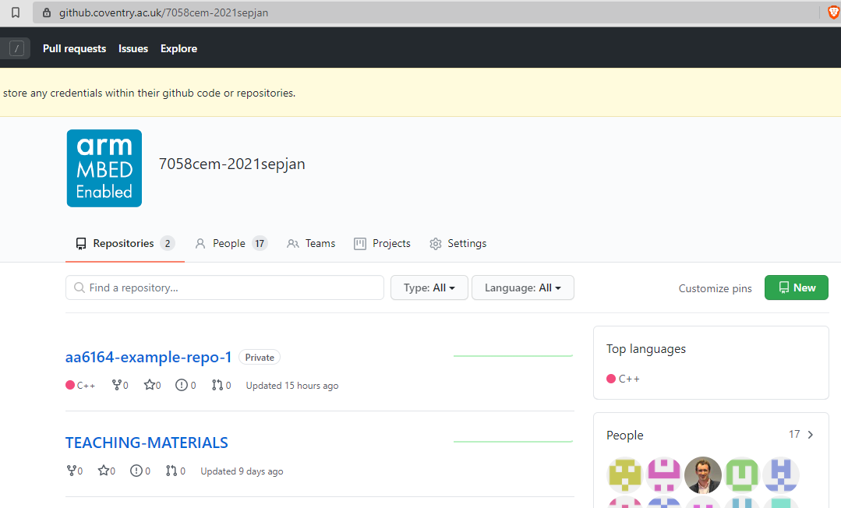

Slide 22
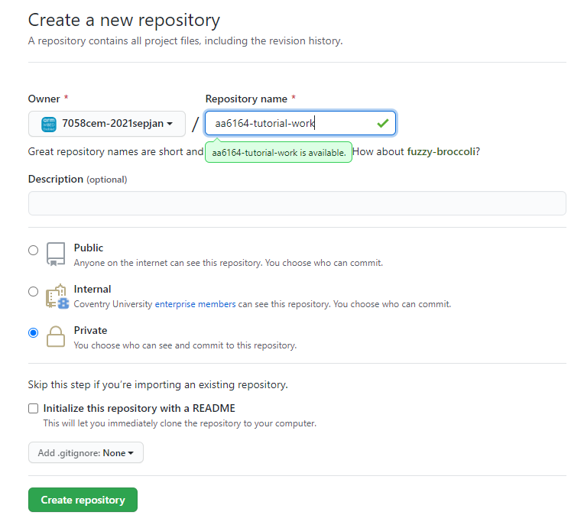

Slide 23
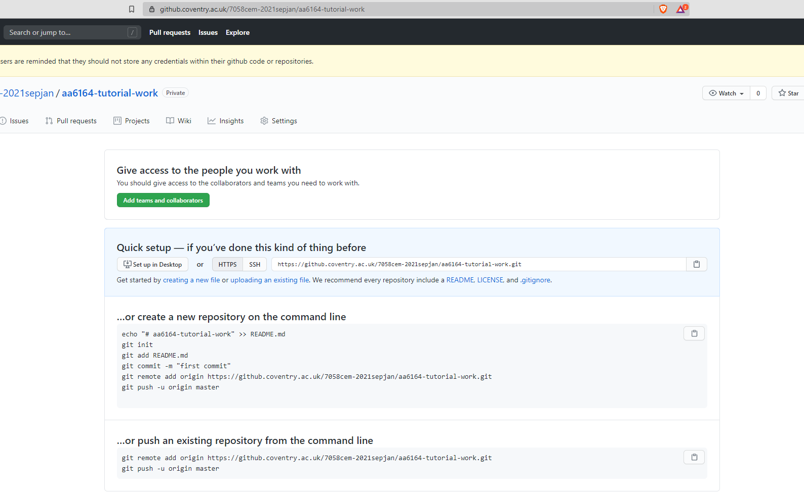

Slide 24
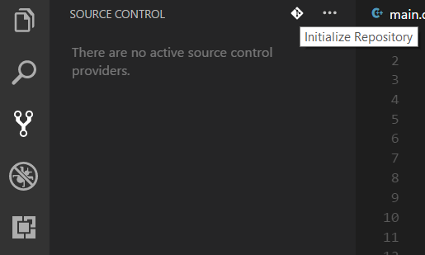
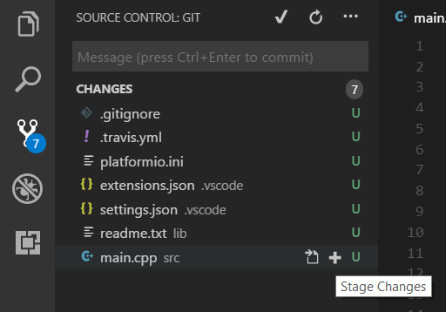
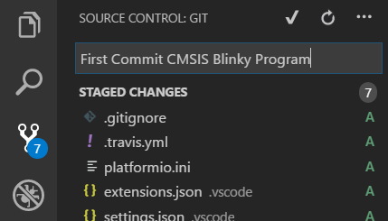
Local Repository
Initialize Repository
Source control tab
In VSCode click the Source Control tab → Initialize Repository → Navigate up-one-level so that you are in the PIO Projects directory → Initialize Repository e.g.
C:\Users\Chris\Documents\PlatformIO\Projects
Next we need to click the + icon next to each file to Stage Changes for all of our files
Type a commit message and click the tick icon to perform a commit to your local repository
Type a commit message
Commit

Slide 25
Local Repository
We are going to setup a git repository on our local system
There are build-in GUI tools to help us do this in VS Code,
or alternatively it can all be done via git commands in the terminal
The following slides show the GUI method, but please feel free to use the git terminal approach if you are already familiar with working with git
Summary:
  Initialise a local git repository – do this in the parent folder (up one level)
  Stage and commit changes
  Link the local git repository to our remote (add a remote)
  Push our local commits to the remote

Slide 26
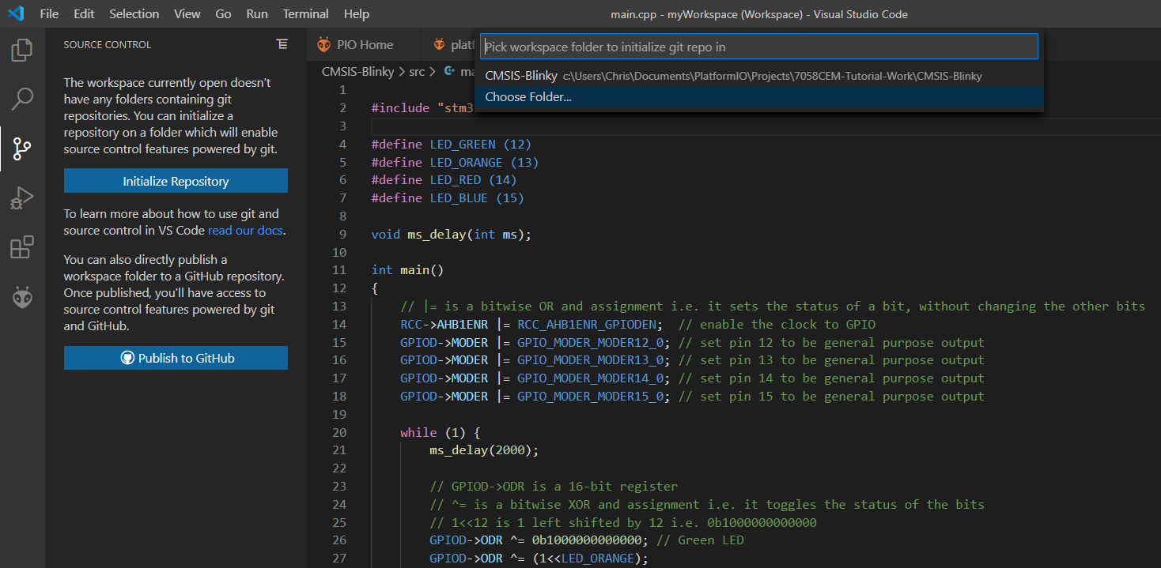
Source control tab
Choose the folder which is one-level above where your project is saved, later on we will have multiple projects all saved to a single git repository.

Slide 27
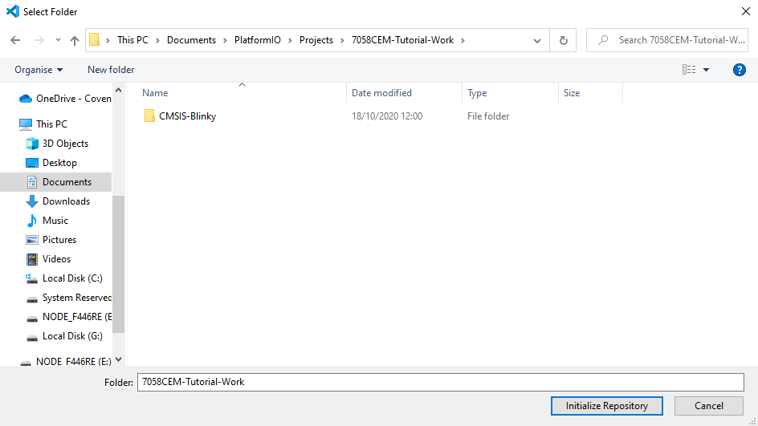
‘CMSIS-Blinky’ is the folder where my project is saved. So I want to initialise a git repository in the parent folder ‘7058CEM-Tutorial-Work’.

Slide 28
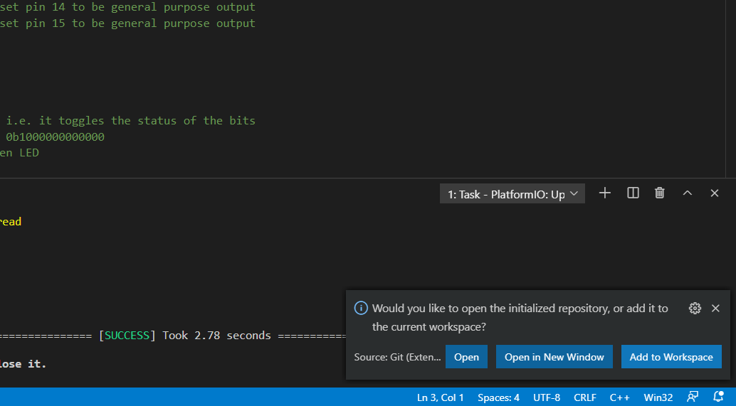
Add to current workspace

Slide 29
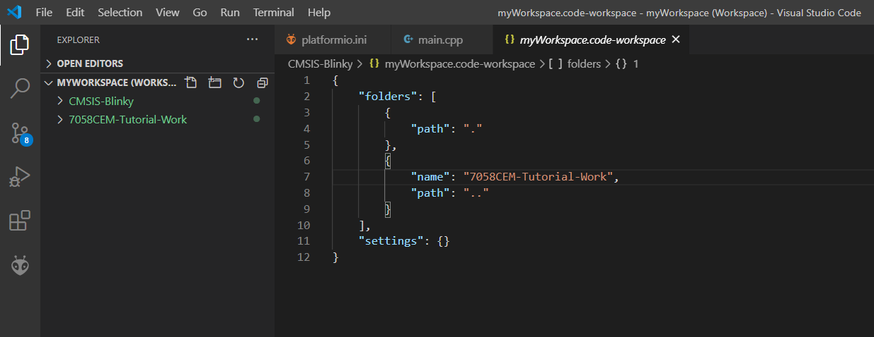
Our myWorkspace.code-workspace file should now look like this.
Our Explorer bar should now look like this.

Slide 30
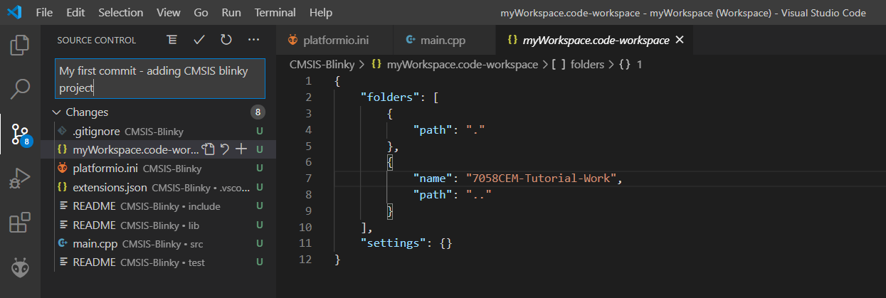
Back to our Version Control Tab, we can now put a commit message and create a commit to our local repository. (You can tick yes if a pop asks to stage changes before commit).

Slide 31
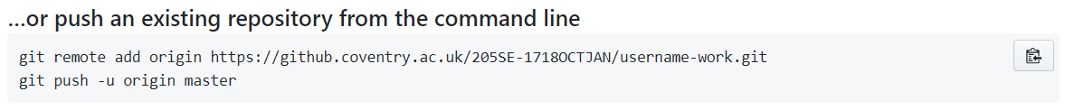
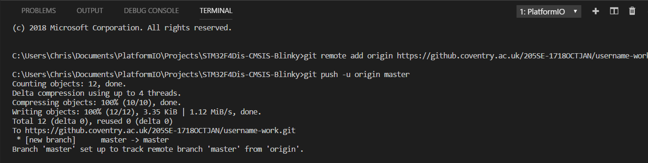
Remote Repository
Now we need to link the local repository to the remote repository.
Either from command line by: copy-paste the git remote add origin command into VSCode terminal window (example below).
Or from VSCode GUI (following 4x slides).

Slide 32
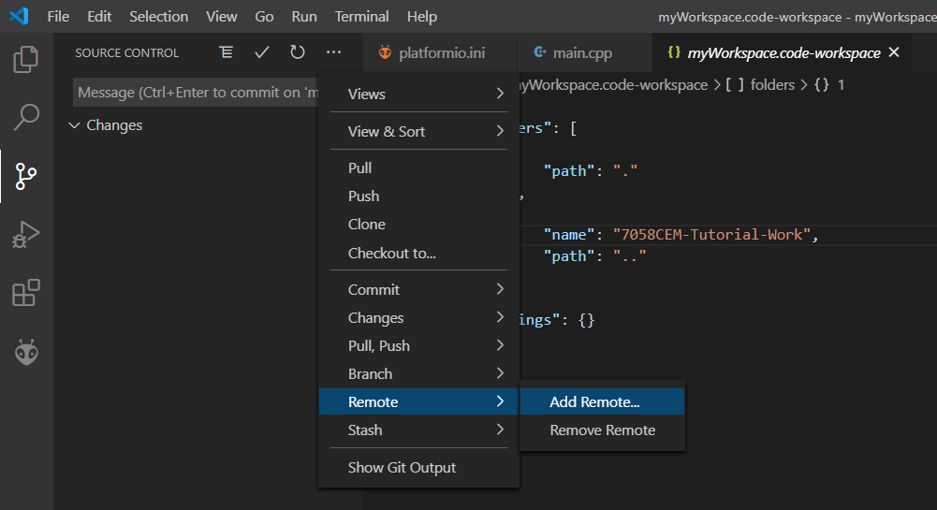
Now we need to connect our remote repository to our local

Slide 33
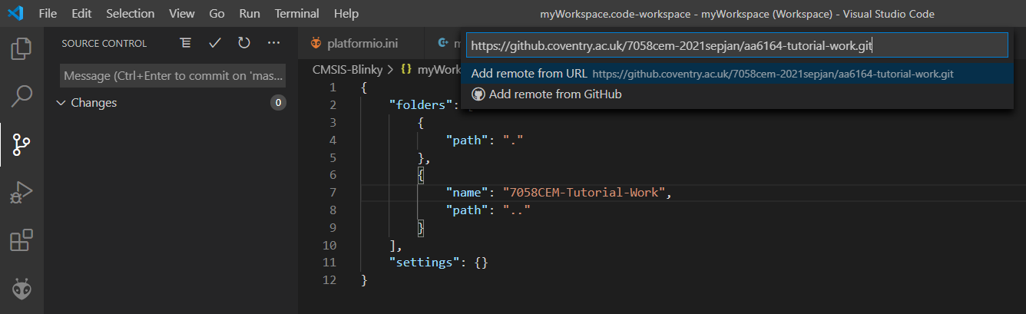
Copy-paste the URL of your remote repository here. You can name the remote repository as ‘CU-GitHub’ or similar.

Slide 34
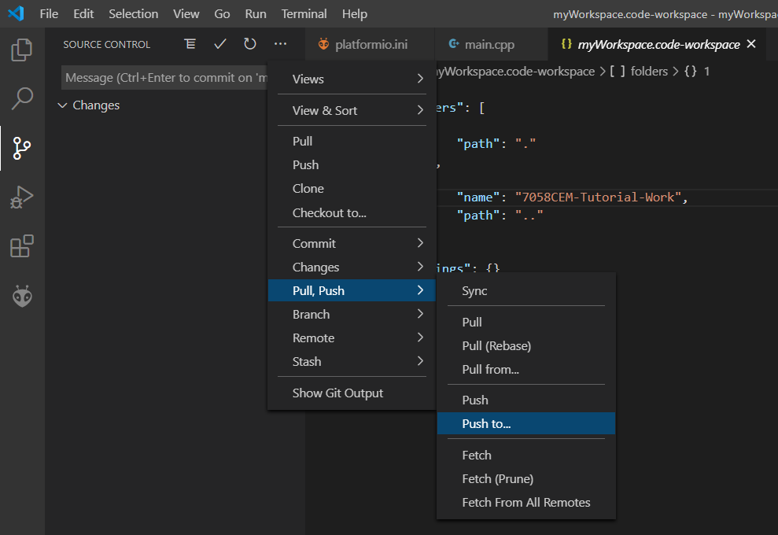
Push to… your CU-GitHub remote.

Slide 35
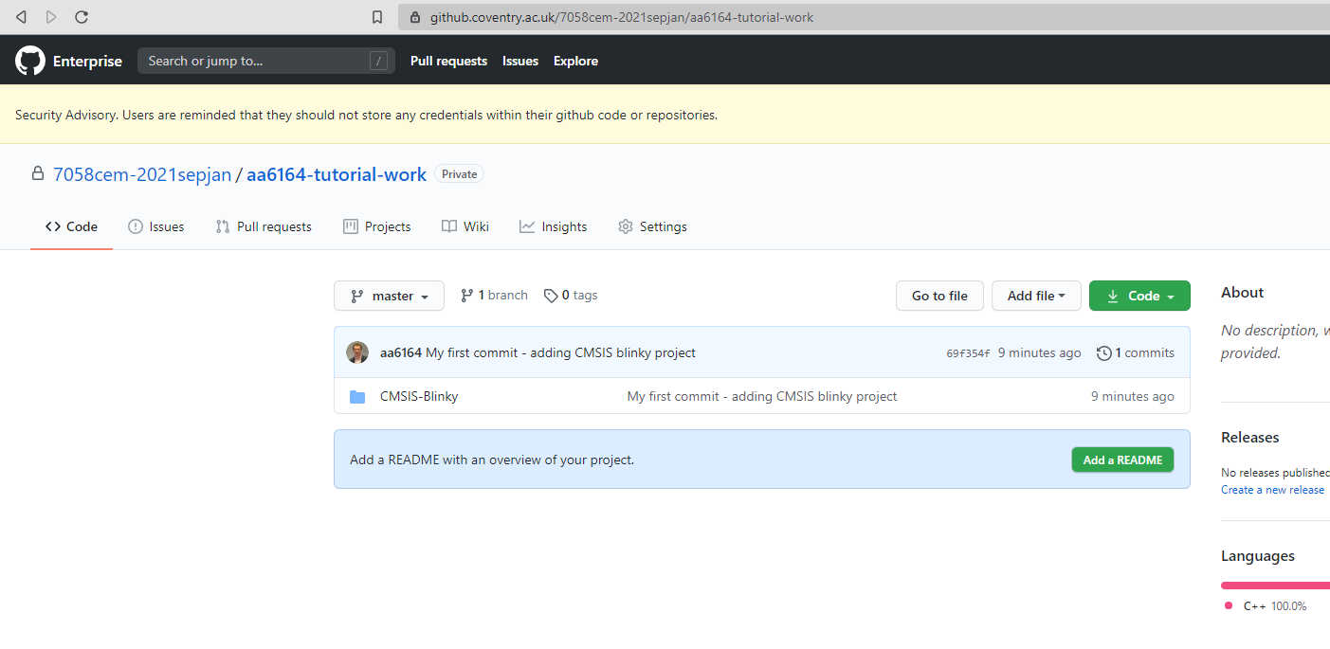
Refresh your remote, it should now contain your project and source code, drill down the folder structure to check it has all your source code.

Slide 36
Other Library/Middleware Options for Programming the STM32F4-Discovery
CMSIS – ARM Cortex Microcontroller Software Interface Standard
SPL – ST Standard Peripherals Library – deprecated
HAL – ST Hardware Abstraction Layer
STM32Cube – ST GUI tool for middleware setup, pinouts, clocks, etc.
Mbed – ARM Rapid Prototyping Libraries – Object-Oriented
3rd party libraries – e.g. TM:
  https://github.com/MaJerle/stm32f429
  https://github.com/MaJerle/stm32fxxx_hal_libraries

Slide 37
About CMSIS
ARM Cortex Microcontroller Software Interface Standard
CMSIS is defined by ARM, not ST – this helps portablity among other microcontrollers and does not tie you to ST microcontrollers
It is very low level (close to the hardware) – basically just providing the definitions for the various registers
No overhead – i.e. very efficient programs can be written – just access the registers directly
CMSIS is simple, versatile, and reliable
Disadvantage is because CMSIS is quite low level (close to the hardware) it often requires more work from the programmer and hence development time is increased
CMSIS is microcontroller dependent

Slide 38
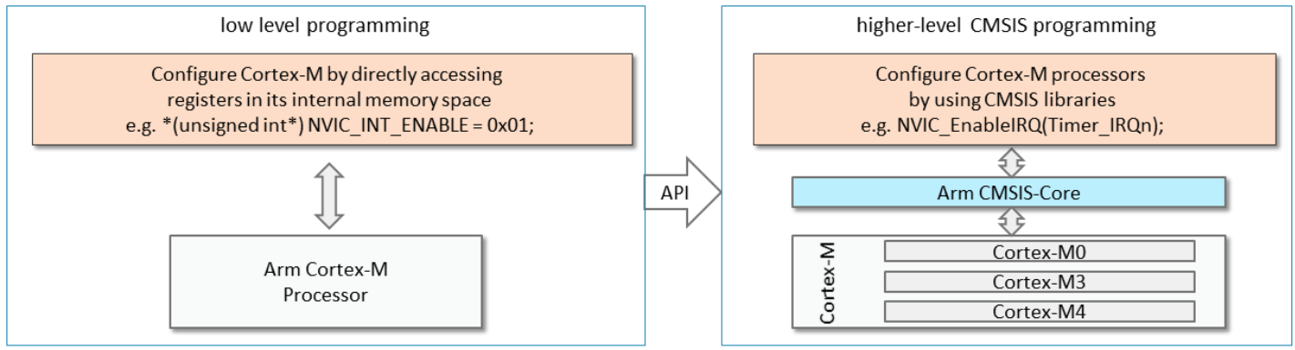
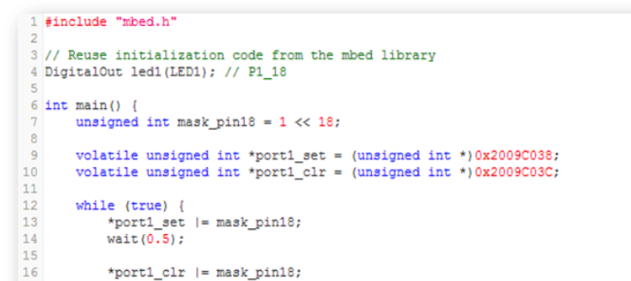
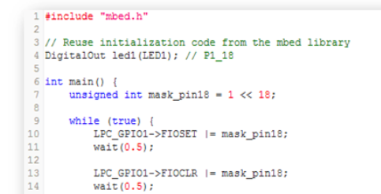
Low-level programming vs. CMSIS – Blinky
Use data structure provided by CMSIS-CORE
Directly access MCU registers

Slide 39

About ARM mbed
Includes SDK, HDK, Online Compiler and Tools
Supported by a range of existing development boards
  https://docs.mbed.com/docs/mbedmicro-api/en/latest/api/md_README.html
Microcontroller independent – highly portable
Open Source – lots of examples and libraries e.g. RTOS
Rapid prototyping – easy to understand code – reduces development time
Object-Oriented using C++ classes and objects
Let’s create the same blinky program again,
but this time we will use the ARM mbed platform to realise it.

Slide 40
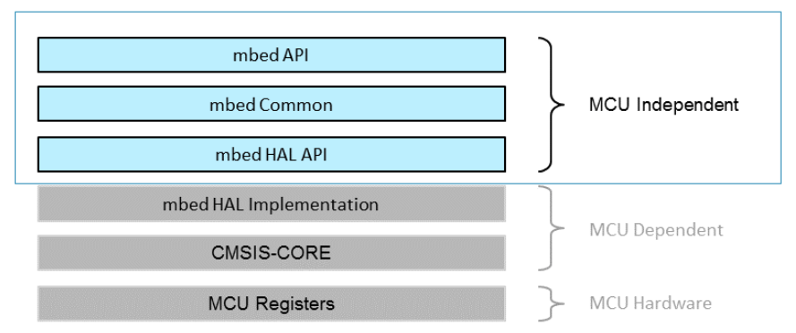
mbed SDK Library Structure
At the lowest level we are working directly with the registers of the actual microcontroller
Above that we have the CMSIS library providing the definitions for the various registers
HAL provides functions which are hardware independent e.g. gpio_init(), gpio_read(), write()
mbed presents an easy to use set of Object-Oriented classes on top of the HAL
High level
(layers of abstraction)
Low level
(close to the hardware)

Slide 41
News / notes on Mbed OS 6 – update 2020
Mbed OS 6 came out in around June 2020:
  https://os.mbed.com/blog/entry/Arm-Mbed-OS-6-released-today/
Mbed OS 6 has replaced OS 5 and is not backwards compatible!
So, all code which was written for OS 5 may not work in OS 6.
E.g. need to use BufferedSerial instead of Serial now:
https://os.mbed.com/docs/mbed-os/v6.3/apis/serial-uart-apis.html
The following tutorial material was written for Mbed OS 5, so some parts may not compile with OS 6.
So, we have 2 options (2020):
  Update all our source code to Mbed OS 6 (also any libraries we are using which use OS 5 code may also have issues compiling)
  Compile using the older Mbed OS 5

Slide 42
Create a PlatformIO Project – mbed
On the PlatformIO Home Page select → New Project…
Let’s create another ‘Blinky’ project which flashes LEDs on the STM32F4-Discovery board.
This time, we will be using the mbed library to do this.
Target board is ARM mbed enabled

Slide 43
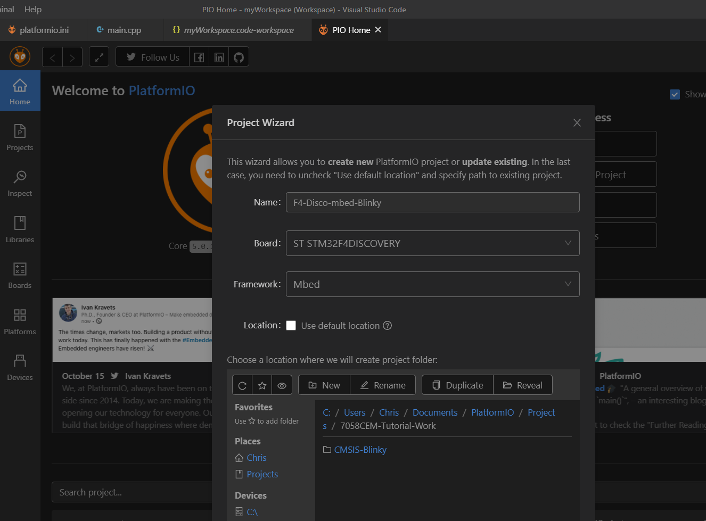
Don’t forget to put the new project in the correct location

Slide 44
PlatformIO.ini file for our mbed Blinky project
This creates a build cache, after the lengthy first build of the mbed libraries the next time you need to build them should be much quicker.
(Thank me later)!
[platformio]​
build_cache_dir = .pio/mycache
[env:disco_f407vg]
platform = ststm32
board = disco_f407vg
framework = mbed
upload_protocol = stlink
Your target board, this could change depending on which target STM32 board you are compiling for. (Set by the project settings when you created the project).
Target board is ARM mbed enabled, so we will use the mbed framework this time.

Slide 45
mbed Blinky
#include <mbed.h>
#define WAIT_TIME_MS 500
DigitalOut led1(LED1);
int main()
{
printf("This is the bare metal blinky example running on Mbed OS %d.%d.%d.\n", MBED_MAJOR_VERSION, MBED_MINOR_VERSION, MBED_PATCH_VERSION);
while (true)
{
led1 = !led1;
thread_sleep_for(WAIT_TIME_MS);
}
}
Create a main.cpp file in the src folder and populate with the following code.
Use the PlatformIO commands to Build then Upload
PIO should build the current project you have open i.e. if you have a main.cpp open and active then it will build the project that comes from when you click build (double check the terminal window output to confirm as needed)
The new project should get added to your workspace file automatically.

Slide 46
Activity 2 – mbed Blinky
Make the LEDs light up in a different order e.g.
Green + Orange + Red + Blue
Green only
Orange only
Red only
Blue only
Green + Orange + Red + Blue
Then reverse order and repeat

Slide 47
Save changes to your remote repository
Commit and Push your new mbed project to your remote repository as well.
Check the your remote repository has the source code for both projects saved.

Slide 48
Activity 3 – mbed Blinky and Digital Input
Modify your program to change the direction that the LEDs light up in when the user clicks the on-board digital button
Hint: Have a look at the ‘DigitalIn’ class which is part of the mbed library

Slide 49
Save changes to your remote repository
Commit and Push your new mbed project to your remote repository as well.
Check the your remote repository has the source code for both projects saved.

Slide 50
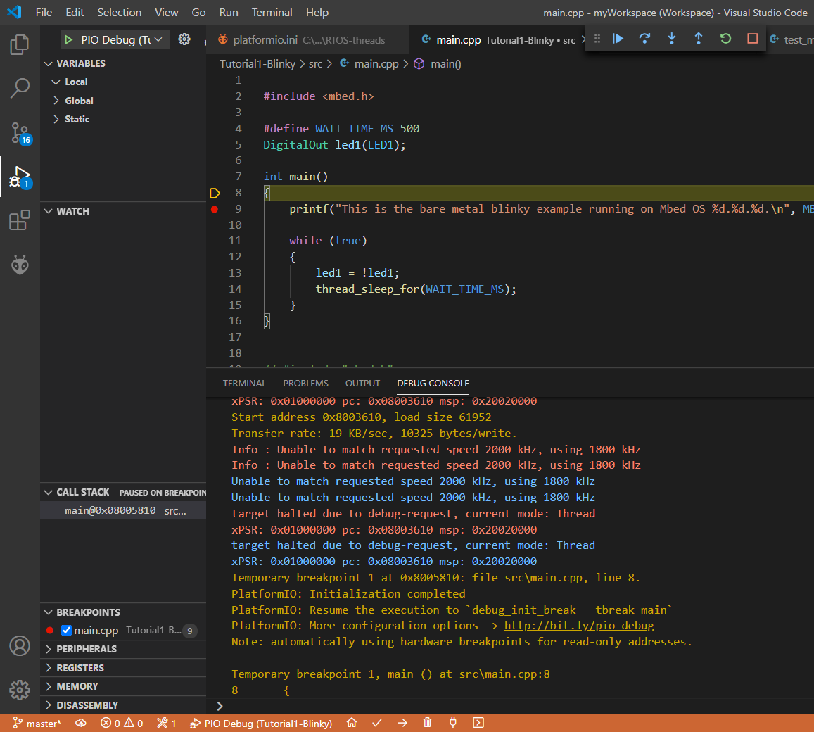
Activity 4 – Platform IO Unified Debugger
Step over
Drop a breakpoint on the first line inside of your main function by clicking in the margin, a dot should appear
From the menu select Debug -> Start Debugging
Platform IO will go into debug mode where we can step through our source code line-by-line
Use the step-over button to move through the code
You can see the LEDs come on one at a time
If you have any variables you can see the values that they contain at each point in the program
Breakpoint
Next line to execute (stack pointer)

Slide 51
Switch to the STM Nucleo-F446RE board after this point
We will need the Virtual COM port for Serial output
(the older STM32F4-Discovery boards do not have a Virtual COM port)
Pinout can be found here:
https://os.mbed.com/platforms/ST-Nucleo-F446RE/#nucleo-pinout

Slide 52
Unit Testing (on an embedded target with PIO)
Unit Testing is the process of writing short tests for testing a small function or procedure
  This is useful for quickly checking if the code we have written does what we think it is supposed to do
We could take this a step further with Test Driven Development (TDD) methodology
  TDD is a process for writing code, whereby the developer writes the unit test before writing the code to pass the test
The next activity is to have a go at Unit Testing on an embedded platform
  You will need to select an STM board which has a Virtual COM port (try Nucleo F446RE for this)
PlatformIO uses the C++ Unity Unit Testing library
References:
  https://docs.platformio.org/en/latest/tutorials/ststm32/stm32cube_debugging_unit_testing.html
  https://github.com/platformio/platformio-examples/tree/develop/unit-testing/mbed-blink

Slide 53
Activity 5 – Unit Testing
#include <mbed.h>
#include <unity.h>
DigitalOut myled(LED1);
// void setUp(void) {
// set stuff up here
// }
// void tearDown(void) {
// clean stuff up here
// }
void test_pin_is_connected(void) {
TEST_ASSERT_EQUAL(myled.is_connected(), 1);
}
void test_led_state_high(void) {
myled.write(1);
TEST_ASSERT_EQUAL(myled.read(), 1);
}
void test_led_state_low(void) {
myled.write(0);
TEST_ASSERT_EQUAL(myled.read(), 0);
}
int main() {
UNITY_BEGIN();
RUN_TEST(test_pin_is_connected);
for (int i = 0; i < 5; ++i){
RUN_TEST(test_led_state_high);
wait_ms(500);
RUN_TEST(test_led_state_low);
wait_ms(500);
}
UNITY_END(); // stop unit testing
//while(1){}
}
Once you have setup a new PIO project
Notice there is a ‘test’ folder in your project directory
Create a new file under the ‘test’ directory called ‘test_main.cpp’ and use the following source code:
From the PlatformIO menu select ‘PlatformIO : Test’

Slide 54
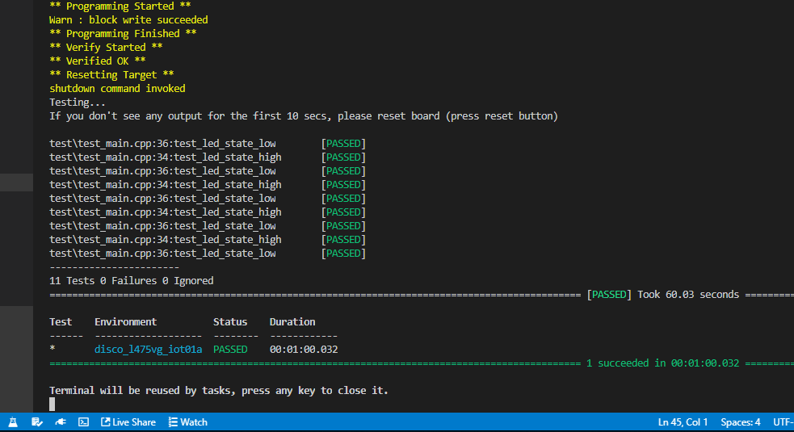
Unit Test Output should look something like this
PlatformIO: Test button

Slide 55
PlatformIO.ini
You can add this to your PlatformIO.ini file to cache the mbed libraries, this should help to reduce the build/compile time.
[platformio]​
build_cache_dir = .pio/mycache
[env:nucleo_f446re]
platform = ststm32
board = nucleo_f446re
framework = mbed
upload_protocol = stlink
Try the Nucleo-F446RE board for the unit testing activity

