Slide 1
7058CEM – Embedded Systems Programming
Getting setup with the embedded system toolchain for online delivery / working at home.
2020 – 2021 Online Delivery
Chris Bass

Slide 2

1. Install Visual Studio Code (VSCode)
First we will need an IDE for our embedded system development
We will be using Visual Studio Code
  (note this is a different IDE to Visual Studio)
https://code.visualstudio.com/
VSCode is a fully customisable IDE which allows you to setup your own environment and toolchain the way you like
In VSCode you can install Extensions to add additional functionality and customise your way of working
We will be using the C/C++ Extension and the PlatformIO Extension

Slide 3
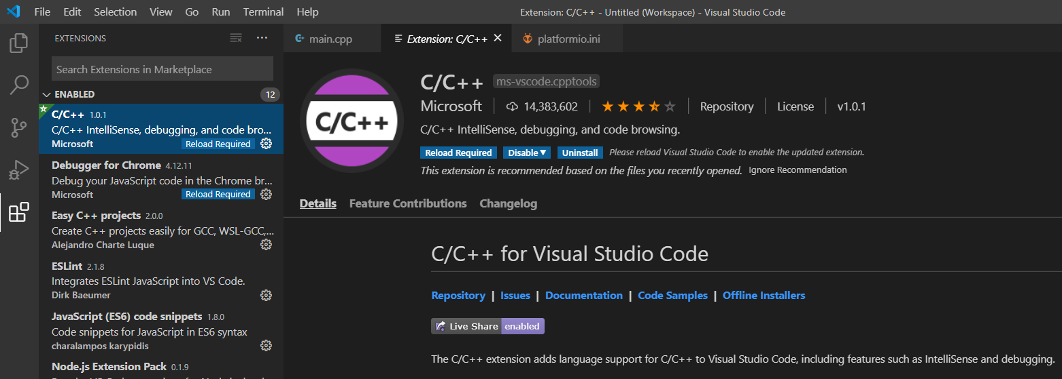
2. Install the C/C++ Extension in VSCode

Slide 4
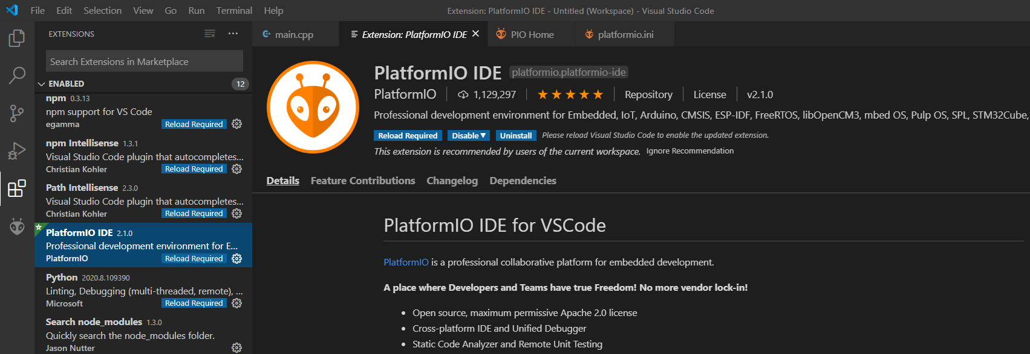
3. Install the PlatformIO (PIO) Extension

Slide 5


PlatformIO
After installing the extension you maybe required to reload VSCode
Click the ‘reload required’ button as needed
After a short while PIO should be installed
With PIO installed the Home page usually pops up
PIO automatically takes care of setting up the embedded system toolchain for us when we create a new project, so we do not need to worry about installing compilers, linkers, etc. for our specific embedded platform – yay!

Slide 6
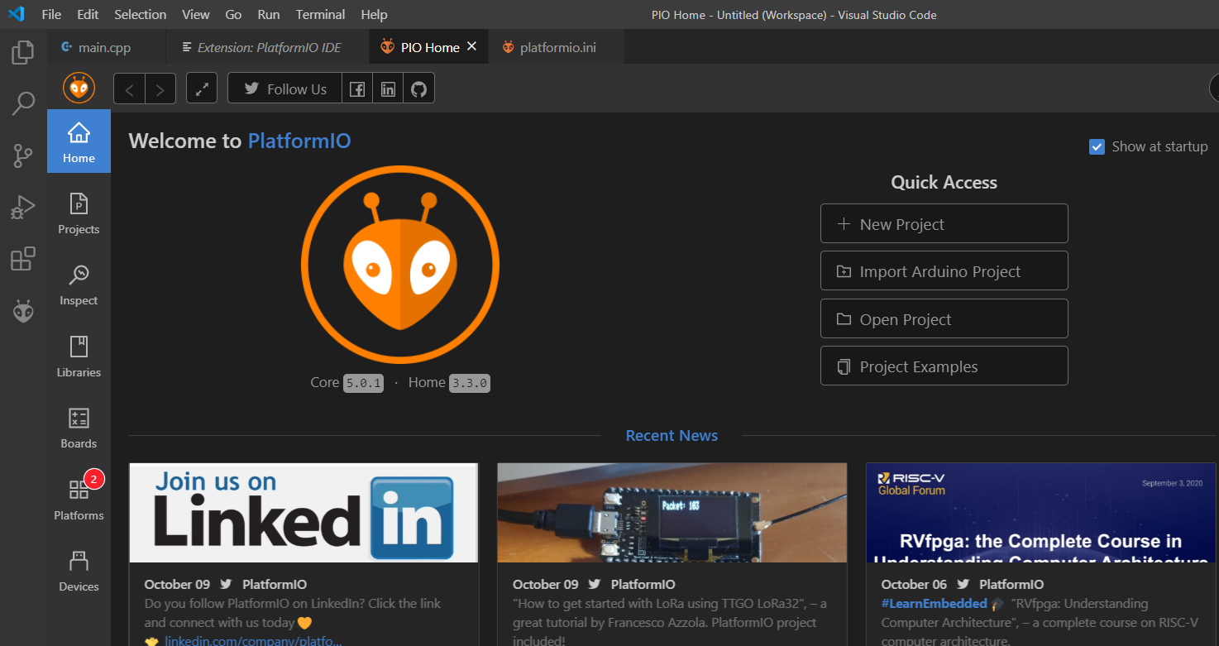
4. PIO Home Page

Slide 7
5. Install STM32 Drivers
The last thing we need install is the drivers for the STM32 so that when we connect our development board via USB it will be recognised
You can download the STM32 drivers from the official ST website, or you can grab them from the TEACHING-MATERIALS repo on CU GitHub
Official:
  https://www.st.com/en/development-tools/stsw-link009.html
CU GitHub:
  https://github.coventry.ac.uk/

Slide 8
Useful links to checkout!
https://platformio.org/

