Slide 1

7058CEM – Embedded Systems Programming
Real Time Operating Systems and Multi-Threading for mbed.
Chris Bass

Slide 2

Today
Operating System Overview
  What is an operating system?
  Functions, Types and Services of Operating Systems
Real-Time Operating System (RTOS)
  RTOS Overview
  RTOS Task Scheduling
  Keil RTX RTOS
RTOS on mbed Platform
  mbed RTOS API
  Using mbed RTOS API for your Project
  Thread, Mutex and Semaphore
Notes:
After briefly discussing what an operating system is and what it is used for, we will provide an overview of real-time operating systems, in particular the Keil RTX RTOS. We will then describe the integration of RTOS into mbed. Finally, we will explain a very important aspect of OS operations, which is the handling of shared data access, and avoiding inconsistent data and deadlocks with mutexes and semaphores.

Slide 3
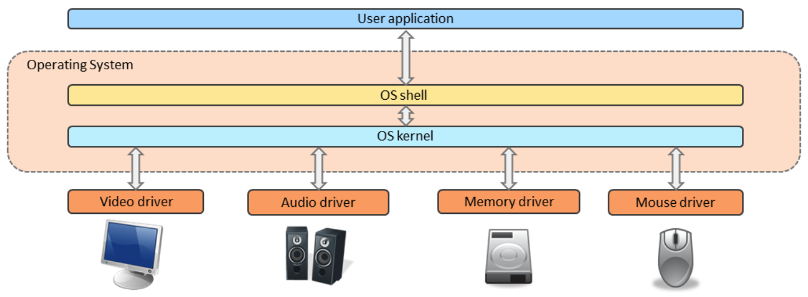
Operating System (OS) Overview
An intermediary interface between user application and computer hardware
Facilitates application development (convenience and efficiency)
Various OSs are available in the market for various hardware platforms e.g. Windows, Linux, Unix, Mac OS, Android, iOS.
Notes:
An operating system (OS) is a middleware between the developer and concrete hardware, such as processor, board, peripherals, etc. A developer should be able to realize code for similar hardware environments in a identical way. Hardware such as video, audio, etc. should always be handled equally when programming and implementing an application. Put another way, an OS provides functionality which can be used by as much hardware as possible, but the hardware itself must also (usually) provide a driver which can be handled by the OS. Therefore, an OS must adapt to hardware and hardware must provide OS-specific drivers. The goal of an OS is the complete transparency, or ideally, invisibility, of the developer’s specific hardware. Developers should focus more on implementing a system’s functionality, and less on addressing specific hardware issues.

Slide 4
Operating System Functions
An operating system acts as an interface between the high-level user application and the low-level hardware components, and it is usually capable of:
  Managing the processor
  Managing memory
  Managing devices
  Managing file systems
  System security
  Fault tolerance and error detection
  Multitasking and job accounting
  Task coordination

Slide 5
Operating System Services
In order to manage the Operating System Functions, different basic services have to be provided.
Basic operating system services may include:
  Scheduling tasks
  Allocating memory resources
  Managing Inputs and Outputs
  Managing file systems
  Communicating and networking
  Detecting and fixing errors
  Protecting and securing information
Notes:
In order to manage the tasks on the previous slide, different basic services have to be provided, including:
Task and file management
Communication to peripherals and the rest of the world
Error management
Safety and security

Slide 6
Types of Operating System
Single-user
  Only one user access
  May allow multiple programs to run at the same time
Multi-user OS
  Allows multiple users to access a computer system at the same time
  Batch operating OS
    Users prepare their jobs offline
    Similar jobs submitted by different users are batched together and run as a group
    Aims to maximise processor usage – less interaction with user applications
  Time-sharing OS
    Processor’s time is shared among multiple users
    More interaction with user applications
Notes:
The most challenging tasks for an OS are ensuring fair load (and time) distribution among different applications and processes, and keeping data consistent via memory management. The greater the number of independent applications that need to run, the more challenging the task. Different types of OS include:
Single user, single processor, which is not suitable for OS anymore, because it only provides manual low level programming.
Single concurrent user, many processes, which is standard for desktop operating systems.
Multi user, many (time shifted) processes, in which all users can apply for a task on a system. In reality, users put their tasks into a queue (= batch) and all items are processed sequentially (= batch processing).
Multi user, many (simultaneous) processes, which accommodates real multi tasking, multi processing, and parallel computing systems.

Slide 7
Types of Operating System
Distributed OS
  Processing is distributed across multiple CPUs
  Processors are interconnected via communication lines, such as high speed buses or various types of networks.
Embedded OS
  Designed to be used in embedded computer systems
  Limited resources, such as memory, I/Os, clock speed
  Compact and energy efficient
Real-Time OS
  Multitasking OS targeted at real-time applications, with real-time constraints
  Must quickly and predictably respond to events
Notes:
An OS can also be classified according to its more technical aspects:
Distributed OS, which accommodates specialized operating tasks on multiple CPUs
Embedded OS, which needs a very small footprint and is used specifically to manage interrupt controlled hardware interaction
Real-time OS, which guarantees task- and process-handling within defined time intervals (= real-time)
Most operating systems are a mixture of all above; for example, a single-user embedded real-time OS.

Slide 8
Real-Time Operating System (RTOS) Overview
A Real-Time OS (RTOS) is an OS that:
  Serve real-time applications
  Responds to requests within a guaranteed and predictable delay
  Processes data in deterministic cycles
RTOS aims at deterministic performance foremost, rather than high throughput
  Performance can be measured by jitter: the variability of the time it takes to complete a task
  Soft RTOS: more jitter, but usually or generally meets a deadline
  Hard RTOS: less jitter, can meet a deadline deterministically
Real-Time definition:
  Real-time guarantees a completion of a process within a defined time interval. Real-time does not make any statement about the total time duration or the processing speed.
Notes:
An RTOS’s process completion time is completely deterministic and guarantees a defined time interval, without reference to a particular processing speed. Real-time does not necessarily mean fast. A very fast process can be blocked and stuck, which means that it is no longer real-time.
For example, imagine that a transatlantic ocean liner must have one emergency-radio-contact every 24 hours. If no contact is registered, a search-and-rescue procedure will be initiated. This includes all the elements of a RTOS: a defined time interval, an action and a result, and a backup-procedure in case of a failure. Note that 24-hours is not fast, but it is defined!

Slide 9
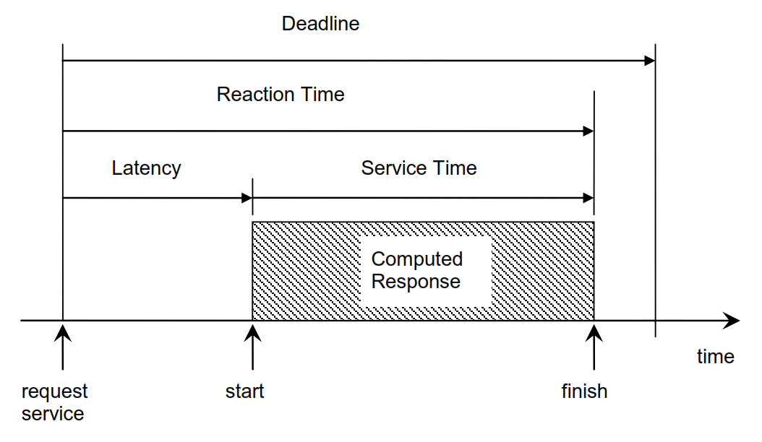
Real-Time Definitions
Extracted from: Intro2ECS_01_TV.pdf
For further definitions and more information on jitter and the task scheduler etc. see: Intro2ECS_03_TV.pdf

Slide 10
RTOS Design Philosophies
There are two common designs for RTOS:
Event-driven RTOS:
  Pre-emptive task scheduling. (Pro-active task scheduling).
  An event of higher priority needs to be served first.
  Processes data more responsively.
Time-sharing RTOS
  Non-pre-emptive task scheduling.
  Tasks are switched on a regular clocked interrupt, and on events, e.g. round robin scheduling.
  Tasks are switched more often, giving a smoother multitasking.
  However, unnecessary task switching results in undesired overheads.
Notes:
An RTOS is based on two main design strategies: load and priority dependent, or independent. These two strategies are also called pre-emptive and non-pre-emptive.
A pre-emptive system allocates more processing time to a higher priority task. Lower priority tasks may be stopped until a higher priority task finishes. If the lower priority task is real-time, a very detailed plan is performed in advance, in order to provide sufficient time intervals for all potentially active tasks.
Non-pre-emptive schedule is much more predictive. All processes are started and stopped within defined time slices, regardless of whether they need the full time slice. This may be very inefficient for a system with a low load, because it is constantly scheduling and switching tasks.
A more intelligent algorithm for time sharing could be the ‘round-robin’-method, which considers both priorities and the remaining loads of single processes.

Slide 11






RTOS Task Scheduling
In a typical RTOS, a task can have at least three states:
  Running – the task is currently being executed by the CPU.
  Ready – the task is ready to be executed by the CPU.
  Blocked – the task is paused and waiting for an event, such as from I/O, to resume its execution.
Task Scheduling
  Usually, only one task per CPU can run at any one time.
  To efficiently switch between tasks, usually a Task Scheduler is used. Various scheduling algorithms exist, including:
    Cooperative scheduling: no pre-emption, tasks can end themselves in a cooperative manner
    Pre-emptive scheduling: tasks can be interrupted by other tasks of higher priority.
    ‘Earliest deadline first’ approach: the task with the earliest deadline is served first.
Examples of RTOSs include: OSE, Windows CE, FreeRTOS, Arm Keil RTX, etc.
Notes:
Task states are running, ready (to run) and blocked (from running and waiting to resume).
Task scheduling manages the tasks and the states above. Because the single core of a CPU can only operate sequentially, we assume that only one task at a time can run on one CPU.
Possible algorithms for task management include:
Cooperative scheduling, which involves no pre-emption. Tasks start and end themselves within defined time intervals.
Pre-emptive scheduling, which allows priority-based interruption of tasks
Earliest deadline first scheduling, in which the most urgent task starts first

Slide 12
Highlights of the Keil RTX RTOS
Deterministic RTOS designed for Arm Cortex-M based devices.
Multitasking with flexible scheduling: round-robin, pre-emptive, and collaborative.
High-speed real-time operation with low interrupt latency.
Small footprint for resource-constrained systems.
Royalty-free, deterministic RTOS with source code.
Unlimited number of tasks, each with 254 priority levels.
Support for multithreading and thread safe operation.
Inter-task communication: manages the sharing of data, memory and hardware resources among multiple tasks.
Unlimited number of mailboxes, semaphores, mutex, timers (hardware-permitting).
Defined stack usage – each task is allocated a defined stack space, enabling predictable memory usage.
Notes:
The Keil RTX RTOS is an RTOS based on Arm Cortex-M systems. Its functionality is also implemented in the mbed platform. This slide lists some of its special features.

Slide 13


mbed RTOS
mbed RTOS API:
  Provides easy-to-use API for programming mbed enabled devices
  Based on Keil RTX RTOS kernel implementation
  Uses the CMSIS-RTOS API open standard
CMSIS-RTOS API
  Common API for real-time operating systems
  Foundation of the official mbed RTOS
  Provides a standardized programming interface that is portable to many RTOSs
  Hence enables software templates, middleware, libraries, and other components that can work across various supported RTOS systems
Notes:
The mbed system provides an API for the Keil RTX RTOS kernel, based on CMSIS RTOS. As mentioned in previous modules, CMSIS is the foundation for hardware abstraction between different Arm processor types.
In the subsequent slides, we will explain three concepts relating to core elements of shared memory real-time programming:
Threads
Mutexes
Semaphores

Slide 14
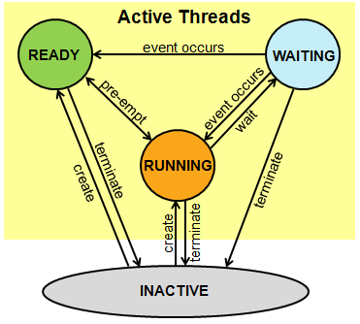
Thread
A task can sometimes be referred to as a thread in multitasking systems.
A thread in mbed API can be in the following states:
Running: The thread that is currently running is in the running state. Only one thread at a time can be in this state (for single core systems).
Ready: Threads which are ready to run are in the ready state. Once the running thread has terminated or is waiting, the next ready thread with the highest priority becomes the running thread.
Waiting: Threads that are waiting for an event to occur are in the waiting state.
Inactive: Threads that are not created or terminated are in the inactive state. These threads typically consume no system resources.
Notes:
Threads and tasks are often used synonymously although, strictly speaking, tasks are a combination of threads. As explained previously, tasks’ states are running, blocked and ready. Mbed adds two further states, ‘waiting’ and ‘inactive’:
Waiting means that the task is actively waiting for its initiating interrupt, but is not yet performing any action.
Inactive is a state in which the task waits to start.
Here is a sports-based example: During a competition, runners are inactive during the pole vault event. When the running competition is announced (creating a thread), the runners move into wait-state. As soon as each runner’s number is called (an interrupt), that runner proceeds to the starting block and waits for the start. When the starting pistol fires, the runners are running.

Slide 15
mbed API for Thread
RTOS:
  https://docs.mbed.com/docs/mbed-os-api-reference/en/latest/APIs/tasks/rtos/
Thread:
  https://docs.mbed.com/docs/mbed-os-api-reference/en/latest/APIs/tasks/rtos/#thread

Slide 16
Create a new PlatformIO project
Create a new PlatformIO project.
I have named my project: ‘L476-disco-mbed-RTOS’
STM32L476G Discovery board
mbed platform
I am using the STM32L476G Discovery board for these examples and exercises, but you can use any mbed compatible board you like.

Slide 17
PlatformIO.ini
[platformio]​
build_cache_dir = .pio/mycache
[env:disco_l476vg]
platform = ststm32
board = disco_l476vg
framework = mbed
upload_protocol = stlink
platform_packages = framework-mbed @ ~5
build_flags = -DPIO_FRAMEWORK_MBED_RTOS_PRESENT
The additional build flag is required when working with the RTOS library.

Slide 18
Interesting information on sleep vs wait in mbed
https://forums.mbed.com/t/difference-between-thisthread-sleep-and-wait/13988
When you use the sleep functions, they seem to mess with the TFT display on the F746 board.
This thread mentions that “Some displays might require full initialisation after coming out of sleep and others require different delays”:
  https://github.com/Bodmer/TFT_eSPI/issues/715
Correct, the display requires a deinit() and then an init() after a sleep to get it working again.

Slide 19
mbed Thread Code Example
#include <mbed.h>
DigitalOut ledGreen(LED1);
DigitalOut ledOrange(LED2);
void threadTask() {
while(1) {
ledOrange = !ledOrange;
wait(1);
}
}
int main() {
Thread myThread;
myThread.start(threadTask);
while(1) {
ledGreen = !ledGreen;
wait(0.5f);
}
return 0;
}
The following code shows an example of creating a thread object from the main.
Starting the thread puts the thread into a ready state.
This thread will now be handled by the RTOS task scheduler.
In parallel the main function continues to run as a separate thread task.

Slide 20
Join and Terminate
#include "mbed.h"
DigitalOut ledGreen(LED1);
DigitalOut ledOrange(LED2);
// Blink function toggles the led 10 times for 10 seconds
void blink() {
for (int i = 0; i < 10; i++) {
ledGreen = !ledGreen;
wait(1);
}
}
// Spawns a thread to run blink for 10 seconds
int main() {
Thread myThread;
myThread.start(blink);
wait(5);
myThread.join(); // waits for myThread to finish execution
myThread.terminate(); // stops the thread
ledOrange = 1;
return 0;
}
The following code should help demonstrate the .join() and .terminate() methods.
Try commenting in/out the .join() and .terminate() methods and run the code to understand how they work.

Slide 21
mbed Thread Parameters
#include "mbed.h"
DigitalOut ledGreen(LED1);
DigitalOut ledOrange(LED2);
void threadTask1(float* waitTime) {
while (1) {
ledGreen = !ledGreen;
wait(*waitTime);
}
}
void threadTask2(DigitalOut *led) {
while (1) {
*led = !*led;
wait(1);
}
}
int main() {
Thread myThread1;
Thread myThread2;
float speed = 0.5f;
myThread1.start(callback(threadTask1, &speed));
myThread2.start(callback(threadTask2, &ledOrange));
while(1) { wait(1); }
return 0;
}
The following code uses callbacks as a convenient way to pass input arguments to Threads.
I think you are only allowed a maximum of 1 argument input to the callback function and it needs to be passed by reference using a pointer.
The following code gives 2 examples of this, passing a primitive type as an argument and passing an object as an argument.
Passing an input argument to a thread

Slide 22

Activity 1 – mbed Threads
Try creating your own thread which will perform a task independently of the other running threads.

Slide 23
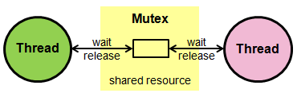
Mutex – Mutual Exclusion Object
A mutex is a locking mechanism.
Ensures no two threads are in their ‘critical section’ accessing a shared resource at the same time.
Make the execution of threads serial/sequential for a ‘critical section’ of code i.e. threads will wait for each other to complete the ‘critical section’.
Protects access to a shared resource, such as a shared memory image or a data buffer.
Protects against the race-condition-error.
Cannot be used in an ISR (see mbed API documentation for details).
Notes:
We explained the concept of the race-condition-error when discussing interrupt-based programming in a previous lecture/tutorial. If a shared (pointer) variable is used by different threads, and pre-emptive multithreading is enabled, the threads may mutually change their accessed data, creating a data inconsistency. Therefore, for critical, non atomic operations, the object must be blocked. This is called a mutual exclusion object, or ‘mutex’.

Slide 24
Mutex Example
#include "mbed.h"
Mutex myMutex;
void notify(const char* name, int state) {
myMutex.lock();
printf("%s: %d\n\r", name, state); // serial output is a shared resource
myMutex.unlock();
}
void threadTask(void const *args) {
while (true) {
notify((const char*)args, 0);
wait(1);
notify((const char*)args, 1);
wait(1);
}
}
int main() {
Thread t2;
Thread t3;
t2.start(callback(threadTask, (void *)"Thread 2"));
t3.start(callback(threadTask, (void *)"Thread 3"));
threadTask((void *)"Thread 1");
}
Critical section
The following code gives an example of using a mutex object to protect the serial output shared resource.
We do not want the scheduler to switch threads during our serial output, so we use a mutex object to essentially make the operation atomic by blocking the other thread.
Try commenting out the .lock() and .unlock() method calls to see the serial output with and without mutex.
Mutex does not guarantee the order of thread execution – only that the critical section will be executed in a sequential manner.
  We can make the threads execute in a different order by changing the thread priorities.
  E.g.: t2.set_priority(osPriorityHigh);
Try commenting in/out the .lock() and .unlock() method calls to see the difference between atomic and non-atomic execution.

Slide 25
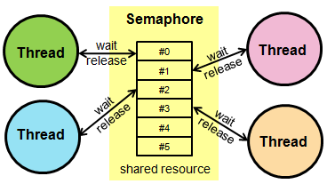
Semaphore
A semaphore is a signalling mechanism.
A semaphore is an object used to manage and protect access to shared resources.
Unlike a mutex, it does not have the concept of an owner.
Unlike a mutex, a semaphore can control access to multiple shared resources.
For example, a semaphore enables access to, and management of, a group of identical peripherals.
Can be signalled from an ISR (see mbed API documentation for details).
Notes:
A ‘semaphore’ defines the maximum number of threads that are allowed to use a particular resource.

Slide 26
Semaphore Example
#include "mbed.h"
Semaphore two_slots(2);
void threadTask(void const *name) {
while (true) {
two_slots.wait();
wait(0.5);
printf("%s\n\r", (const char*)name);
wait(0.5);
two_slots.release();
}
}
int main () {
Thread t2;
Thread t3;
Thread t4;
t2.start(callback(threadTask, (void *)"2 Thread 2"));
t3.start(callback(threadTask, (void *)"3 Thread 3"));
t4.start(callback(threadTask, (void *)"4 Thread 4"));
threadTask((void *)"1 Thread 1");
}
The following code gives an example of using a semaphore object to restrict the number of threads which can access the serial output resource at the same time.
In this contrived example, notice that the first two threads which call the semaphore .wait() method will execute the serial printf() at the same time.
This means that the output maybe a jumble of characters from thread 1 and thread 2, for example.
Once the tasks have called the .release() method the next two threads can enter the protected code section.
This enforces that a maximum of 2 threads can access the critical section at any one time.
Semaphores are typically used as a method for signalling between threads.

Slide 27
Thread Signalling Example
#include "mbed.h"
DigitalOut ledGreen(LED1);
void threadTask() {
while (true) {
Thread::signal_wait(0x1);
ledGreen = !ledGreen;
}
}
int main() {
Thread myThread;
myThread.start(callback(threadTask));
while (true) {
wait(1);
myThread.signal_set(0x1);
}
}
As an alternative to semaphores, mbed also provides signals for sending messages between threads.
This code example show the use of signals to pause thread execution until a signal set flag is active.
The .signal_wait() method will wait until a specified signal flag (in this case 0x1) is set.
If 0 is used as an input argument to the .signal_wait() method then it will wait for any signal flag to be set.

Slide 28
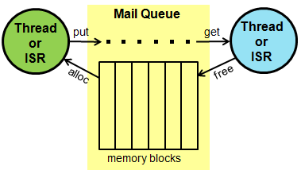
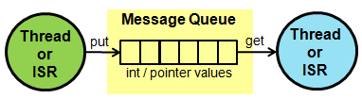
Queue, Memory Pool and Mail
‘Queue’ is a First In First Out data structure (FIFO).
‘Memory Pool’ is used to allocate memory for a queue data structure.
‘Mail’ combines a Queue and a Memory Pool into a single class.
These data structures can be helpful when passing data between threads.

Slide 29
Queue and Memory Pool Example (i.e. Mail)
#include "mbed.h"
/* Mail */
typedef struct {
float voltage; /* AD result of measured voltage */
float current; /* AD result of measured current */
uint32_t counter; /* A counter value */
} mail_t;
Mail<mail_t, 16> mail_box;
Thread thread;
void send_thread (void) {
uint32_t i = 0;
while (true) {
i++; // fake data update
mail_t *mail = mail_box.alloc();
mail->voltage = (i * 0.1) * 33;
mail->current = (i * 0.1) * 11;
mail->counter = i;
mail_box.put(mail);
wait(1);
}
}
int main (void) {
thread.start(callback(send_thread));
float free_time = 4;
while (true) {
wait(free_time); // if we do not clear the queue fast enough it will overflow and lose data!
if (mail_box.full()) {
printf("Mail box is full, please free some space!\n\r");
free_time = 0.1;
}
if (mail_box.empty()) {
printf("Mail box is empty\n\r");
free_time = 4;
}
osEvent evt = mail_box.get();
if (evt.status == osEventMail) {
mail_t *mail = (mail_t*)evt.value.p;
//printf("Voltage: %.2f V\n\r" , mail->voltage);
//printf("Current: %.2f A\n\r" , mail->current);
printf("Number of cycles: %lu\n\r", mail->counter);
mail_box.free(mail);
}
}
}
Here is an example of using a Mail object (which is just a combination of a Queue and a Memory Pool object – see documentation for detail).
In this example a thread is used to continually poll a sensor for data (fake data update).
Instead of processing the data in the same thread used for polling, the data is temporarily stored in a Mail box queue.
The main thread then processes the messages in the Mail box queue in FIFO order.
The Mail box has a limited size for messages.
Notice that if the Mail box overflows then messages will be lost.
We can solve this by making the Mail box larger in size and by freeing memory at a higher frequency than we allocate.

Slide 30
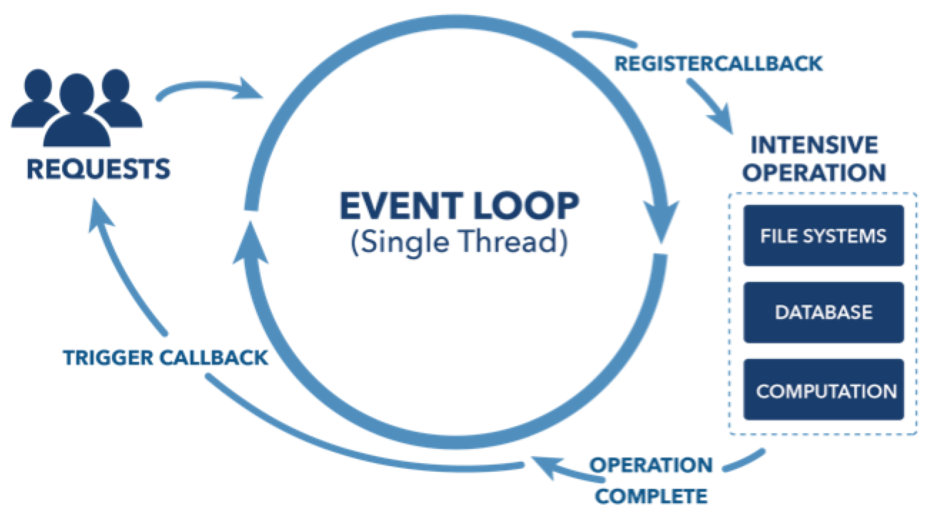
Event Loop
Interrupts and the use of RTOS threads are commonly used design options when considering the main structure of our embedded programs.
As we have seen, when programming with threads there are some operations which are not allowed to be used from the context of interrupt service routines (e.g. mutex).
One option to get around this is to use an Event Loop.
mbed provides the EventQueue to allow us to build an Event Loop driven embedded system.
The main benefit of the EventQueue, is that it allows us to defer the execution of code to a different context.
In particular, a common use of an event loop is to postpone the execution of a code sequence from an interrupt handler to a user context.
The mbed EventQueue API:
  https://os.mbed.com/docs/latest/tutorials/the-eventqueue-api.html

Slide 31
30/01/2024 – for the EventQueue lab tasks you might need to add an mbed_app.json file such as:
{
"target_overrides": {
"*": {
"target.printf_lib": "std",
"platform.callback-nontrivial" : true
}
}
}

Slide 32
Event Loop Example
#include "mbed.h"
#include "mbed_events.h"
DigitalOut ledGreen(LED1);
InterruptIn userButton(JOYSTICK_CENTER);
EventQueue queue(32 * EVENTS_EVENT_SIZE);
Thread myThread;
void rise_handler(void) {
printf("rise_handler in context %p\r\n", Thread::gettid());
ledGreen = !ledGreen;
}
void fall_handler(void) {
printf("fall_handler in context %p\r\n", Thread::gettid());
ledGreen = !ledGreen;
}
int main() {
// Start the event queue
myThread.start(callback(&queue, &EventQueue::dispatch_forever));
printf("Starting in context %p\r\n", Thread::gettid());
// The 'rise' handler will execute in IRQ context
userButton.rise(rise_handler);
// The 'fall' handler will execute in the context of thread 'myThread'
userButton.fall(queue.event(fall_handler));
}
The following code shows an example of using an EventQueue object to manage a main event loop for us.
Interrupts are being used here, but instead of handling interrupt directly in an ISR, an EventQueue is used to postpone the handling code until later and in a different context.
This example demonstrates the different contexts of the handlers.
Note, we should not be using the printf() function inside an ISR normally.
This blog post is a good read on this topic:
  http://blog.janjongboom.com/2016/12/19/simplify-your-codebase.html

Slide 33
Multiple Threads and Event Loop Example
#include "mbed.h"
#include "mbed_events.h"
DigitalOut ledGreen(LED1);
DigitalOut ledRed(LED2);
InterruptIn userButton(JOYSTICK_CENTER);
EventQueue queue(4 * EVENTS_EVENT_SIZE); // 32 *
Thread myThread;
void rise_handler(void) {
printf("rise_handler start in context %p\r\n", Thread::gettid());
wait(0.2);
ledGreen = !ledGreen;
printf("rise_handler end in context %p\r\n", Thread::gettid());
wait(0.2);
}
void fall_handler(void) {
printf("fall_handler start in context %p\r\n", Thread::gettid());
wait(0.2);
ledGreen = !ledGreen;
printf("fall_handler end in context %p\r\n", Thread::gettid());
wait(0.2);
}
int main() {
// Start the event queue
myThread.start(callback(&queue, &EventQueue::dispatch_forever));
printf("Starting in context %p\r\n", Thread::gettid());
// The 'rise' handler will execute in IRQ context
userButton.rise(queue.event(rise_handler));
// The 'fall' handler will execute in the context of thread 'myThread'
userButton.fall(queue.event(fall_handler));
while (1) {
ledRed = !ledRed;
wait(0.5);
}
}
This code demonstrates the use of multiple threads and experiments with modifying the size of the event queue.
If the event queue overflows then queued events are lost.
In this example there is a main thread which blinks the red LED and a thread for the event loop which processes the events coming from the interrupt handlers.
This solution gives us the efficiency of multithreading with the responsiveness of using interrupts.
The EventQueue operates in a single thread and can process more than one event via queuing the incoming events.
If we want to process multiple events at the same time, we could create multiple EventQueue objects running in multiple threads.

Slide 34
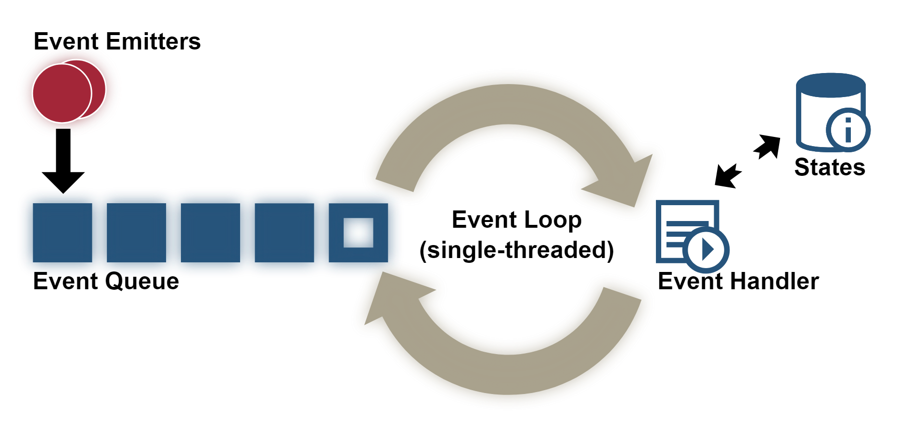
Activity 2 – Multi-Threaded Event Loops
Build a RTOS driven program which uses both multiple threading and event loops to poll sensors, process interrupts and perform other i/o tasks at the same time with efficiency and responsiveness in mind.
Investigate creating multiple Event Loops running in separate threads.
Event Loop as Thread 1
Event Loop as Thread 2

Slide 35
References
mbed RTOS:
  https://docs.mbed.com/docs/mbed-os-api-reference/en/latest/APIs/tasks/rtos/
The difference between Mutex and Semaphore:
  https://barrgroup.com/Embedded-Systems/How-To/RTOS-Mutex-Semaphore
  https://www.geeksforgeeks.org/mutex-vs-semaphore/
The EventQueue API:
  https://os.mbed.com/docs/latest/tutorials/the-eventqueue-api.html
Simplify your codebase with mbed-events:
  http://blog.janjongboom.com/2016/12/19/simplify-your-codebase.html

