Slide 1
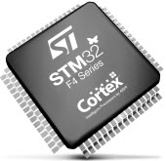
7058CEM – Embedded Systems Programming
Object-Oriented Programming for Embedded Systems with the ST Nucleo F072RB board
Chris Bass

Slide 2
Today
Object-Oriented Programming:
Creating our own custom Classes and working with multiple Objects

Slide 3
Block-Structured Programming
A block-structured view of programming:
  Focus is on the functions we have to perform
  Encapsulating functions and function specific data (local variables) into blocks and running them back to back
    Getting away from the ‘spaghetti code’ goto statements of old
  Problem – to share data between high level blocks we use global variables
    This can become an issue as programs get bigger e.g. naming conflicts.
Process Block A
Process Block B
Process Block C

Slide 4
Object-Oriented Programming
An object-oriented view of programming:
  Focus is not only on the functions, but also on the data we have to store
  Encapsulating data and related functions into a software object
    Making our code more modular to improve code reuse
    Getting away from difficult to maintain programs of old – avoids global variables
  Communication between objects is through methods (member functions)
Software Object 1
Methods/Interface
Object 1’s Data (Private/Hidden)
Software Object 2
Methods/Interface
Object 2’s Data (Private/Hidden)
Software Object 3
Methods/Interface
Object 3’s Data (Private/Hidden)

Slide 5
We have already been using objects
The mbed library makes extensive use of object-oriented programming concepts including classes and objects
When we have been using the DigitalOut or the AnalogIn, we have been creating an object instance from the class and then we have called methods from the object instance to do things. For example:
DigitalOut greenLED(PD_12);
greenLED.write(1);
Notice that the greenLED object remembers its own pin number, so when we call the write method the greenLED object already knows which pin we are talking about
The data related to the pin number of the object is encapsulated inside the object instance. If we had 4 led objects each object would remember its own pin number.
This separation of concerns means we do not have to keep multiple pieces of data in our head at the same time.
DigitalOut is the class
greenLED is the object
write is the method

Slide 6
Creating our own custom classes
Last week we were working with the TC74 temperature sensor
Communication to the TC74 was via the I2C protocol
In code we setup pins for SDA (data) and SCL (clock)
When sending a packet of data to the TC74 sensor we needed the ‘sensorAddress’, which was a unique to the TC74 device
The process was fairly straightforward, however today we are going to create our own TC74 class to see how classes can be used and the benefits that they provide especially when working with multiple objects

Slide 7
Create a new Project in PlatformIO
Create a new Project in PlatformIO
Take the TC74 code from last week as a starting point compile and check it still works as we designed it

Slide 8
Creating a new files to store our custom class
Inside of your project next to your main.cpp create two new files: “TC74.cpp” and “TC74.h”
The header file (.h) usually contains the ‘class definition’
  A ‘class definition’ specifies what the class consists of – i.e. the attributes and the methods making up the class.
The source file (.cpp) usually contains the ‘method definitions’
  Whereas the header file usually specifies just the method header (stub), the source file specifies the full method definition (including method body).

Slide 9
TC74.h
#include <mbed.h>
// Start of class definition for our TC74 class
class TC74 {
private: // attributes are usually private - hidden from outside this classes scope
I2C myI2C; // object composition - a TC74 object contains an I2C object
int mySensorAddress; // attribute
char myData[1];
public: // methods are often public - so they can be used from outside this classes scope
TC74(PinName sda, PinName scl, int sensorAddress); // constructor
char* readTemp(); // method declaration
};
A class definition is usually contained in a header file in C++.
The class definition is like a blueprint for creating objects.
Composition is a class relationship.
When an object is created from a class a set of attributes are created as well to store all of the data for that object.
Creating 2 objects means there will be 2 sets of attributes created which are separate to each other.

Slide 10
TC74.cpp
#include "TC74.h"
// constructor definition
TC74::TC74(PinName sda, PinName scl, int sensorAddress) :
myI2C(sda, scl),
mySensorAddress(sensorAddress) {
}
// method definition
char* TC74::readTemp() {
char cmd[1];
cmd[0] = 0x00; // Command to READ (page 8 of the TC74 datasheet)
myI2C.write(mySensorAddress, cmd, 1); // Send command to read
myI2C.read(mySensorAddress, myData, 1); // Read the data from the device
return myData;
}
The constructor is a special method which is called only when an object is created (instantiated).
In this constructor we have 3 parameters and an initialiser list.
The initialiser list gives initial values to the attributes when the object is created.
It is often the job of the constructor to give initial values to attributes so that there are no ‘rubbish’ values.

Slide 11
Activity 1 – main.cpp
Now, use your newly created class in your main.cpp:
Include "TC74.h" at the top so that the class type is declared before you try to use it
Create an object of the TC74 type
  Note that when you do this you will be calling the constructor which you declared and defined in your TC74.h and TC74.cpp files.
  What arguments is the constructor expecting that you pass to it?
Using your object instance, call the readTemp() method to get back the temperature data
Finally, print out the temperature data you received to the serial monitor

Slide 12
Activity 2 – Multiple TC74 sensors, multiple objects
Now we have added 2 extra files and more code to do the same thing we did before, you maybe thinking “why add all this extra complexity?”
As mentioned earlier, the real benefits of object-oriented programming are when programs start to get a bit larger
Instead of just a single TC74 sensor let’s try 3, all on the same bus!
The I2C protocol allows for multiple I2C devices all to be connected to the same bus at the same time – provided they all have a unique address, of course!
Wire up two more TC74 sensors all on the same I2C bus.
Now modify your main.cpp to create 3 objects and take 3 temperature readings

Slide 13
Benefits of OOP
Now you have completed Activity 2 hopefully you should start to be seeing the real benefits of object-oriented programming
We did not have to copy and paste huge blocks of code – usually a sign of poor class design
Adding new temperature sensors was really easy
main.cpp is very easy to read, very high level language
Imagine that we needed to modify how temperatures are read from the sensor, all of our changes would be in a single class (ideally) – this is very good from a code maintenance perspective
One of the biggest advantages, however, is seeing that now our code is becoming more modular, it would be fairly straightforward to take our TC74 class and reuse it in multiple projects – just like we have been doing with the mbed library!

Slide 14
Activity 3 – UML Class Diagram
In UMLStudio draw a UML Class Diagram to accurately represent your TC74 class
Consider the composition relationship between the TC74 class and the I2C class, how is it represented in UML?
One of the most difficult parts of object-oriented programming is object-oriented design
There are many books, design principles and design patterns published on the topic
They typically refer to class relationships, however just coming up with good classes and well thought out attributes and data structures can also be very challenging
One approach to finding classes is: Abbott textual analysis

Slide 15
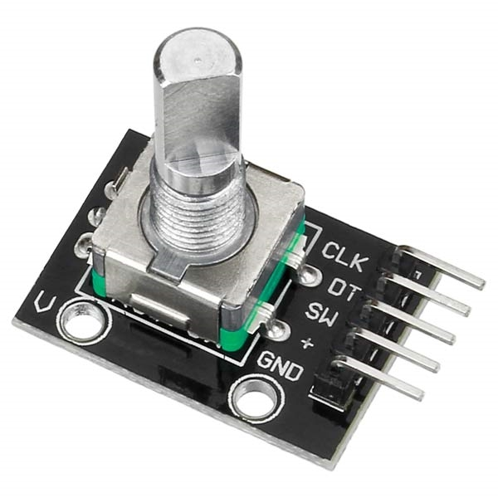
Quadrature Encoder
A Quadrature Encoder (QED)
This is a hardware device that generates pulses on two channels which are 90 degrees out of phase with each other in order to count clockwise or anticlockwise rotation.
It also contains a button click by pressing the thumbwheel in.

Slide 16
Activity 4 – On your own
We have some Quadrature Encoders (QED) in the lab.
As a final challenge to test yourself, see if you can design your own class for it.
When you are designing the class, do not just think about what the object should be able to do (methods), also consider what data/state the object needs to store (attributes).
And finally, if you are very keen you could try using it as an input device for the Nokia 5510 displays that we used in the last tutorial.
It is particularly well suited for scrolling through software menus or pages and selecting things.

Slide 17
Possible Solution to Activity 2 – main.cpp
// I2C Program - Microchip TC74 Temperature Sensor
#include <mbed.h>
#include "TC74.h"
// TC74(pin sda, pin scl, sensorAddress)
// Default TC74 address is 1001 1010 or 9A in hex - note that the LSB 0 is a write and 1 would be a read operation
TC74 tempSensor1(PB_9, PB_8, 0x9A); // SOT-23A 1001 1010 = 9A in hex
TC74 tempSensor2(PB_9, PB_8, 0x94); // TO-220 Yellow is A2 address 1001 010 0 = 94 in hex
TC74 tempSensor3(PB_9, PB_8, 0x90); // TO-220 Red is A0 address 1001 000 0 = 90 in hex
// Create a BufferedSerial object to be used by the system I/O retarget code.
FileHandle *mbed::mbed_override_console(int fd) {
static BufferedSerial serial_port(USBTX, USBRX, 9600);
return &serial_port;
}
int main() {
char* data1 = tempSensor1.readTemp();
printf("data1 SOT-23A is: %d\n\r", data1[0]);
char* data2 = tempSensor2.readTemp();
printf("data2 TO-220 Yellow is: %d\n\r", data2[0]);
char* data3 = tempSensor3.readTemp();
printf("data3 TO-220 Red is: %d\n\r", data3[0]);
return 0;
}

Slide 18
Possible Solution to Activity 4 – Quadrature Encoder
There is already a very good library class for QED written by Aaron Berk here:
  https://os.mbed.com/users/aberk/code/QEI/file/5c2ad81551aa/QEI.h/
This solution is rather extensive so do not worry if your solution is a simpler version, as long as it is working and you are understanding the object-oriented concepts that we are learning.

