Slide 1
7058CEM – Embedded Systems Programming
Timers and Pulse-Width Modulation with the ST Nucleo F072RB board
Chris Bass

Slide 2
Today
Timers and Pulse-Width Modulation (PWM)
  Components of a Standard Timer
  Compare mode
  Capture mode
  Pulse-Width Modulation (PWM) mode
mbed Timer and PWM
  mbed Timer
  mbed Time Ticker
  mbed PWM
Notes:
Timer, timing and pulse-width modulation are important topics for programming microcontrollers. Because timers combined with counters might be used for generating interrupts, or waking up a controller from a sleep mode, these modulations are an essential element of low-power-programming.
We will explain different types of timer operation modes and practise them with software implementations, using the mbed SDK.

Slide 3
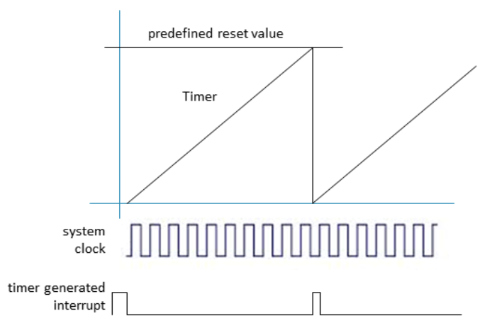
Timer Overview
A hardware timer is a digital counter that:
  Counts regular events, normally using a clock source with a relatively high and fixed frequency.
  Increments or decrements at a fixed frequency.
  Resets itself when reaching zero, or a predefined value.
  Generates an interrupt when reset.
In contrast, a software timer is a similar function block but implemented in software. A software timer usually:
  Is based on a hardware timer.
  Increments and decrements when interrupted hardware timers.
  Provides lower time precision compared with hardware timers.
  Can have multiple instances, notably more than hardware timers.
Notes:
The basis for a hardware timer is the system clock source. This provides signals at a relatively high and fixed frequency, but because a wide range of frequencies is required, it is inflexible for direct use in normal applications. Therefore, timers are used instead.
Timers are counters which, depending on the mode of operation, either increment or decrement by the system clock source. If they have reached a predefined value or zero, they reset automatically and generate a reset. This reset can be used to, for example, wake up the controller.
Timers can be designed to be either software- or hardware-based. Software-based timers are broadly similar to hardware timers. The advantage of software timers is that they can be used multiple times by instances. The disadvantage is that they are less precise than hardware timers.

Slide 4
Components of a Standard Timer
A prescaler
  Takes the clock source as its input.
  Divides the input frequency by a predefined value e.g. 4, 8, 16.
  Outputs the divided frequency to other components.
A timer register
  Is incremented or decremented at a fixed frequency.
  Is driven by the output from the prescaler, often referred to as ‘ticks’.
A capture register
  Loads the current value from the timer register upon the occurrence of certain events.
  Can also generate an interrupt upon events.
A compare register
  Is loaded with a value, which is periodically compared with the value in the timer register.
  If the two values are the same, an interrupt can be generated.
Notes:
The timer consists of four standard components:
The prescaler, which scales the clock frequency down into a setting required for the timer task
The timer register, which counts the ticks of the prescaler
The capture register, which loads values from the timer register on a events. It can also generate an event if a certain condition is met.
The compare register, which is similar to the capture register in that it reads the timer on events. It also regularly and permanently compares the timer with a given value and if the timer hits that value, an interrupt is created.

Slide 5
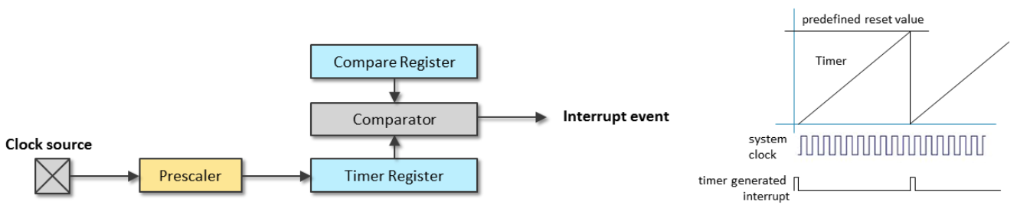
Timer Operation Mode – Compare mode
Typically, a standard timer may have three operation mode: compare mode capture mode, and PWM mode
Compare mode example:
  Preload the compare register with a desired value
  Timer register is incremented or decremented automatically at a certain frequency dictated by the prescaler.
  The values in the compare register and the timer register are automatically compared. Once equal, an interrupt can be generated, and the timer register should be reset.
Notes:
The main application of the compare-mode is to create a customized clock.
A downscaled (prescaled) system clock increments the timer register. If the preset value in the compare register is reached, a comparator creates an interrupt and the timer may be reset.

Slide 6
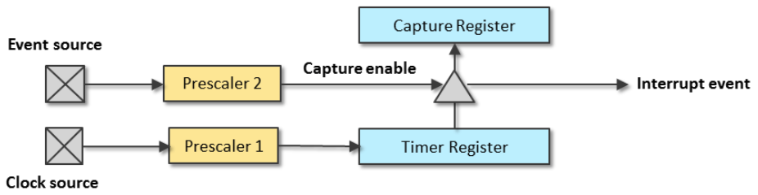
Timer Operation Mode – Capture mode
Capture mode example
  The event source generates a sequence of pulses.
  Optionally, the prescaler can be used to divide the frequency of the events.
  Once event (or frequency divided event) occurs, the capture will be enabled.
  The capture register then takes a ‘snapshot’ of the timer register at the moment when the event occurs.
  Optionally, the interrupt can be generated to notify the processor to perform some actions.
Notes:
The major application for capture mode timers is the measurement of time intervals.
As in compare mode, the timer register is regularly incremented or decremented by the system clock. However, the capture register may be triggered by an external event source, and perhaps also downscaled with a prescaler. After triggering, the capture register reads the current timer value and submits an event. This requires the processor to perform an action, such as reading the timer value from the capture register. The next event from the prescaler may result in a new reading. Its difference can be calculated into the time span between the two events.

Slide 7
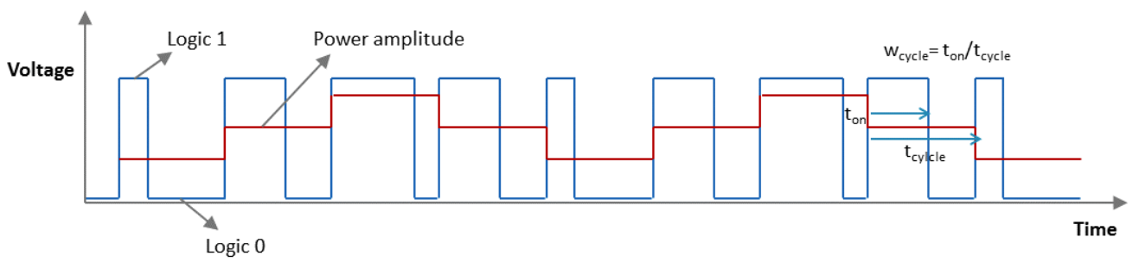
Timer Operation Mode – PWM mode
Pulse-width modulation mode example:
  Uses the width of a pulse to modulate an amplitude.
  The amplitude reflects the duty cycle, which describes the proportion of the ‘1’ state in one pulse period.
  Mainly used to control the power supplied to electrical devices.
  Pulse frequency ranges from few KHz (e.g. motor drive) to tens or hundreds of KHz (e.g. audio amplifier, computer power supplies).
Notes:
A pulse with modulation is used if a device cannot be controlled by amplitude, for example in the case of LEDs. Instead, the energy supplied to the device is regulated by on-off-intervals (= duty cycle) at the full amplitude. The cycle energy is wcycle= ton/tcycle in % of the maximum energy.
The red line represents the average power supplied. Notice that an increased duty cycle increases the average power supplied.
Analog output is more accurate than using PWM, but requires an additional DAC hardware which adds complexity and cost. PWM can realised with built-in timer resources with no need for extra hardware. Another advantage of PWM is it can be easily adapted to be used with a MOSFET diode or a relay to handle high power signals e.g. DC motor control. For this reason it is common to find much more PWM outputs than analog outputs on embedded microcontrollers.

Slide 8
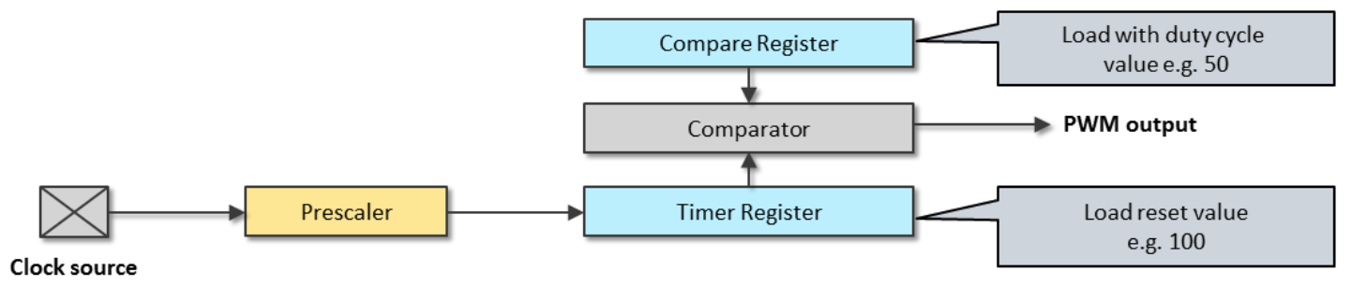
Timer Operation Mode – PWM mode
Example of PWM mode
  The PWM mode is similar to the compare mode.
  For example, to generate a 50% power output:
    Set timer register to reset when reaching 100
    Set compare register to 50
The implementation of the three modes of operation can differ among various devices.
Notes:
The PWM-mode is similar to the compare mode except that, in this instance, the timer is not automatically reset after reaching the compare value, but instead counts to the end or maximum value of the timer before it resets.
This means that two interrupts are generated: one compare interrupt and one timer-overflow-interrupt. These two interrupts can be used to switch the PWM and its duty cycle on and off.

Slide 9
mbed handbook
mbed Timer:
  https://docs.mbed.com/docs/mbed-os-api-reference/en/latest/APIs/tasks/Timer/
mbed Ticker:
  https://docs.mbed.com/docs/mbed-os-api-reference/en/latest/APIs/tasks/Ticker/
mbed PwmOut:
  https://docs.mbed.com/docs/mbed-os-api-reference/en/latest/APIs/io/PwmOut/

Slide 10
Create a new PlatformIO project
Create a new PlatformIO project.
I have named my project: ‘Nucleo-F072RB-mbed-PWM’
Nucleo F072RB board
mbed platform

Slide 11
PlatformIO.ini
[platformio]
build_cache_dir = .pio/mycache
[env:nucleo_f072rb]
platform = ststm32
board = nucleo_f072rb
framework = mbed
upload_protocol = stlink
monitor_speed = 115200

Slide 12
mbed_app.json
To get the printf statements to work properly you might require an additional settings file: mbed_app.json
Additional help here:
https://forums.mbed.com/t/float-printf-doesnt-work-in-desktop-version/9164
https://github.com/ARMmbed/mbed-os/blob/master/platform/source/minimal-printf/README.md
Hitchhikers guide to printf:
  https://forums.mbed.com/t/hitchhikers-guide-to-printf-in-mbed-6/12492

Slide 13
mbed_app.json – add this file in your project directory (next to the platformio.ini file)
{
"target_overrides": {
"*": {
"target.printf_lib": "std"
}
}
}

Slide 14
What are the IO pins for the Nucleo F072RB Discovery?
One method to find the pin names is to look inside the: ‘PinNames.h’ and ‘PeripheralPins.c’ library files.
You can find this file for your specific board by looking through the installed packages on your PC.
You can also find online ‘PeripheralPins.c’:
  https://os.mbed.com/users/mbed_official/code/mbed-dev/file/9c2029bfadbe/targets/TARGET_STM/TARGET_STM32F0/TARGET_NUCLEO_F072RB/PeripheralPins.c/
Or ‘PinNames.h’:
  https://os.mbed.com/users/mbed_official/code/mbed-dev/file/9c2029bfadbe/targets/TARGET_STM/TARGET_STM32F0/TARGET_NUCLEO_F072RB/PinNames.h/

Slide 15
Note about the AnalogIn read method
The AnalogIn read method uses a Mutex lock.
Mutex locks are not allowed in an ISR context.
ISR should be kept short, i.e. just set a flag in the ISR context and then do the AnalogIn read method and processing in the normal main thread context.

Slide 16
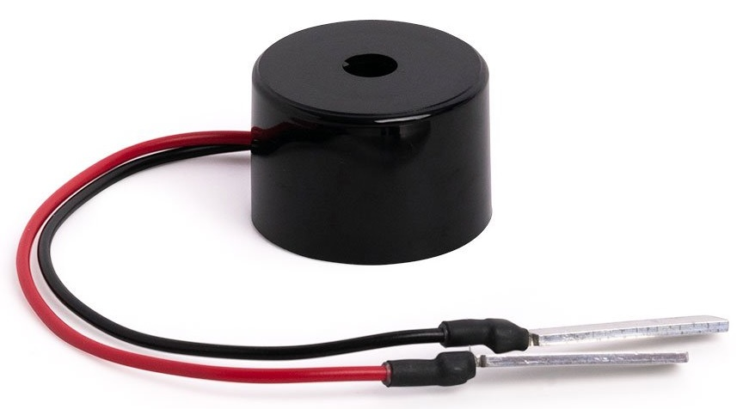
Playing Tunes with PWM
#include <mbed.h>
#define Do 261.63 // middle C
#define Re 293.66 // D
#define Mi 329.63 // E
#define Fa 349.23 // F
#define So 392.00 // G
#define La 440.00 // A
#define Si 493.88 // B
#define No 0 // no sound
#define b1 0.5 // half note
#define b2 0.25 // quarter note
#define b3 0.125 // eighth note
#define b4 0.0625 // sixteenth note
float note[] = { Mi,No,Mi,No,Mi,No, Mi,No,Mi,No,Mi,No, Mi,No,So,No,Do,No,Re,No,Mi,No, Fa,No,Fa,No,Fa,No,Fa,No, Fa,No,Mi,No,Mi,No,Mi,No,Mi,No, Mi,Re,No,Re,Mi, Re,No,So,No };
float beat[] = { b3,b3,b3,b3,b2,b2, b3,b3,b3,b3,b2,b2, b3,b3,b3,b3,b3,b3,b3,b3,b2,b1, b3,b3,b3,b3,b3,b3,b3,b3, b3,b3,b3,b3,b3,b3,b4,b4,b4,b4, b2,b3,b3,b2,b2, b2,b2,b2,b2 };
// The ADC on the Nucleo F072RB is a 12-bit ADC with a conversion range: 0 to 3.6 V
AnalogIn volume(PA_7); //D9 //PC_1); // pin labelled A4 on arduino headers
AnalogIn speed(PA_6); //PC_0); // pin labelled A5 on arduino headers
PwmOut buzzer(PH_6); //D10 // PA_8); // pin labelled D7 on arduino headers
DigitalOut led(LED1); // only 1 user led on Nucleo F072RB
// Create a BufferedSerial object to be used by the system I/O retarget code.
FileHandle *mbed::mbed_override_console(int fd) {
static BufferedSerial serial_port(USBTX, USBRX, 9600);
return &serial_port;
}
Ticker ticker;
volatile static unsigned k = 0;
volatile float speedValue;
volatile float volumeValue;
void onBeat();
int main() {
led = 1;
printf("PWM program start\r\n");
ticker.attach(&onBeat, 1000ms); // start playing in 1 second
while(1) {
// error fix - Analog reads do a mutex lock. Mutex lock is not allowed in an ISR context, so do in main instead:
// every few seconds lets take a new analog reading of our potentiometer values and store them.
volumeValue = volume.read();
float volumeVoltage = volumeValue * 3.3;
printf("volume (A4) is: %f convert to voltage is: %f \n", volumeValue, volumeVoltage);
speedValue = speed.read();
float speedVoltage = speedValue * 3.3;
printf("speed (A5) is: %f convert to voltage is: %f \n", speedValue, speedVoltage);
ThisThread::sleep_for(1s); // wait for 1 second
// printf should not be done in an ISR context either, so we can do here instead.
printf("k: %d, (sizeof(note)/sizeof(float)): %d \r\n", k, (sizeof(note)/sizeof(float)));
}
}
void onBeat() {
// if we have not reached the end of the note array
if (k < (sizeof(note)/sizeof(float) - 1)) {
if (note[k] == No) {
buzzer = 0;
led = 0;
}
else {
buzzer.period(1/note[k]); // period is the time taken to complete a full cycle of a wave, it is 1/frequency.
buzzer = 0.9*volumeValue; // sets the ouput duty-cycle, specified as a percentage between 0.0f = 0% and 1.0f = 100%.
// a higher duty cycle will have more on time and less off time.
// this means the average power will be higher and hence the volume will be higher as well, at least upto a point.
led = 1;
}
k++;
ticker.attach(&onBeat, (beat[k] / 2) + (speedValue / 2)); // reattach for the next note in the tune
} else {
k = 0;
buzzer = 0;
}
}
Try putting the following code into your main.cpp.
What tune does it play?
You will need a buzzer or speaker attached to PwmOut to listen. Some buzzers are 5v not 3.3v and may require extra power to run at a louder volume.
2x AnalogIn potentiometers control volume and speed.

Slide 17
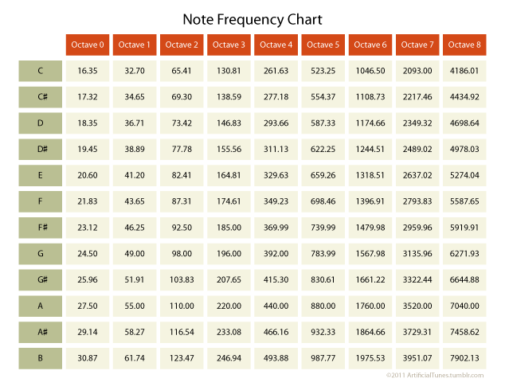

Slide 18
Activity 1
Can you make the speaker/buzzer play a different tune with PwmOut?
Can you change the brightness of coloured LEDs with PwmOut in time with the tune?

Slide 19
Activity 2
Find out what devices we have in lab which can run with PwmOut?
Can you create a DC motor controller with the PwmOut signals?
Can you control the position of a servo motor with PwmOut?
Use an oscilloscope to check the PwmOut duty cycle.

