Slide 1
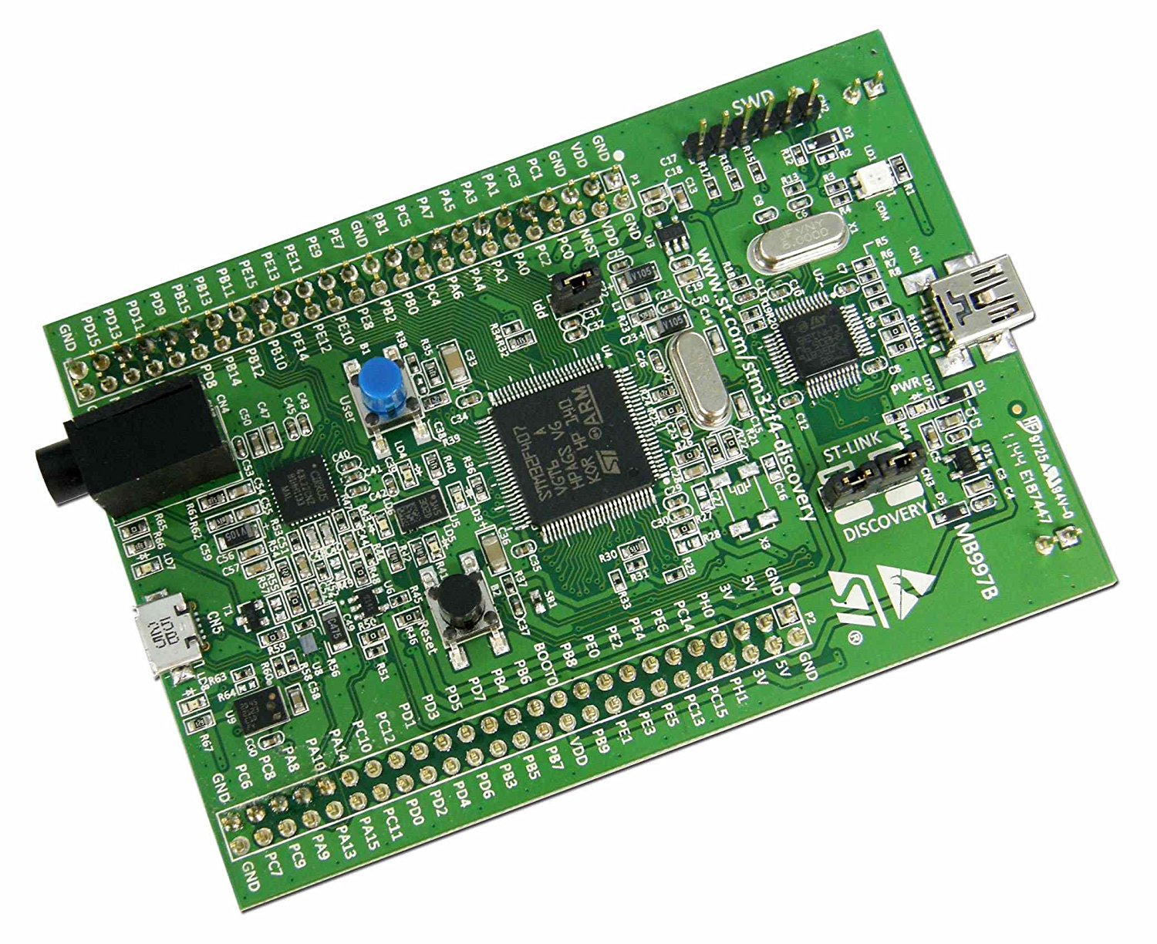
7058CEM – Embedded Systems Programming
Hardware and Software Interrupts with the STM32F4 Discovery board
Chris Bass

Slide 2
Today
Discussion about interrupts, first with underlying CMSIS and HAL libraries, then with the Arm mbed library.
Volatile keyword and when to use
Atomic and non-atomic operations (divisible)
  Race condition problem
  Critical sections and disabling interrupts
Programming with:
  Hardware Interrupts
  Polling
  Software Interrupts
Switch Debounce
Low power mode

Slide 3
How can we detect when a button is pressed?
One option is polling, i.e. using software to regularly check the status of a switch. However, polling is:
  Slow and inefficient: program needs to check to see if the switch is pressed repeatedly.
    E.g. is it pressed yet? no, …wait …how about now? no, …wait …poll again? no, wait again…
  Wasteful of CPU time: the faster the response needed, the higher the polling rate required.
  Not scalable: It is difficult to build and manage a multi-activity system that can respond quickly. The system’s response time depends on all the other processing it has to do.
Another option is to use an interrupt, i.e. using special hardware in the MCU to detect and run an Interrupt Service Routine (ISR) in response. An interrupt is:
  Efficient: the code runs only when necessary.
  Fast: it is a hardware mechanism.
  Scalable:
    ISR response time does not depend on most other processing.
    Code modules can be developed independently.
Polling is straightforward to implement for small programs – It is probably the technique you used during our last lab for DigitalIn.
But programming with interrupts is easier to manage as embedded systems get larger.

Slide 4
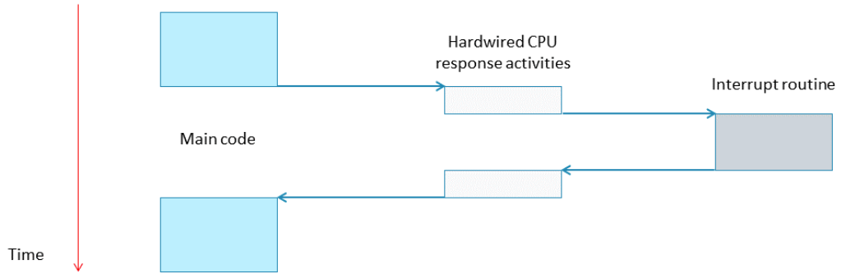
Interrupt or Exception Processing Sequence
Main code is running. When the interrupt trigger occurs:
  The processor does some hard-wired processing.
  The processor executes the ISR, including return-from interrupt instruction at the end.
Then the processor resumes running main code.

Slide 5
Interrupts
Hardware-triggered asynchronous software routine
  Triggered by hardware signal from peripheral or external device.
  Asynchronous: can happen anywhere in the program (unless interrupt is disabled).
  Software routine: Interrupt Service Routine runs in response to interrupt.
Fundamental mechanism of microcontrollers
  Provides efficient event-based processing rather than polling.
  Provides quick response to events regardless of the program state, complexity, or location.
  Allows many embedded systems to be responsive without an operating system (specifically task scheduler).

Slide 6
What happens when an exception occurs?
Finish current instruction.
Push context (registers) onto current stack (Main Stack Pointer or Process Stack Pointer).
Switch to handler/privileged mode, use MSP.
Load Program Counter (PC) with the address of the interrupt handler.
Load Link Register (LR) with EXC_RETURN code.
Load Interrupt Program Status Register (IPSR) with exception number.
Start executing code of the interrupt handler.
Usually 16 cycles from exception request to execution of the first instruction in the interrupt handler.
Code inside the Interrupt Service Routine (ISR) / Interrupt Handler is executed.
Exiting the Exception Handler:
Execute instruction triggering exception return processing.
Select return stack, restore context from stack.
Resume execution of code at the restored address.

Slide 7
Types of Interrupts
Hardware Interrupts
  Asynchronous: not related to what the processor is currently doing.
Exceptions, faults, software interrupts
  Synchronous: the result of specific instructions executing.
  Examples: undefined instructions, overflow occurs for a given register.
Some interrupts can be enabled or disabled, some cannot be disabled
Interrupt Service Routine (ISR) – also known as Interrupt Handler
  Subroutine which processor is forced to execute to respond to a specific event.
  After ISR completes, MCU goes back to previously executing code.

Slide 8
Nested Vectored Interrupt Controller (NVIC)
NVIC manages and priorities external interrupts.
Interrupts are types of exceptions.
Modes:
  Thread Mode: entered on reset.
  Handler Mode: entered on executing an exception.
Privilege level
Stack pointers:
  Main Stack Pointer (MSP) – Operating System – Protects from app exceptions.
  Process Stack Pointer (PSP) – User Applications.
Exception states: Inactive, Pending, Active, A&P

Slide 9
Core Exception Mask Register
Similar to ‘Global interrupt disable’ bit in other MCUs.
Use to prevent data race conditions with code needing atomicity.
  I.e. a section of code may need to run through from start to completion as if it were a single instruction.
  In this case we would not want an interrupt to happen in the middle of this code execution because it may put our system in an unstable state or cause a logic error.
  So to prevent this we can disable interrupts until our atomic code block is finished executing.
  Atomicity is a guarantee of isolation from interrupts, signals, concurrent processes and threads.

Slide 10
Exception Prioritization
Exceptions are prioritised to order the response to simultaneous requests (smaller number = higher priority).
Priorities of some exceptions are fixed.
  Reset: -3, highest priority.
  NMI: -2
  Hard Fault: -1
Priorities of other (peripheral) exceptions are adjustable.
  Value is stored in the interrupt priority register (IPR0-7)
If 2 exceptions happen at the same time the high priority exception with pre-empt the lower priority one.

Slide 11
Interrupt Response Latency
Latency = time delay
Why do we care?
  Overhead
  This delays our system response to external events, which may not be acceptable for a real-time system.
How much work should we do in an ISR?
  Trade-off: faster response time for ISR code will delay other code.
  In a system with multiple ISRs with short deadlines, perform critical work in the ISR and buffer partial results for later processing
How to communicate between ISR and other threads?
  Data buffering
  Data integrity and race conditions
    Volatile data: can be updated outside of the program’s immediate control.
    Non-atomic shared data: can be interrupted partway through read or write is vulnerable to race conditions.

Slide 12
Volatile data
Compilers assume that variables in memory do not change spontaneously, and optimize based on that belief:
  Do not reload a variable from memory if current function has not changed it.
  Read variable from memory into register (faster access)
  Write back to memory at the end of the procedure, or before a procedure call, or when compiler runs out of free registers.
This optimisation can fail.
  Example: reading from an input port, polling for key press
    while(SW_0); will read from SW_0 once and reuse that value.
    Will generate an infinite loop triggered by SW_0 being true.
Variables for which it fails.
  Memory-mapped peripheral register: register changes on its own.
  Global variables modified by an ISR: ISR changes the variable.
  Global variables in a multi-threaded application: another thread or ISR changes the variable.

Slide 13
The volatile keyword in C/C++
We need to tell the compiler which variables may change outside of its control.
Use volatile keyword to force the compiler to reload these variables from memory for each use
  I.e. stops optimisation.
volatile unsigned int num;
Pointer to a volatile int:
volatile int * var; // or
int volatile * var;
Now each C source read of a variable (e.g. status register) will result in an assembly language LDR instruction.
Note that we used volatile keyword to stop the compiler optimising out our delay counter in the previous lab.

Slide 14
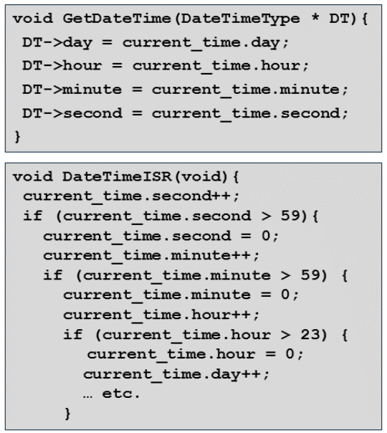
Non-atomic Shared Data – Race Condition Problem
Let’s say that we want to keep track of the current_time and date.
We use a 1 Hz software interrupt from a timer to update the DateTimeISR function (Interrupt Service Routine).
System:
  current_time structure tracks the time and days since some reference event.
  current_time fields are updated by periodic 1 Hz timer ISR
Update DateTimeISR() every 1 Hz

Slide 15
Example: Checking the Time
If the DateTimeISR() interrupts half way through the GetDateTime() we may end up with corrupted return data!
Problem: An interrupt at the wrong time will lead to half updated data in DT.
Failure case:
  current_time is {10, 23, 59, 59} {10th day, 23:59:59}
  Task code calls GetDateTime(), which starts copying the current_time fields to DT: day = 10, hour = 23.
  A timer interrupt occurs, which updated current_time to {11, 0, 0, 0}.
  GetDateTime() resumes executing, copying the remaining current_time fields to DT: minute = 0, second = 0.
  DT now has a time stamp of {10,23,0,0}.
  The system thinks the time just jumped backwards 1 hour!
Fundamental problem: ‘race condition’
  Pre-emption enables ISR to interrupt other code and possibly overwrite data.
  Must ensure atomic (indivisible) access to the object
    Native atomic object size depends on the processor’s instruction set and word size
    32 bits for Arm

Slide 16
Examining the problem more closely
Protect any data object which both:
  Requires multiple instructions to read and write (non-atomic access), and
  Is potentially written to by an ISR
How many tasks/ISRs can write to the data object?
  If one, then we have one-way communication
    Must ensure the data is not overwritten part-way through being read.
    Writer and reader do not interrupt each other.
  If more than one, we
    Must ensure the data is not overwritten part-way through being written.
    Writers do not interrupt each other.

Slide 17
Definitions
Race condition
  Unusual behaviour due to unexpected critical dependence on the relative timing of events. Result of example code depends on the relative timing of the read and write operations.
Critical section
  A section of code which creates a possible race condition. The code section can only be executed by one process at a time. Some synchronisation mechanism is required at the entry and exit of the critical section to ensure exclusive use.

Slide 18
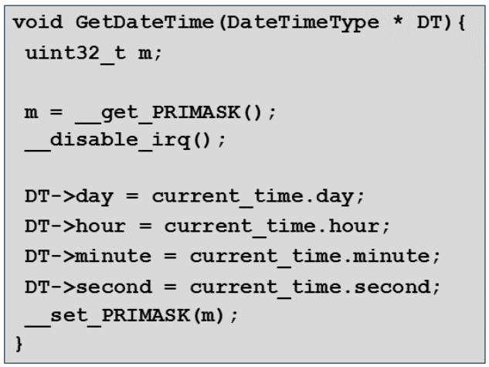
Solution: Briefly Disable Interrupts
Disable interrupts until the critical section in the function has finished execution.
Save current interrupt masking state in m.
Disable interrupts.
Restore previous interrupt masking state afterwards.
Use CMSIS-CORE to save, control and restore interrupt masking state.
Avoid disabling interrupts. Disabling delays response to all other processing requests.
Use as few instructions as possible.

Slide 19
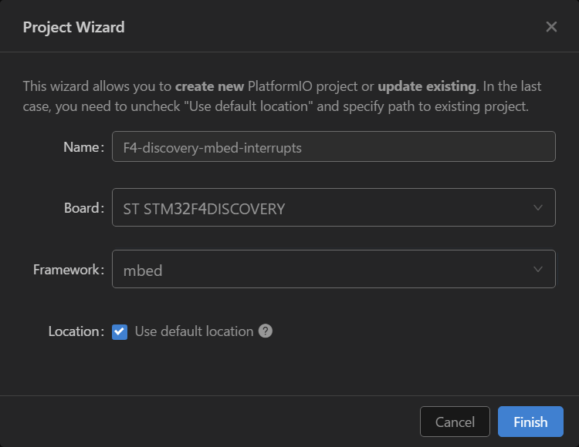
Create a new PlatformIO project
Project name:
  ‘F4-discovery-mbed-interrupts’
Board:
  STM32F4 Discovery
Framework:
  mbed

Slide 20
PlatformIO.ini
[platformio]​
build_cache_dir = .pio/mycache
[env:disco_f407vg]
platform = ststm32
board = disco_f407vg
framework = mbed
upload_protocol = stlink

Slide 21
What are the IO pins for the STM32F4 Discovery?
One method to find the pin names is to look inside the: ‘PinNames.h’ library file.
You can find this file for your specific board by looking through the installed packages. On my PC it is stored in the path:
  C:\Users\Chris\.platformio\packages\framework-mbed\targets\TARGET_STM\TARGET_STM32F4\TARGET_STM32F407xG\TARGET_DISCO_F407VG\PinNames.h
We have 4 coloured user LEDs for output and we have 1 button input.
Let’s create a hardware interrupt for the button to control the LEDs.

Slide 22
mbed handbook
Whenever we use a new mbed library class we can read all about it in the mbed handbook.
Let’s have a read about the: InterruptIn class:
  https://docs.mbed.com/docs/mbed-os-api-reference/en/latest/APIs/io/InterruptIn/
First note that InterruptIn is a class.
The constructor of the class accepts 1 input parameter called PinName pin.
The InterruptIn class has useful methods rise() and fall() which both accept 1 input parameter – a callback function.
Callback functions are implemented as a function pointer in C.
A Callback is any executable code that is passed as an argument to other code, which is expected to call back (execute) the argument at a given time.
In simple language, if a reference to a function is passed to another function as an argument to call it, then it will be called as a Callback function.

Slide 23
InterruptIn
#include <mbed.h>
DigitalOut greenLED(LED1); // PD_12
DigitalOut orangeLED(LED2); // PD_13
DigitalOut redLED(LED3); // PD_14
DigitalOut blueLED(LED4); // PD_15
InterruptIn blueButton(BUTTON1); // USER_BUTTON
void callbackFunction();
int main() {
blueButton.rise(&callbackFunction);
while(1) {
greenLED = !greenLED;
wait_us(1000 * 200);
}
}
void callbackFunction() {
orangeLED = !orangeLED;
wait_us(1000 * 1000);
}
Open the main.cpp file and populate with the following code.
An InterruptIn object is created for the blue user button and callback function is set to interrupt on the rising edge.
This is an example of a hardware interrupt.
It is asynchronous – we do not know when the user button will be pressed.

Slide 24
Activity 1
There is already an interrupt for toggling the green LED on the rising edge of the button.
Create another interrupt which will toggle the red LED on the falling edge of the button.
What do you notice about the operation of the interrupts?
What happens (or stops happening) when an interrupt is triggered?
What happens when a different interrupt occurs at the same time as an interrupt is already running?

Slide 25
Observations About Interrupts
Did you observe that the green LED stops blinking when an interrupt is running?
Interrupt 1 occurs
Interrupt handler
Interrupt 1
Main thread
Blink greenLED
Blink greenLED
Time

Slide 26
Observations About Interrupts
Did you observe that when a 2nd different interrupt occurs at the same time as the 1st interrupt is running that it is put into a queue and processes immediately after the 1st interrupt completes?
If interrupts keep occurring, it is possible that the greenLED stops flashing altogether!
Interrupt 2 occurs
Interrupt 1
Interrupt handler
Interrupt 1
Interrupt 2
Main thread
Blink greenLED
Blink g…
Time

Slide 27
Some ‘Soft’ Rules for Programming Interrupts
Rule 1 – you do not talk about interrupts.
Rule 2 – you do not talk about interrupts.
Rule 1 – Do not use wait() in callbacks.
Rule 2 – Avoid printf() statements in callbacks.
Rule 3 – Try to keep interrupts as short as possible.
Why? – because we want to keep our program responsive.

Slide 28
Using Hardware Interrupts to Set Flags for a Polling System
#include <mbed.h>
DigitalOut greenLED(LED1); // PD_12
DigitalOut orangeLED(LED2); // PD_13
DigitalOut redLED(LED3); // PD_14
DigitalOut blueLED(LED4); // PD_15
InterruptIn blueButton(BUTTON1); // USER_BUTTON
volatile bool orangeFlag = false;
volatile bool redFlag = false;
void callbackFunction1();
void callbackFunction2();
int main() {
blueButton.rise(&callbackFunction1);
blueButton.fall(&callbackFunction2);
while(1) {
greenLED = !greenLED;
wait_us(1000 * 200);
if (orangeFlag) {
orangeLED = !orangeLED;
wait_us(1000);
orangeFlag = false;
}
if (redFlag) {
redLED = !redLED;
wait_us(1000);
redFlag = false;
}
}
}
void callbackFunction1() {
orangeFlag = true;
}
void callbackFunction2() {
redFlag = true;
}
One method for keeping interrupt routines short is by the use of flags.
I.e. when an interrupt is triggered, just set a flag that the interrupt has happened and then go back to the main polling loop, which can check if the flag has been set and handle the response inside the polling loop code.
See the following code for an example of this.
One possible advantage of this approach is that the green LED will toggle at least once and not be completely stopped from flashing even when interrupts keep occurring in rapid succession (up to a point).
The system now behaves in a very similar manner to an ordinary polling setup.
However, this way is more efficient because the added interrupt flags will mean that the system will not miss any quick/short input to the system which maybe missed by a pure polling system.

Slide 29
Using the Volatile Qualifier
#include <mbed.h>
DigitalOut greenLED(PD_12);
DigitalOut orangeLED(PD_13);
DigitalOut redLED(PD_14);
DigitalOut blueLED(PD_15);
InterruptIn blueButton(USER_BUTTON);
bool orangeFlag = false;
volatile bool redFlag = false;
void callbackFunction1();
void callbackFunction2();
int main() {
blueButton.rise(&callbackFunction1);
blueButton.fall(&callbackFunction2);
while(1) {
greenLED = !greenLED;
if (orangeFlag) {
orangeLED = !orangeLED;
orangeFlag = false;
}
if (redFlag) {
redLED = !redLED;
redFlag = false;
}
}
}
void callbackFunction1() {
orangeFlag = true;
}
void callbackFunction2() {
redFlag = true;
}
In the previous code notice that we used the keyword volatile for the interrupt flags.
This is important, because the optimiser may optimise the logic from our code when dealing with the interrupt flags, thinking that the value of the flags has not changed, when in fact it has.
See the following code which should demonstrate an example of why using the volatile keyword is important:
The wait(0.2) had to be removed, just to show the issue.
As you are running this example, note that the interrupt flags need to be made volatile, because the optimiser will think that they do not change inside the polling loop – The optimiser does not consider that they could change in the interrupt service routines.

Slide 30
Using Software Interrupts
Now there is still the issue of using wait() in our code to make our LEDs flash at a specific rate.
The wait() function is a bad solution because it blocks our program from doing anything useful while it is waiting.
One way round this is the use of multi-threading, which we could achieve with the help of a Real Time Operating System (RTOS). We will explore RTOS in a later part of the module.
Another solution is to make use of a combination of timers to trigger software interrupts.
A software interrupt is classified as synchronous, because we know when it will occur.
Let’s use this approach to avoid using a wait() function altogether.
Let’s have a look at the ‘Timeout’ and ‘Ticker’ classes for generating software interrupts.

Slide 31
More in the mbed handbook
Timeout
  https://docs.mbed.com/docs/mbed-os-api-reference/en/latest/APIs/tasks/TimeOut/
Ticker
  https://docs.mbed.com/docs/mbed-os-api-reference/en/latest/APIs/tasks/Ticker/
Not to be confused with:
Timer
  https://docs.mbed.com/docs/mbed-os-api-reference/en/latest/APIs/tasks/Timer/

Slide 32
Applying Software Interrupts – Ticker and Timeout Objects
#include <mbed.h>
DigitalOut greenLED(PD_12);
DigitalOut orangeLED(PD_13);
DigitalOut redLED(PD_14);
DigitalOut blueLED(PD_15);
InterruptIn blueButton(USER_BUTTON);
Ticker tickerGreenOn; // ticker will repeatedly call
Timeout timeoutGreenOff; // timeout calls once
volatile bool orangeFlag = false;
volatile bool redFlag = false;
void callbackOrangeFlag();
void callbackRedFlag();
void callbackGreenOn();
void callbackGreenOff();
int main() {
blueButton.rise(&callbackOrangeFlag);
blueButton.fall(&callbackRedFlag);
greenLED = 1;
tickerGreenOn.attach(&callbackGreenOn, 0.4); // ticker turns green on every 0.4 seconds
while(1) {
if (orangeFlag) {
orangeLED = !orangeLED;
wait(1);
orangeFlag = false;
}
if (redFlag) {
redLED = !redLED;
wait(1);
redFlag = false;
}
}
}
void callbackOrangeFlag() {
orangeFlag = true;
}
void callbackRedFlag() {
redFlag = true;
}
void callbackGreenOn() {
greenLED = 1;
timeoutGreenOff.detach();
timeoutGreenOff.attach(&callbackGreenOff, 0.2); // turn off after 0.2 seconds
}
void callbackGreenOff() {
greenLED = 0;
}
This code uses a combination of software interrupts with Ticker and Timeout objects.
Notice that now we have removed the need for a blocking wait(0.2) function to blink the greenLED.
Clever use of hardware and software interrupts together with flags and polling has made our system much more responsive. i.e. we can flash the greenLED and respond to the orange and red interrupts at the same time!
Note the wait(1) function calls are only left in the code to represent a long and complex piece of code. Remember we moved these out of the interrupt service routines earlier to avoid locking up our system with long interrupts.

Slide 33
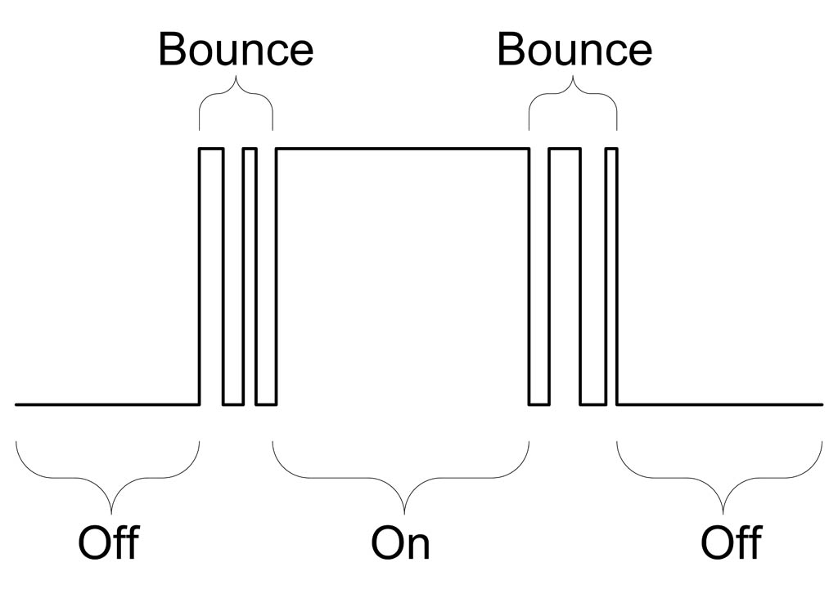
Button Bounce
Have you noticed that when you press the button that the interrupt sometimes triggers twice on the rise or fall of the digital input?
This fault is caused by switch/button ‘bounce’.
Sometimes the rise or fall is registered twice in error due to button ‘bounce’.

Slide 34
Activity 2 – Button De-bounce
How do you think we can solve the issue of button bounce?
Can you add to our piece of code which will solve the button bounce issue?

Slide 35
Button De-bounce Solution
#include <mbed.h>
DigitalOut greenLED(PD_12);
DigitalOut orangeLED(PD_13);
DigitalOut redLED(PD_14);
DigitalOut blueLED(PD_15);
InterruptIn blueButton(USER_BUTTON);
Ticker tickerGreenOn;
Timeout timeoutGreenOff;
Timeout timeoutOrangeDebounce;
volatile bool orangeFlag = false;
volatile bool redFlag = false;
void callbackOrangeFlag();
void callbackRedFlag();
void callbackGreenOn();
void callbackGreenOff();
void callbackOrangeDebounce();
int main() {
blueButton.rise(&callbackOrangeFlag);
blueButton.fall(&callbackRedFlag);
greenLED = 1;
tickerGreenOn.attach(&callbackGreenOn, 0.4); // ticker turns green on every 0.4 seconds
while(1) {
if (orangeFlag) {
orangeLED = !orangeLED;
orangeFlag = false;
}
if (redFlag) {
redLED = !redLED;
redFlag = false;
}
}
}
void callbackOrangeFlag() {
orangeFlag = true;
blueButton.rise(NULL); // temporarily cancel this interrupt to avoid bounce
timeoutOrangeDebounce.attach(&callbackOrangeDebounce, 0.3); // enable this interrupt again only after 0.3 seconds
}
void callbackRedFlag() {
redFlag = true;
}
void callbackGreenOn() {
greenLED = 1;
timeoutGreenOff.detach();
timeoutGreenOff.attach(&callbackGreenOff, 0.2); // turn off after 0.2 seconds
}
void callbackGreenOff() {
greenLED = 0;
}
void callbackOrangeDebounce() {
blueButton.rise(&callbackOrangeFlag); // enable the interrupt again
blueLED = !blueLED; // just for debugging, to see when this function is called
}
One possible solution to this issue is by using a Timer or a Timeout.
Here is my code solution:
When running this example, notice when you ‘double click’ the user button in rapid succession that the orangeLED will only toggle once.
We now have to wait 0.3 seconds for the interrupt to be enabled again.
Just for debugging, you can see that the blueLED will toggle when it is ready.

Slide 36
A final point about ‘using hardware interrupts to set flags for a polling system’
#include <mbed.h>
DigitalOut greenLED(PD_12);
DigitalOut orangeLED(PD_13);
DigitalOut redLED(PD_14);
DigitalOut blueLED(PD_15);
InterruptIn blueButton(USER_BUTTON);
Ticker tickerGreenOn;
Timeout timeoutGreenOff;
Timeout timeoutOrangeDebounce;
volatile bool orangeFlag = false;
volatile bool redFlag = false;
void callbackOrangeFlag();
void callbackRedFlag();
void callbackGreenOn();
void callbackGreenOff();
void callbackOrangeDebounce();
int main() {
blueButton.rise(&callbackOrangeFlag);
blueButton.fall(&callbackRedFlag);
greenLED = 1;
tickerGreenOn.attach(&callbackGreenOn, 0.4);
while(1) {
wait(1); // both rise and fall trigger here, orangeLED toggles before redLED
if (orangeFlag) {
orangeLED = !orangeLED;
orangeFlag = false;
}
wait(1); // both rise and fall trigger here, redLED toggles before orangeLED
if (redFlag) {
redLED = !redLED;
redFlag = false;
}
}
}
void callbackOrangeFlag() {
orangeFlag = true;
blueButton.rise(NULL);
timeoutOrangeDebounce.attach(&callbackOrangeDebounce, 0.3);
}
void callbackRedFlag() {
redFlag = true;
}
void callbackGreenOn() {
greenLED = 1;
timeoutGreenOff.detach();
timeoutGreenOff.attach(&callbackGreenOff, 0.2);
}
void callbackGreenOff() {
greenLED = 0;
}
void callbackOrangeDebounce() {
blueButton.rise(&callbackOrangeFlag);
blueLED = !blueLED;
}
Both rise and fall interrupts could happen here or here
Pressing the user button triggers a rising interrupt.
Depressing the user button triggers a falling interrupt.
Note that even if the rising interrupt triggers before the falling interrupt (as it would on a normal button click), that both flags will be set.
Also note that these interrupts can occur at any point during the main polling loop.
This means that the falling flag could be handled before the rising flag even if the interrupts did not trigger in that order, i.e. order is not preserved.
Therefore on a normal button click the redLED can toggle before the orangeLED, i.e. out of (possibly expected) order.
This behaviour is caused by when the interrupts occur.
The following code adds some wait(1) statements to make this behaviour more noticeable under observation:

Slide 37
Low power mode
The mbed library contains a sleep function which will put the microcontroller into a low power mode by disabling the main clock.
It essentially invokes the __wfi() function (wait for interrupt – is part of CMSIS-Core) which puts the microcontroller into a sleep mode and will only be woken up again when an interrupt occurs.
This is great for systems with a low power requirement, such as infrequent IoT data loggers, where the system may only need to wake up from sleep mode once every hour to take a few sensor measurements and transmit them before going back to sleep mode again.
In these kinds of systems a low power platform and implementation become very important as it will save on power usage in the overall design.
This could be especially important for systems which run on batteries, so that the battery does not need to be replaced frequently.
Let’s see an example of the low power sleep() mode next:

Slide 38
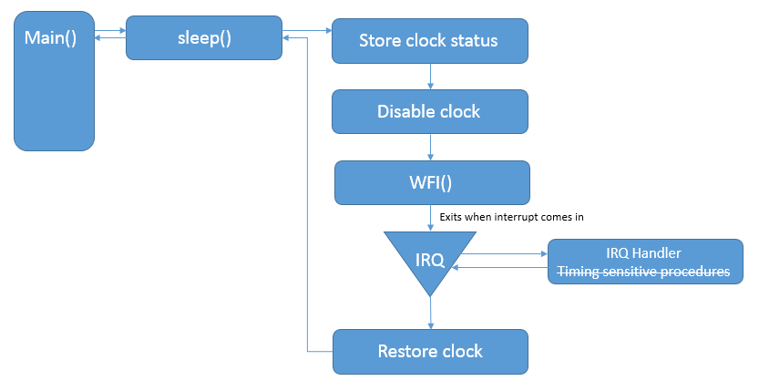
Low power sleep() example
#include <mbed.h>
DigitalOut greenLED(PD_12);
DigitalOut orangeLED(PD_13);
DigitalOut redLED(PD_14);
DigitalOut blueLED(PD_15);
InterruptIn blueButton(USER_BUTTON);
Timeout timeoutDebounce;
void wakeUp();
void debounce();
int main() {
blueButton.rise(&wakeUp);
while(1) {
orangeLED = !orangeLED;
greenLED = 1; // turn on greenLED and sleep
sleep(); // greenLED on shows low power sleep mode on
greenLED = 0; // on waking up turn greenLED off
wait(1);
}
}
void wakeUp() {
blueButton.rise(NULL);
timeoutDebounce.attach(&debounce, 0.3);
redLED = !redLED;
wait(1);
}
void debounce() {
blueButton.rise(&wakeUp);
blueLED = !blueLED;
wait(1);
}
Note that when the low power sleep mode is on the main polling loop pauses execution (because the main clock is turned off).

Slide 39
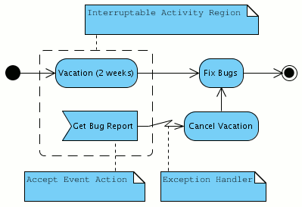
Presenting Interrupts in UML Activity Diagrams
Example from: A Brief Introduction into UML 2:
  http://metagear.de/articles/uml-introduction/index.html

Slide 40
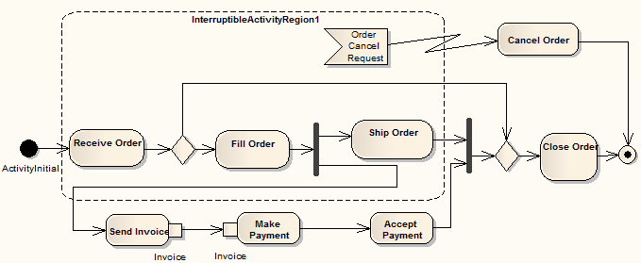
Presenting Interrupts in UML Activity Diagrams
Example from: Interruptible Activity Region:
  http://sparxsystems.com/enterprise_architect_user_guide/11/standard_uml_models/interruptibleactivityregion.html

Slide 41
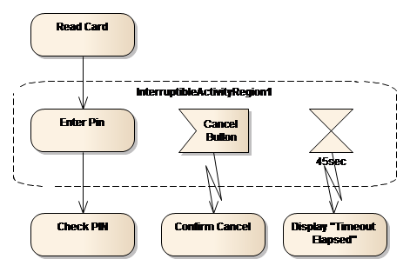
Presenting Interrupts in UML Activity Diagrams
Example from: Interrupt Region:
  https://www.sparxsystems.eu/resources/project-development-with-uml-and-ea/activity-diagram/

Slide 42
References
Regarding interrupts, their use and blocking:
  https://os.mbed.com/users/AjK/notebook/regarding-interrupts-use-and-blocking/
Timers interrupts and tasks:
  https://os.mbed.com/teams/TVZ-Mechatronics-Team/wiki/Timers-interrupts-and-tasks
Pushbuttons and Switches
  https://os.mbed.com/users/4180_1/notebook/pushbuttons/
Power management:
  https://os.mbed.com/docs/v5.8/reference/power-management.html
Silicon Labs – Using the improved mbed sleep API
  https://os.mbed.com/teams/SiliconLabs/wiki/Using-the-improved-mbed-sleep-API

Slide 43
Interrupts in UML Activity Diagrams
Interruptible Activity Region:
  http://sparxsystems.com/enterprise_architect_user_guide/11/standard_uml_models/interruptibleactivityregion.html
Interrupt Region:
  https://www.sparxsystems.eu/resources/project-development-with-uml-and-ea/activity-diagram/
A Brief Introduction into UML 2:
  http://metagear.de/articles/uml-introduction/index.html
Visual Paradigm Activity Diagram:
  https://www.visual-paradigm.com/learning/handbooks/software-design-handbook/activity-diagram.jsp

Slide 44
Note about debugging in PlatformIO
PIO Unified debugger is not part of the free version of PlatformIO
This is a free variable viewer – maybe useful, but not a full debugger:
https://os.mbed.com/users/wim/notebook/stm-studio-viewer/

