Slide 1
5050CEM
Programming for Engineers
Tutorial 17
C++ Unit Testing in Visual Studio
Chris Bass

Slide 2

Objectives for Today
Unit Testing in C++
CppUnitTest framework
Work through the ‘Write unit tests for C/C++ in Visual Studio’ online tutorial by Microsoft Visual Studio.
Test Driven Development – TDD
Profiling in Visual Studio (5051CEM) – add breakpoints start and end, then measure CPU time for each part. Parts with high CPU time require more consideration for optimisation.

Slide 3

Activity 1 – Clone the C++ project from here:
https://github.coventry.ac.uk/5050CEM-5051CEM-2122SEPJAN/TEACH-unit-test-activity
This project contains a few Classes, methods, and functions which perform some geometry calculations such as line circle intersections, etc.
But the project does not contain any unit tests, yet.
These functions might be useful for our CodinGame activities, but before we use them we need to test they actually work.
We will create a Unit Test suite to check their operation.

Slide 4
C++ Unit Testing in Visual Studio
We will be roughly following the Microsoft tutorial for C++ unit testing in Visual Studio:
  https://docs.microsoft.com/en-us/visualstudio/test/writing-unit-tests-for-c-cpp?view=vs-2019
Next slides:
Add a new “Native Unit Test Project” project to your solution.
Add a reference to link your unit test project to your main project.
In the unit test project, add an #include "../MyProgram/MyClass.h"
Write your test methods using Assert::IsTrue() and Assert::AreEqual() to make your checks.
View and run your tests under Test → Test Explorer.

Slide 5
Activity 2 – Create a Unit Test project as part of the solution
Right-click solution → add… → new project →
Search for and select “Native Unit Test Project”
This one uses the CppUnitTest framework which will be great for our project.
Note that there are many unit testing frameworks all with slightly different syntax, but there are often similarities for their usage.

Slide 6
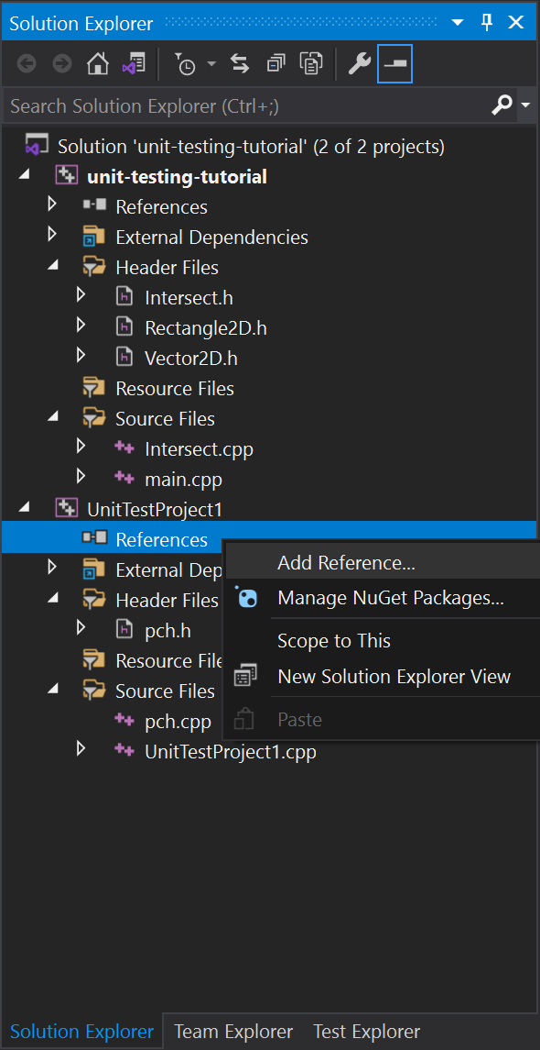
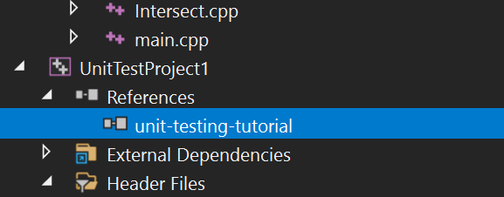
Create references to other projects in the solution
Right-click on References under your new test project node in Solution Explorer for a pop-up menu.
Choose Add > Reference.
In the Add Reference dialog, choose the project(s) you want to test.

Slide 7
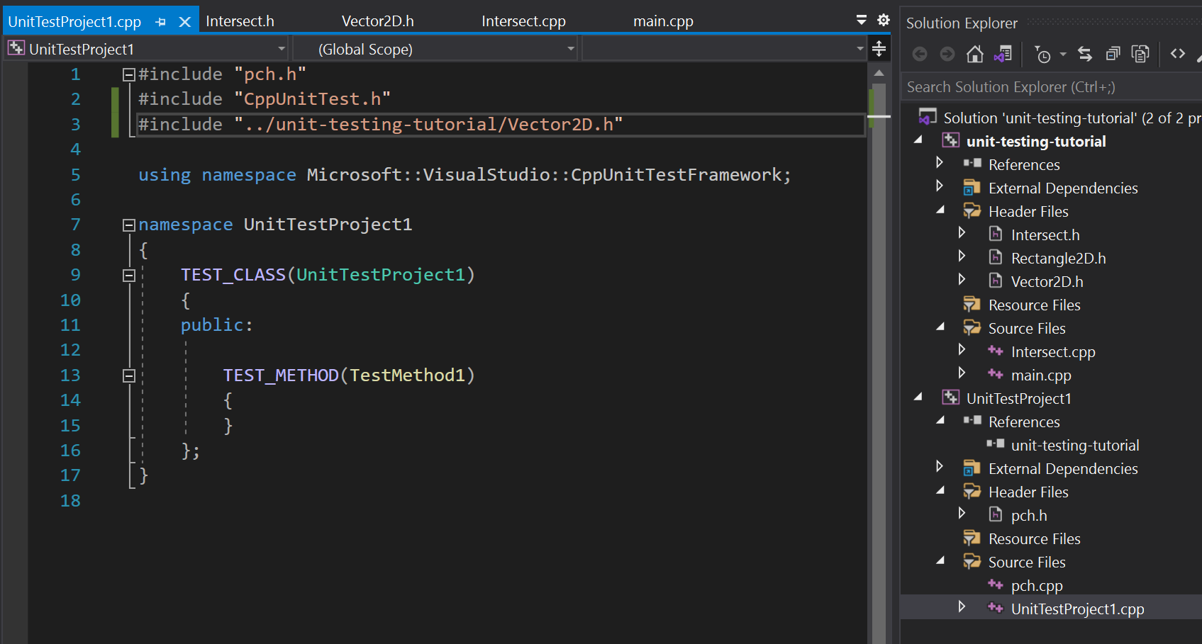
Add #include directives for header files
Note the ../ at the start of the path to navigate the directory structure.

Slide 8
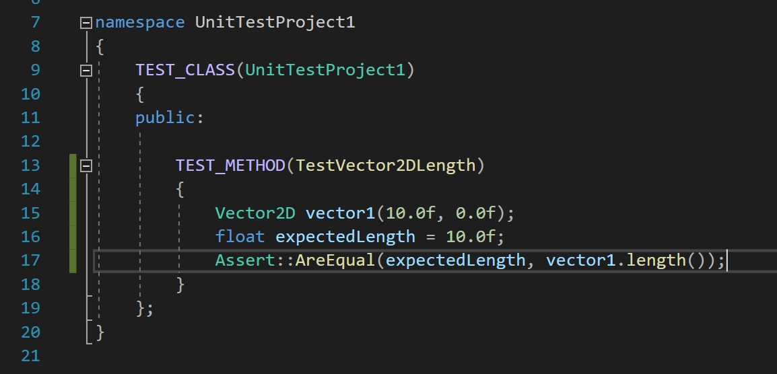
Write test methods
Here we want to check the expectedLength against the method return so we do an Assert::AreEqual test.

Slide 9
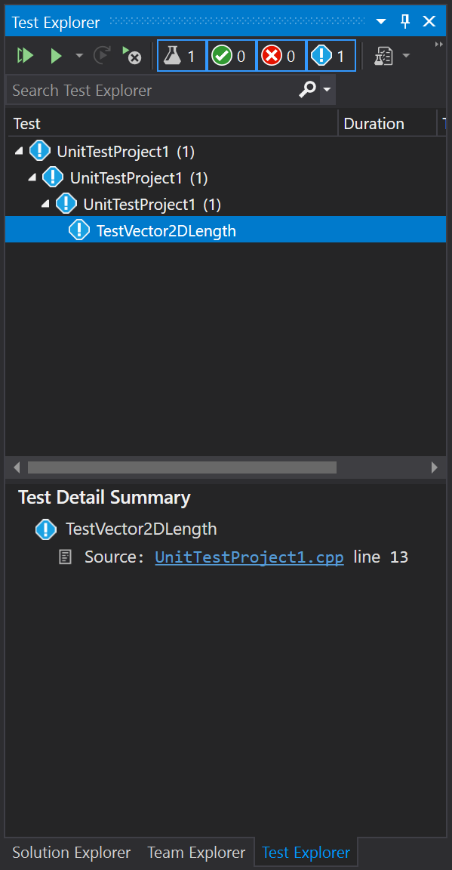
Run the Test
Test menu → Test Explorer.
Build your project. Build → Build solution.
Test explorer → Run all

Slide 10
Activity 3 – Create a new TEST_METHOD for a different Vector2D object and test length again.
It is best practice to stick with one assert in each test in order to avoid losing information. Proper unit tests should fail for exactly one reason, that is why you should be using one assert per unit test.
Create a new Vector2D object, then write an Assert::AreEqual() to check that the length method works for a different expectedLength.
Try to have 1 unit test (TEST_METHOD()) for checking x, one for y, one for x and y at the same time, one for negatives, and one for zeros.
Also, break the test on purpose to see what happens when a test is failing.

Slide 11
Activity 4 – Create a new TEST_METHOD for the normalize method.
Write a new “TEST_METHOD(TestVector2DNormalize)”, which will check if the normalize method in Vector2D does what it is supposed to do.
Write Assert::AreEqual() statements which check different vectors, e.g. Up, Down, Diagonal, Negative, Also try a Zero vector.
Normalize in vector mathematics means:
  To normalize something means to scale a vector to make it a unit vector.

Slide 12
Tricky Error for Assert::AreEqual between complex types
If running into error such as: Error C2338: Test writer must define specialization of ToString<const Q& q> for your class …
You can define your own ToString method such as:
template<>
inline std::wstring Microsoft::VisualStudio::CppUnitTestFramework::ToString<Vector2D>(const Vector2D& v)
{
std::wstring output = L"Vector2D(" +
std::to_wstring(v.x) + L", " + std::to_wstring(v.y) + L")";
return output;
}
Put this at the top of your UnitTestProject1.cpp file outside of any namespace. This will print the x and y values of the Vector2D to the test message console.

Slide 13
Activity 5 – Create a new TEST_CLASS for the Intersect.h file.
Create a new TEST_CLASS() for the Intersect.h file.
Pick one of the intersection functions you would like to test.
Write Unit Tests for the intersection function to check it calculates the intersection points correctly.

Slide 14
LNK… Linker errors.
If you are getting a linker error such as:
Error LNK2019 unresolved external symbol "class std::vector<class Vector2D,class std::allocator<class Vector2D> > __cdecl intersect::ray_linesegment(class Vector2D,class Vector2D,class Vector2D,class Vector2D)“
Then we need to make sure that the test project can find the our .obj files to link to.
Right-click UnitTestProject1 → Properties → Linker → Input → Additional Dependencies → Edit → then add the path to your .obj files, could try something like:
$(SolutionDir)$(IntDir)*.obj
https://stackoverflow.com/questions/47722333/linker-error-while-unit-testing-with-visual-studio-c

Slide 15
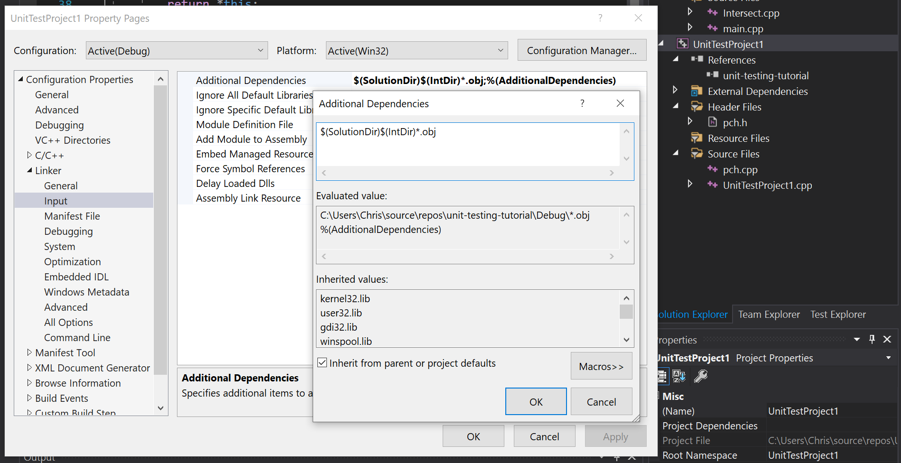
Evaluates to on my PC.

Slide 16
Activity 6 – Create a new TEST_CLASS for the Rectangle2D class.
Create a new TEST_CLASS() for the Rectangle2D class.
Test that one Rectangle is equal to another Rectangle.
You might get an error such as:
Error C2676 binary '==': 'const T' does not define this operator or a conversion to a type acceptable to the predefined operator UnitTestProject1 C:\Program Files (x86)\Microsoft Visual Studio\2019\Community\VC\Auxiliary\VS\UnitTest\include\CppUnitTestAssert.h 137

Slide 17
Assert::AreEqual
In order to use Assert::AreEqual with your own custom class types you will need to override the operator== for your custom classes.
For example you can do something like:
class Vector2D { //...
bool operator==(const Vector2D& v) const {
return x == v.x && y == v.y;
}
}
Override the operator== for your Rectangle2D class in a similar way to how it was done in Vector2D.
Then override the ToString for the Rectangle2D UnitTest similar to how we did for Vector2D (slide 12).

Slide 18
Activity 7 – Test the Rectangle2D ray_intersect() method.
Create a new TEST_CLASS() for the Rectangle2D class.
Test the ray_intersect() method.
Write Unit Tests for the ray_intersect() method to check it calculates the intersection points correctly.

Slide 19
Test driven development (TDD) –
(part of Agile Software development methodology)
Test driven development (or TDD) is the idea that the unit test should be written before the code which passes the test. Method as follows:
Write a “single” unit test describing an aspect of the program.
Run the test, which should fail because the program lacks that feature.
Write “just enough” code, the simplest possible, to make the test pass.
“Refactor” the code until it conforms to the simplicity criteria.
Repeat, “accumulating” unit tests over time.

Slide 20
Activity 8 – Test driven development (TDD)
First write a new unit test for a Rectangle2D::line_intersect() method for the Rectangle class (which does not exist yet).
Run the test, it should fail.
Write a Rectangle::line_intersect() method which passes your unit test.
Refactor your code to improve its readability.
Add 2-3 more unit tests for the Rectangle::line_intersect() method to confirm operation for specific test cases.

Slide 21
Finding hidden bugs with good Unit Tests and solving with std::unique()
Find the bug with duplicated data points on Rectangle::line_intersect.
  Try a Unit Test with a 45-degree line touching one corner of the rectangle intersection (should return a single intersection point, not 2x intersections).
Then look at these links for std::vector::erase and std::unique for how to remove duplicate Intersection points:
https://stackoverflow.com/questions/1041620/whats-the-most-efficient-way-to-erase-duplicates-and-sort-a-vector
https://en.cppreference.com/w/cpp/algorithm/unique

Slide 22
Profiling in Visual Studio (5051CEM)
To do – look at profiling:
  https://docs.microsoft.com/en-us/visualstudio/profiling/profiling-feature-tour?view=vs-2019
Perhaps do the 2x breakpoint method, i.e. add 2 breakpoints and measure the elapsed time between each.
For optimising focus on functions which are called a lot. E.g. nested looping to call a function 100,000 times means any performance gains are amplified 100,000 times…

Slide 23
References / Extra Reading
TDD:
  https://www.agilealliance.org/glossary/tdd/

