Slide 1

5050CEM
Programming for Engineers
Tutorial 8
Text File IO

Slide 2

Last Tutorial
Introduction to classes and objects
Car class
Creating an instance of a class
myCarObject.drive();
Class member variables (attributes)
Class member functions (methods)
Access specifiers (public, private)

Slide 3

Today
Text File IO
Reading from text files
  std::ifstream
  Using the input file stream class
Writing to text files
  std::ofstream
  Using the output file stream
std::string
std::rand

Slide 4
Reading from text files
Create a std::ifstream object
  Standard input file stream
Open the text file
Read from the text file
  Line by line
  Character by character
  Token by token
Close the text file
Also do some error checking on the input

Slide 5
Error Checking on Reading
Read, then check – read, then check…

Slide 6
Writing to text files
Create a std::ofstream object
  Standard output file stream
Open the text file
Write to the text file
Close the text file

Slide 7
CLion – setting the Current Working Directory
In CLion IDE you can set the CWD to help with finding input text files and your project directory structure.
Via the “Edit Run Configurations…” drop down -> Working directory -> Insert Macros -> $ProjectFileDir$
I have set to $ProjectFileDir$ and allows me to put my input text files next to my source files.
https://www.jetbrains.com/help/clion/2022.2/configuring-third-party-tools.html
https://www.youtube.com/watch?v=dTtZEAfh_LM

Slide 8
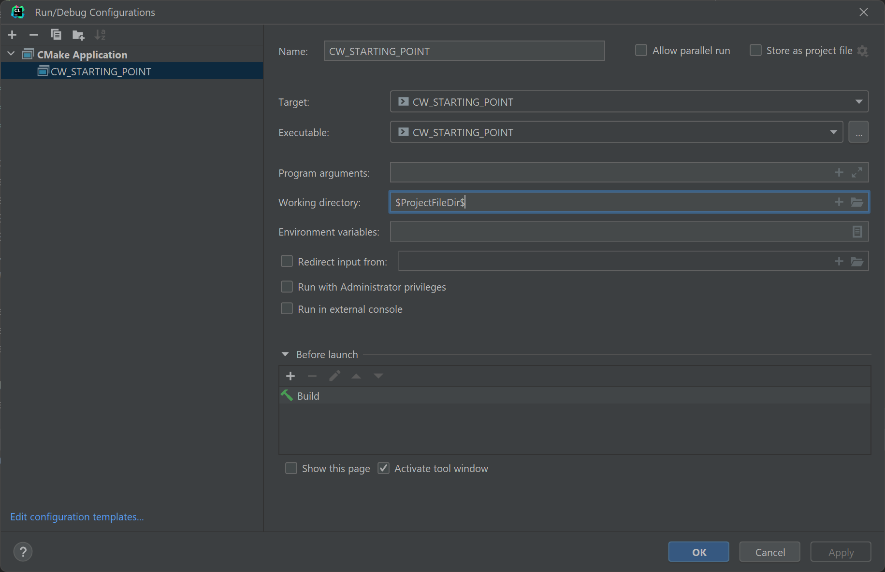
CLion – setting the Current Working Directory

Slide 9

Activity 1 – Text File IO
Download the Text File IO code from Moodle
Create a new console application in Visual Studio and try to get the code running
You will need to put the input text files inside of your project directory

Slide 10
Activity 2 – Word search
One implementation of reading from the input text file stores each word in a std::string
Modify this part of the program so that it will search for a particular word in your input text file and store a count of how many times that word appears
Output the number of times that word appears after the file has been read

Slide 11
Activity 3 – Random numbers
Pseudo random number generator
std::rand
Download the random number dice game program from Moodle, it is under the section programming functions
After you have got it working and explored what it does, have a think about how you could keep a leader board for the all time best total score
You will need to keep track of the all time best score using a text file output
The program should display the all time best score every time the program is run

Slide 12
Activity 4 – std::stringstream
Using the stringstream library, convert the following string literals from a string to a double:
  "47,001"
  "122,234"
  "0,9999"
Note that you will need to convert from a ',' to a '.' for the decimal place first.
Write it as a function called unformatData(), which accepts a string parameter and returns a double so that it can be called from the main 3 times such as:
double answer1 = unformatData("47,001");
double answer2 = unformatData("122,234");
double answer3 = unformatData("0,9999");

Slide 13
Activity 5 – stringstream and getline()
The getline() function can be used with a stringstream object and a delimiter to separate a string out into multiple strings.
getline(ss, token, delimiter);
Where ss is the stringstream, token is the output string after parsing, and delimiter is the character to break at.
Use the getline() function together with a stringstream object to break apart the following string literal into 3 strings, and then use your function from Activity 4 to convert them to 3 doubles.
"47,001;122,234;0,9999"
Token 1
Token 2
Token 3

Slide 14

CodinGame Activity 6
Break into mini competition groups (desk of 6?)
With everyone on your desk/group starting at the same time, (wait/help the rest of the group to complete the previous task first), see who can solve the following CodinGame puzzle first:
Defibrillators:
  https://www.codingame.com/training/easy/defibrillators
The input for this one is in an unusual string format. You will need to use the stringstream library to parse from string to double and use stringstream with getline() to separate a string on semicolons.
Fiddly but straightforward, use your answers from the last 2 activities to help.

