Slide 1
5050CEM
Programming for Engineers
Tutorial 6
Functions and File Structure

Slide 2

Recap on Last Week
cout << "Please enter an integer: " << endl;
int userInput;
cin >> userInput; // e.g. 3976
int thousands = userInput / 1000;
int hundreds = userInput % 1000 / 100;
cout << "Thousands: " << thousands << endl;
cout << "Hundreds: " << hundreds << endl;
switch ( thousands )
{
case 3:
cout << "MMM";
break;
}
switch ( hundreds )
{
case 9:
cout << "CM";
break;
}
Use integer division and modulus operators to find the thousands, hundreds, tens and units
Working from the most significant digit, use a switch-case or alternatively an if-else chain
Have a case for 1 to 9
Have a switch for thousands, hundreds, tens and units

Slide 3

Today’s Objectives
Block-Structured Programming
Functions (Subroutines)
File Structure
Source Files (.cpp)
Header Files (.h)
Next Week Object-Oriented Programming

Slide 4

What are Functions?
Imagine you are reading a book…
Suddenly the door bell goes and you need to answer it
So you put a bookmark in the book you are reading
Then go and answer the door to collect a parcel
After collecting and signing for the parcel you return back to reading your book at the same position you left off in

Slide 5
Why Functions/Subroutines?
Program organisation and structure
  Block-structured programming paradigm
  Activities can map to functions
  Top-down problem solving (divide and conquer)
Code reuse
  Call a function whenever we need it
  Smaller programs

Slide 6




Programming Functions
Declare
  We must declare the function prototype before calling
  This is in a similar manner to variables, the identifier must exist before we can talk about it
Call
  To run the code inside a function we must call it
  We can call a function from inside any other function e.g. from inside the main function
Define
  We must define a function after declaring it
  Defining what a function does when it is called

Slide 7
Declaring Function Prototypes
We should use lowerCamelCase for Function Identifiers
Like variables we must declare our functions before using them. So function declarations (prototypes) usually appear above the main function and then the definitions can appear afterwards.
void myFunctionName ( );
Return Type
Parameter List
Function Identifier/Name

Slide 8

Calling Functions
We can call a function from any other function, whenever we need that behaviour
Once the function completes it’s task then the program flow continues from where wee left off
myFunctionName ( );
myFunctionName ( );
1st Function Call
2nd Function Call
Function Identifier
Arguments List

Slide 9
Defining Functions
Return Type
Function Identifier
Parameter List
Start of Function Body
void myFunctionName ( )
{
  cout << "HelloWorld";
} // end of myFunctionName
Function Body
End of Function Body

Slide 10

Starting the Tutorial Work
If on a new PC, clone your remote source repository from last time:
  https://github.coventry.ac.uk/205SE-1920SEPJAN /<your username>-tutorialwork
Open the cloned repo in Visual Studio
Create a new solution ‘T6-FunctionsFiles’
Commit changes
Push commits to remote
Begin working on Activity 1

Slide 11


Activity 1
Declare a function called helloWorld which returns void and takes no input parameters
Call the function from the main
Define the function so that when called it will display “hello world!” in the console window

Slide 12

Activity 2
Modify your function so that it will return your favourite integer value back to where it was called from
Test the operation by using cout inside of the main to display the value you passed back from the function
Hint: you need to change the return type and use the keyword return

Slide 13
Declaring Function Prototypes Extra
int functionAdd(int x, int y);
Return Type
Function Identifier
1st Parameter
2nd Parameter
Parameter List (comma separated)

Slide 14
Calling Functions Extra
Function Identifier
functionAdd(1, 2);
int result = functionAdd(3, 4);
1st Call
2nd Argument
1st Argument
Assigning return value to a variable
2nd Call
Arguments List (comma separated)

Slide 15
Defining Functions Extra
Parameter List (comma separated)
Return Type
Function Identifier
1st Parameter
2nd Parameter
int functionAdd(int x, int y)
{
  int answer = x + y;
  return answer;
  cout << "never";
}
Local variable (matches return type)
return keyword ends the function and passes back data as per return type
Never gets here!

Slide 16

Activity 3
Modify your function so that it will accept two integer type parameters as input, subtract one from another and then return the result
Notice that you will need to pass input arguments from the main when calling this function

Slide 17

Activity 4
Create a function which will calculate the surface area of a cuboid and return the answer back to the main
Call this function from the main 3 times for different cuboids and output the results:
9.7 by 5.8 by 4.2
1.1 by 3.1 by 7.4
3.3 by 8.6 by 2.9

Slide 18
Why Separate Files?
Program organisation and structure
  Group similar/related source code into files
  Top-down problem solving (divide and conquer)
Code reuse
  Separate files of code can be shared between multiple projects (for example #include <iostream>)
Speed up compilation for file changes
  Recompiling 20,000 lines 1 of 1 file vs.
  Recompiling 2,000 lines 1 of 10 files
Multiple programmers working on the same project
  Team management systems and version control systems
Increase program modularity
  Key concept in both block-structured and object-oriented programming

Slide 19

File Structure
Header Files (.h) – Overall Design
  Usually for function declarations/prototypes
  Declarations contain the essential information that we need to know in order to use the functions (return type, identifier, parameter list)
  The header file is often the first place to look for information about the contained functions
Source Files C++ File (.cpp) – Detail
  Usually for function definitions and behaviour details
  For defining the body/behaviour of a function
In block-structured programming we would usually have one header file (.h) for each source file (.cpp)
  Similar names (myFormulas.h and myFormulas.cpp)

Slide 20


Activity 5
Separate your program into 3 files:
main.cpp – for your main function
myFormulas.h – for your function declarations
myFormulas.cpp – for your function definitions
Right Click Source Files > Add > New > C++ File (.cpp)
Right Click Header Files > Add > New > Header File (.h)
Remember to use #include "myFormulas.h" for including your function prototypes in the main.cpp
Test operation by trying to call a function declared and defined in the separate files from main

Slide 21
Activity 6
In Visual Studio:
  Place a breakpoint in your main, just before you call your function
  Run your program in debug mode to pause at the breakpoint
While in debug mode, open the call stack window
  Debug → Windows → Call Stack
Use the ‘step into’ command to step into your function and watch what happens to the call stack
Use the ‘step over’ or ‘step out’ to leave a function
Explain what is happening and the purpose of the call stack and the call stack viewer in Visual Studio (Deitel)

Slide 22
Nesting if statements can be bad
As we add more levels of nested statements, the code becomes more difficult to read. It becomes harder to find and read the else clauses as they move further away from the if statement in long nested chains.
void anyFunction() {
if (wifi) {
if (login) {
if (admin) {
seeAdminPanel();
}
else {
std::cerr << "error - not admin" << std::endl;
}
}
else {
std::cerr << "error - not logged in" << std::endl;
}
}
else {
std::cerr << "error - no wifi" << std::endl;
}
}

Slide 23
Replace Nested Conditional with Guard Clauses – Guard Clauses Technique
Guard clause
void anyFunction() {
if (!wifi) {
std::cerr << "error - no wifi" << std::endl;
return;
}
if (!login) {
std::cerr << "error - not logged in" << std::endl;
return;
}
if (!admin) {
std::cerr << "error - not admin" << std::endl;
return;
}
seeAdminPanel();
}
See how this code has been re-written. Now it is easier to read.

Slide 24
Bad Comments
int main() {
// this prints "Hello World" to the console:
std::cout << "Hello World" << std::endl;
// this initialises the totalStudents variable to 10:
int totalStudents = 10;
return 0;
}
These comments are not helpful – we already know the code prints “hello world”, so these comments are just clutter.

Slide 25
Better Comments
int main() {
// prints out the lowercase letters in the alphabet:
for (int i = 97; i <= 122; i++) {
std::cout << char(i) << " ";
}
TRISA = 0xFF; // set PORT A as input
TRISB = 0x00; // set PORT B as output
return 0;
}
Good comments tell us something we did not already know – such as why we do something a particular way or summarise a complex iteration structure or function.

Slide 26
With good code practices we can reduce the need for comments at all – i.e. self-documenting code
int main() {
const int LOWERCASE_A = 97;
const int LOWERCASE_Z = 122;
for (int i = LOWERCASE_A; i <= LOWERCASE_Z; i++) {
std::cout << char(i) << " ";
}
return 0;
}

Slide 27
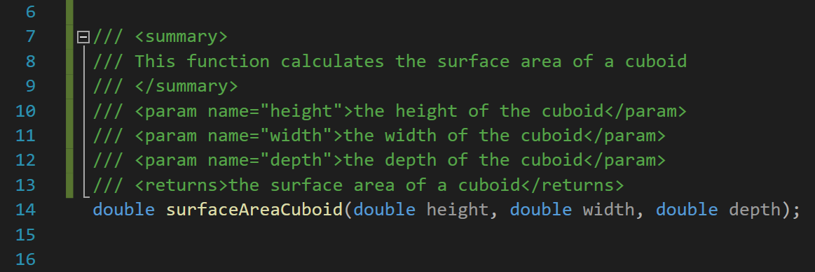
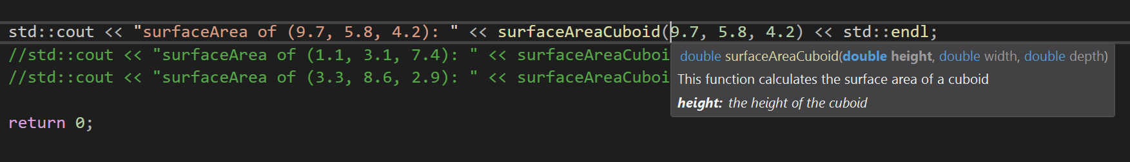
Documentation for Functions
By documenting our functions, we get helpful dropdown messages when we call them:

Slide 28
Activity 7 – Documentation
In C++ there are preferred ways to write documentation your code.
Visual Studio allows for ‘Doxygen’ or ‘XML Doc’ style comments:
  https://devblogs.microsoft.com/cppblog/doxygen-and-xml-doc-comment-support/
We can use a triple slash to start a documentation comment above a function.
The triple slash in Visual Studio C++ will auto-generate a documentation comment which allows you to explain your function, parameter list, and return types.

Slide 29

CodinGame Activity 8
Break into mini competition groups (desk of 6?)
With everyone on your desk/group starting at the same time, (wait/help the rest of the group to complete the previous task first), see who can solve the following CodinGame puzzle first:
Mars lander – episode 2:
  https://www.codingame.com/ide/puzzle/mars-lander-episode-2
This one might give you new ideas how to get better at the Coders Strike Back!

Slide 30

Homework 1 – Fun Functions
Write a function titled sayHello() that outputs to the screen “Hello”.
Easy ★ Modify the function so that it takes an integer argument and says hello a number of times equal to the value passed to it.
Medium ★★ Make another function that takes two integers arguments and then returns an integer that is the product of the two integers.
(i.e., integerA: 4, integerB: 5 (4*5 =) returns: 20)
Hard ★★★ Make a function called half() that takes an integer argument. The function must print the number it received to the screen, then the program should divide that number by two to make a new number. If the new number is greater than zero the function then calls the function half() passing it the new number as its argument. If the number is zero or less than the function exits.
Call the function half() with an argument of 100, the screen output should be
100, 50, 25, …, …, 1.
Try using recursion for this. i.e. make the half function call itself. Careful not to get stuck in an infinite loop and get a stack overflow error!

Slide 31
Homework 2 – Function Lingo
From memory recall the technical terminology which we use when talking about Functions in different contexts.
For the next 3 slides:
Easy ★ Fill in the title …… spaces of each slide with the correct programming lingo.
Medium ★★ Fill in the blue box …… spaces with the correct programming lingo.
Hard ★★★ Write an explanation of the purpose of each snippet of code and give an example where you would expect to find them when separating the code into multiple files.

Slide 32
………… Function P…………
int doSomethingAmazing(int, int);
........... Type
…………….. List
Function …………..…..

Slide 33
………… Functions
Function …………
doSomethingAmazing(9, 1);
int result = doSomethingAmazing(7, 2);
1st Function ………
2nd …………
1st …………
Assigning ……………
2nd Function ………
………… List (comma separated)

Slide 34
………… Functions
………… List (comma separated)
………… Type
Function …………
1st …………
2nd …………
int doSomethingAmazing(int x, int y)
{
  int answer = (x * y) / (x + y);
  return answer;
}
………… Variable
return ……………

