Slide 1
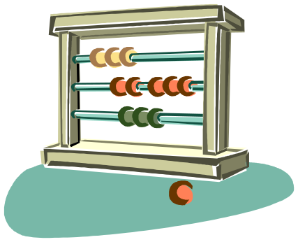
5050CEM
Programming for Engineers
Tutorial 4
Counter Control

Slide 2


Quick Recap on Last Week
while loops
Grains of rice on a Chessboard!
int (limits of storage space)
double
Increment operator ++
do… while loops
char

Slide 3

Objectives for Today
do... while Loop Solution
Compound Boolean Expressions and De Morgan's
Increment Operator ++
for Loops
Counter Controlled Repetition
Nesting
2 Dimensional Counting

Slide 4

The Increment Operator ++
Interview Question – What is the difference between these two statements?
value2 = value1++;
value2 = ++value1;
Let’s write some code to find out!

Slide 5

Let’s write some code to find out…
int value1;
int value2;
value1 = 5;
value2 = 5;
value2 = value1++;
cout << "value1 is: " << value1 << endl;
cout << "value2 is: " << value2 << endl;
value1 = 5;
value2 = 5;
value2 = ++value1;
cout << "value1 is: " << value1 << endl;
cout << "value2 is: " << value2 << endl;

Slide 6

Revisiting Last Week’s do… while loop Activity
Use a do... while loop to ask the user to enter either a ‘y’ or a ‘Y’ then check the user’s input before continuing with your program (continue by breaking out of the loop).

Slide 7

Last Week’s do… while loop Solution
char c;
do
{
  cout << "enter y or Y to continue: ";
  cin >> c;
}
while(!((c == 'y') || (c == 'Y')));
this also works:
while((c != 'y') && (c != 'Y'));

Slide 8

De Morgan's Laws
A | B | Result
True | True | False
True | False | False
False | True | False
False | False | True
NOT (A OR B) ≡ (NOT A) AND (NOT B)
Similar to the do… while solution
NOT (A AND B) ≡ (NOT A) OR (NOT B)
Another example equality
De Morgan's Laws:
I remember it as: ‘invert the parts, invert the whole expression, and change the sign’
A | B | Result
True | True | False
True | False | True
False | True | True
False | False | True

Slide 9

for loop
for( <initialise>; <condition>; <increment>)
{
// body of the for loop
// if <condition> is true do this & loop
}
Example usage:
for(int i = 0; i < 10; i++)
{
// range of i values from 0 to 9
// loops 10 times
}

Slide 10

Starting the Tutorial Work
If on a new PC, clone your remote source repository from last time:
  https://github.coventry.ac.uk/5050CEM-5051CEM-2122SEPJAN/<your username>-tutorialwork
Open the cloned repo in Visual Studio
Create a new solution ‘T4-CounterControl’
Commit changes
Push commits to remote
Begin working on Activity 1

Slide 11

Activity 1 – Counter Control
Using a single for loop:
  Make a counter count from 1 to 100 in steps of 1
  Make a counter count from 100 to 1 in steps of -1
  Make a counter count from 7 to 77 in steps of 7
  Make a counter count from 121 to -11 in steps of -11
Use cout inside your for loop to check that your counter is working as you expect it to

Slide 12
Activity 2 – Casting int to char
Using a single for loop:
  Output all of the ASCII characters from 33 to 126
  Format the output so that it shows 10 ASCII characters on each line – use a nested if statement inside your for loop for this
Hint – you can use:
  char ascii = static_cast<char>(i)
  to convert from an int to a char.

Slide 13

Nesting Statements
Nesting one statement inside another, e.g.
if(x < y)
{
cout << "x less than y";
if(x < z)
{
cout << "x less than z as well!";
}
}

Slide 14
Activity 3 –
2 Dimensional Counter Control
Using two for loops with one nested inside another:
Create a multiplication square
From 1 to 20 in x and 1 to 20 in y
Use cout to print the 2D grid of multiplications

Slide 15
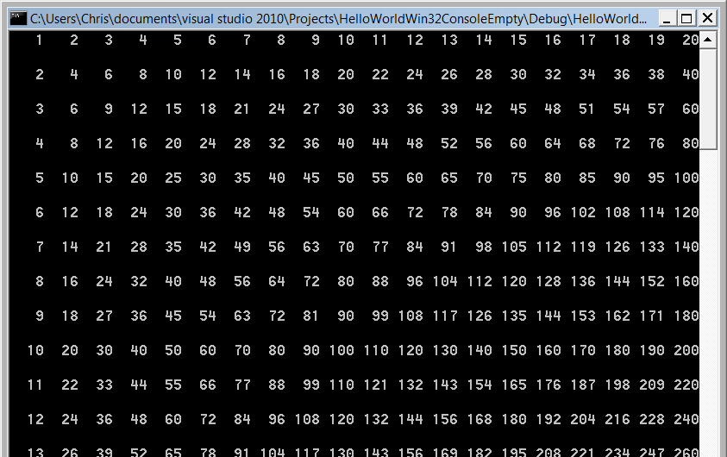
Activity 3

Slide 16

CodinGame Activity 4
Break into mini competition groups (desk of 6?)
With everyone on your desk/group starting at the same time, (wait/help the rest of the group to complete the previous task first), see who can solve the following CodinGame puzzle first:
Temperatures:
  https://www.codingame.com/training/easy/temperatures
(You will need to sign up for an account with them or use your google account etc.)
It has its own web browser based IDE

Slide 17


Let’s Explore the Deitel Exercises
Chapter 4 Deitel Exercises
Deitel Exercises 4.05 to 4.22
What do these operators do?
?:
%
*=
/=
--

Slide 18

Homework 1 – Stars and Stripes
Using for loops and nested for loops make the following patterns:
Easy ★
*
**
***
****
*****
Medium ★ ★
----*
---**
--***
-****
*****
Hard ★ ★ ★
-----|-----|-----|-----|-----|-----|-----|-----
----*|*----|----*|*----|----*|*----|----*|*----
---**|**---|---**|**---|---**|**---|---**|**---
--***|***--|--***|***--|--***|***--|--***|***--
-****|****-|-****|****-|-****|****-|-****|****-
*****|*****|*****|*****|*****|*****|*****|*****

Slide 19
Homework 2 – Pancake Glutton
Write a program that asks the user to enter the number of pancakes eaten for breakfast by 10 different people (Person 1, Person 2, ..., Person 10).
The program must analyse the data and output the total number of all the pancakes eaten.
Easy ★ Modify the program so that it also outputs how many pancakes were eaten by the person that ate the most.
Medium ★★ Modify the program so that it also outputs which person ate the most pancakes for breakfast.
Hard ★★★ Modify the program so that it also outputs how many pancakes were eaten and which person ate the least number of pancakes for breakfast.
Very Hard ★★★★ Modify the program so that if more than one person ate the most, it also outputs every person who ate the most. E.g. Person 1, 4 and 5 ate 9 pancakes each and 9 is the most by anyone then output: “Person 1 and Person 4 and Person 5 ate the most pancakes: 9 each!".

