Slide 1

5050CEM / 5051CEM
Programming for Engineers
Tutorial 1 – Version Control System
How to use CU GitHub with CLion
Chris Bass
2022

Slide 2

Today’s Tasks
About Git, GitHub and attempt to login to CU GitHub.
Create a new remote repository for completing the weekly tutorial tasks.
  “<username>-tutorialwork”.
Create new solutions inside the remote repository for each new tutorial task.
  “T1-HelloWorld” and “T1-ASCIIArt”.
Complete the tutorial tasks and make your first git commit and git push from IDE.
Programming games: Lightbot game, Codingame.

Slide 3

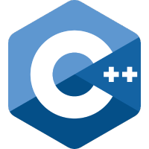
About Git and GitHub
Why Git? – The use of Git version control tools has become an industry standard for managing source code. Useful for coding jobs especially teams
Git is a free and open source distributed version control system it has its own language syntax e.g. git init, git clone, git commit, git push… etc.
GitHub is a Git repository hosting service. GitHub provides a Web-based graphical interface for managing a Git repository.
CU GitHub is a Coventry University hosted GitHub. We will be using CU GitHub for looking after our source code.

Slide 4
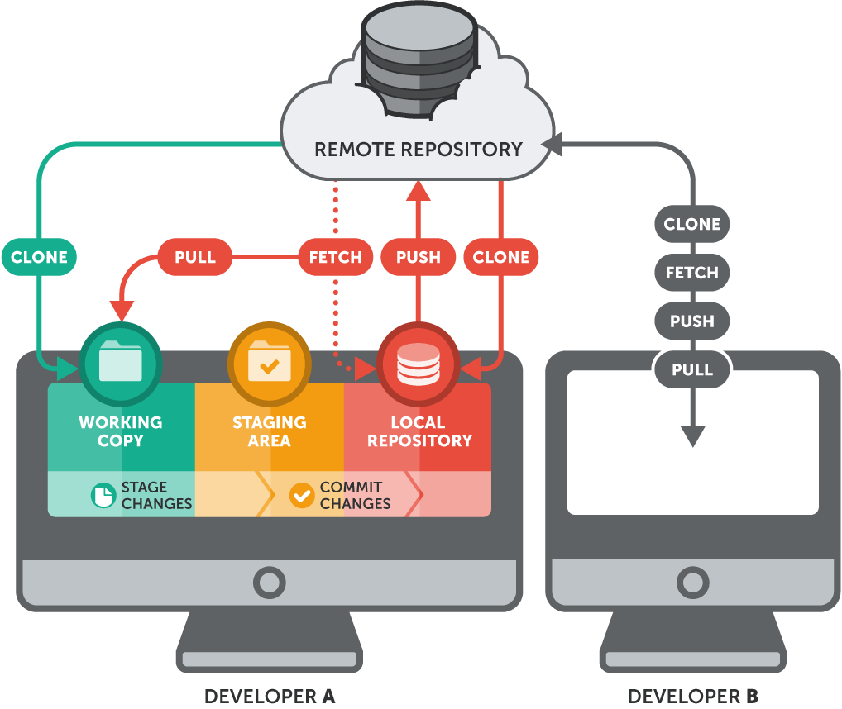
First we will create a remote repository
CU GitHub
Git commands
Then we will create our local repository and link them together

Slide 5
Attempt to login to CU GitHub
Navigate to:
  https://github.coventry.ac.uk/5050CEM-5051CEM-2223SEPJAN
In the top right click ‘Sign in’
Enter your normal University login details
If you cannot login, or cannot access the organisation page then I need your University username, so that I can add you manually

Slide 6

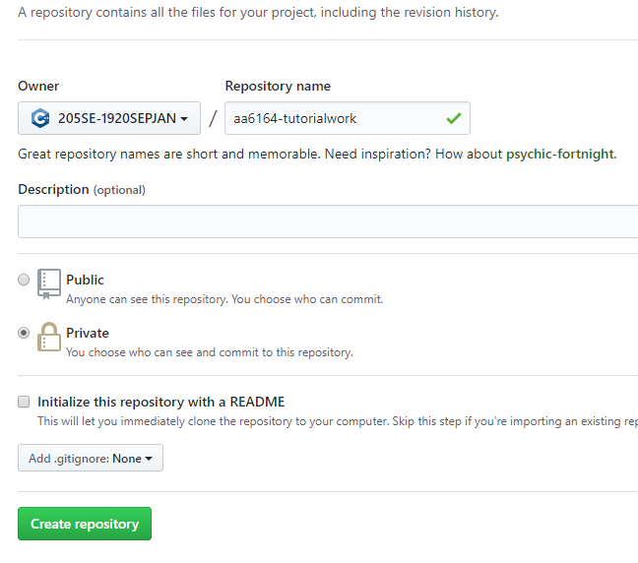
Create a remote repository
Click on the green ‘New’ button
Create a new remote repository under our 5051CEM class with these settings
Repository name should be ‘<your_username>-tutorialwork’ e.g. aa6164-tutorialwork

Slide 7
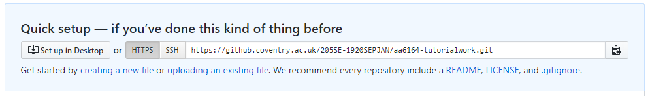
Create a remote repository
We now have an empty remote repository setup for storing our source code
Copy your remote URL for later
Click to copy

Slide 8
Create a local repository
Now we will use the GUI tools in CLion to setup a local repository and link it to our newly created remote
  (Note that this can also be done via the git command line if we wanted to)
Open CLion
Official getting started with git in CLion instructions:
https://www.jetbrains.com/help/clion/working-with-git-tutorial.html

Slide 9
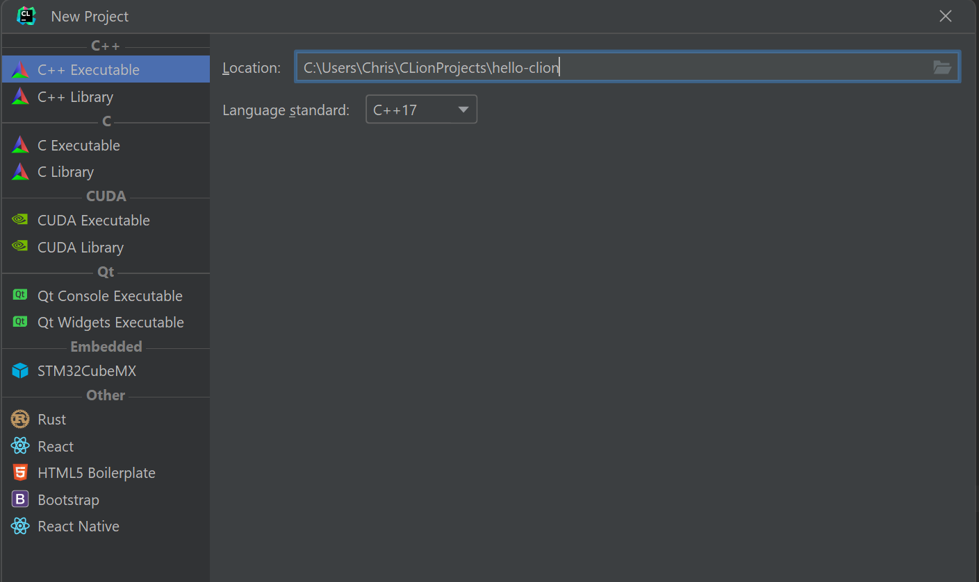
Starting with a new project.

Slide 10
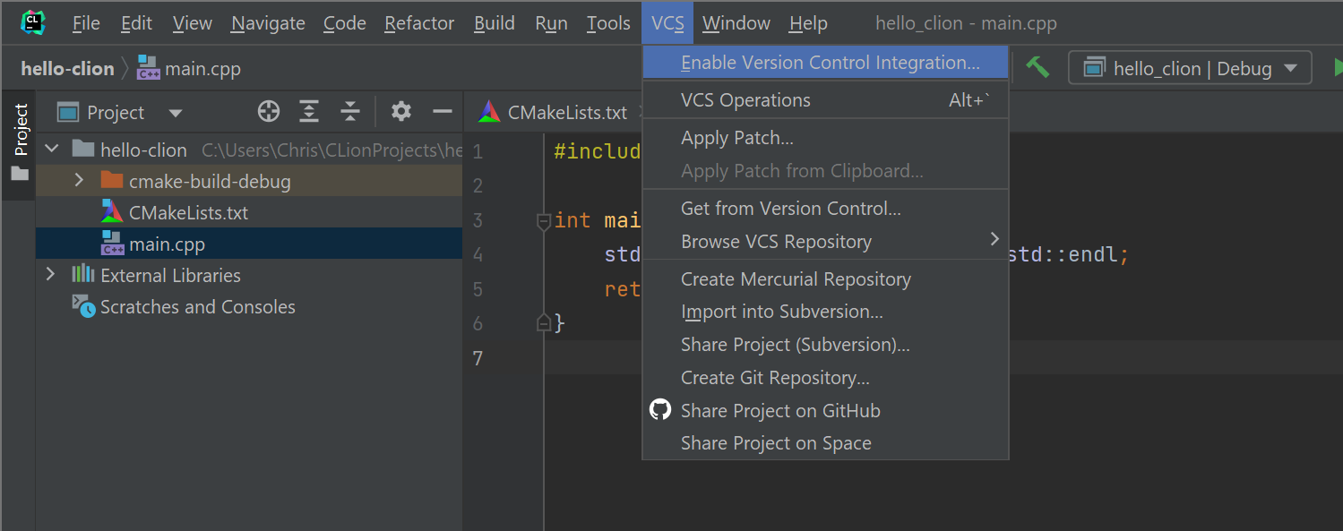
Enable version control

Slide 11
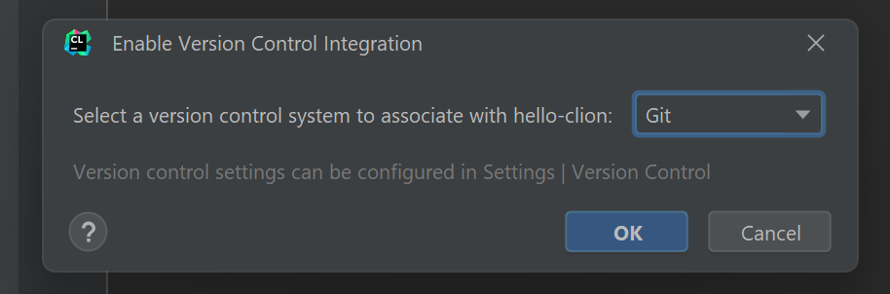
Enable version control

Slide 12
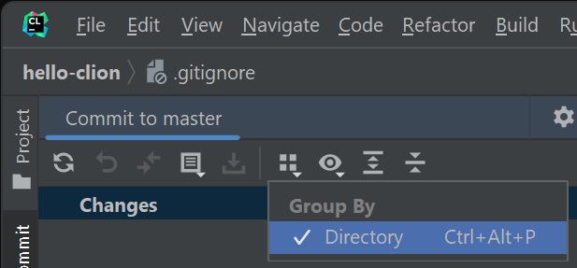
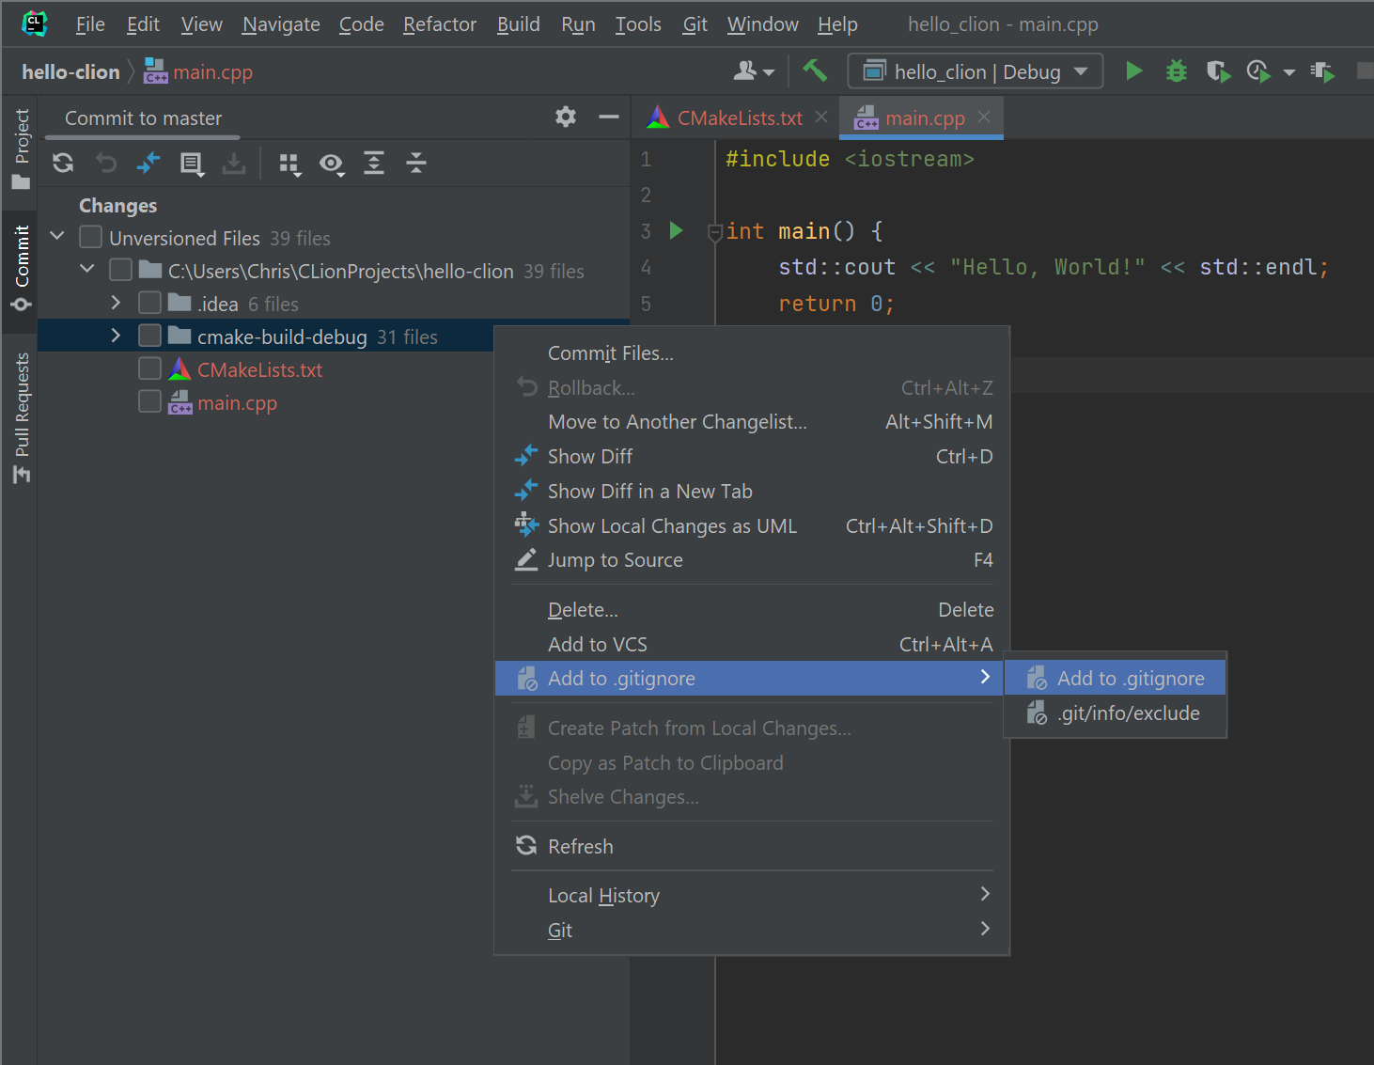
Switch to group by directory, then add files to .gitignore

Slide 13
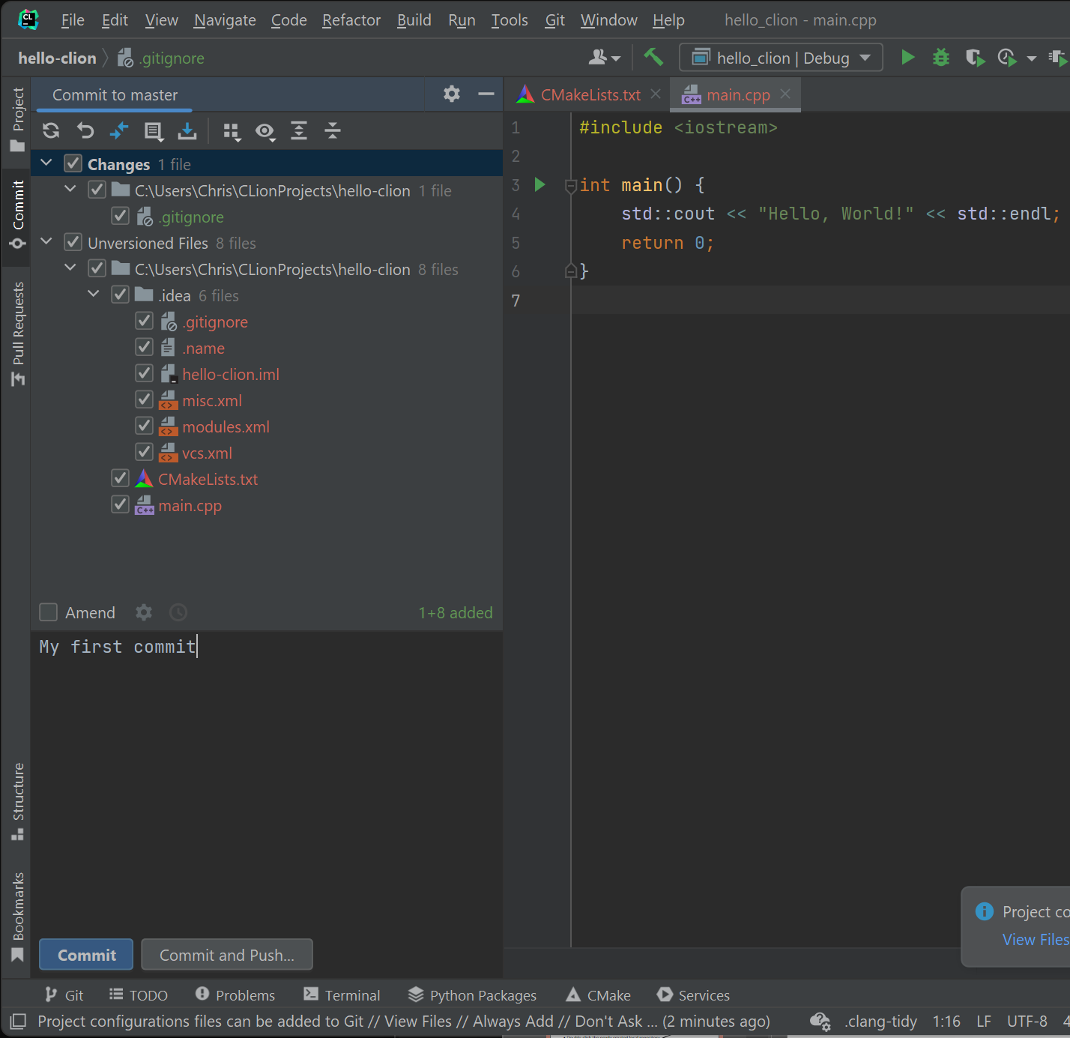
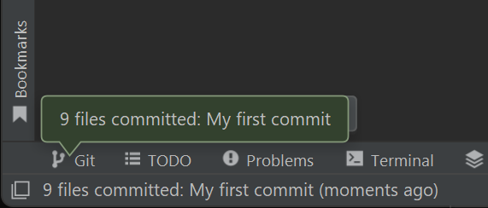
Create a local commit

Slide 14
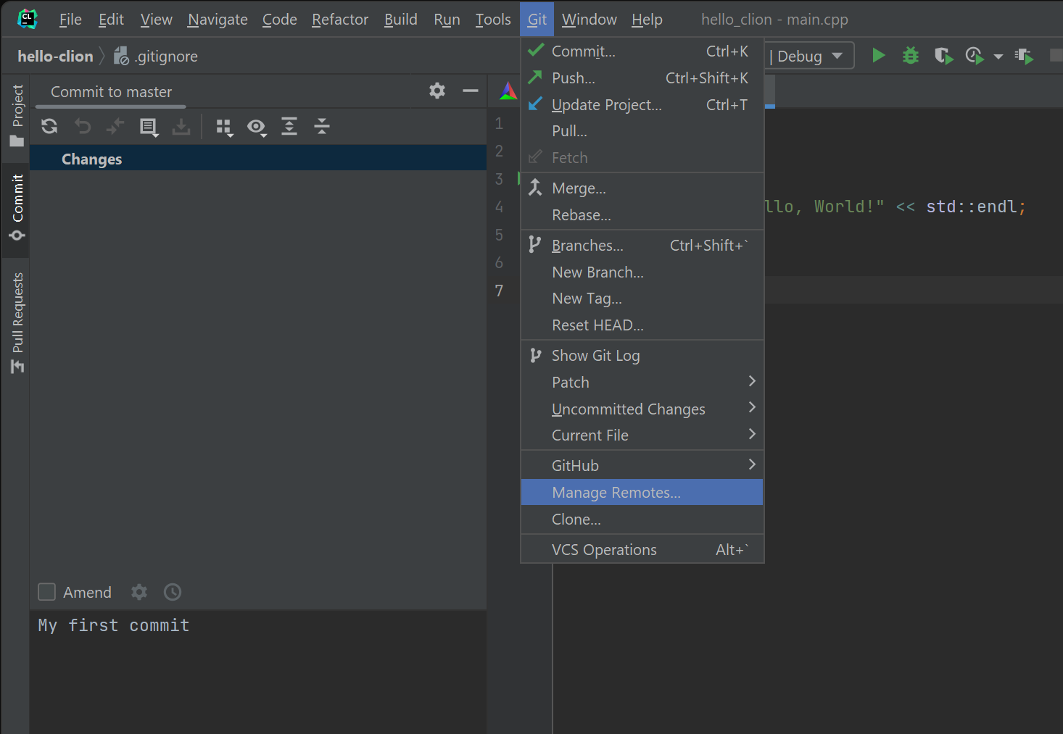
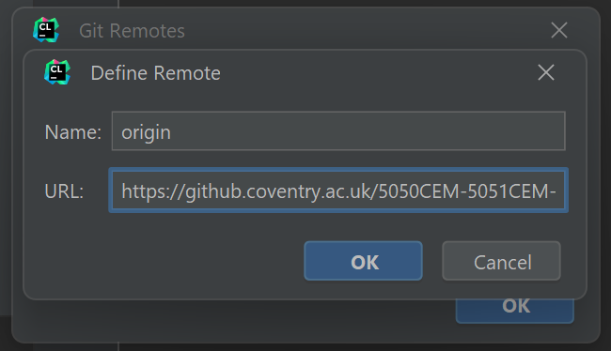
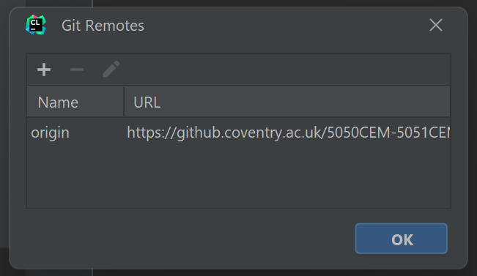
Manage remote repositories

Slide 15
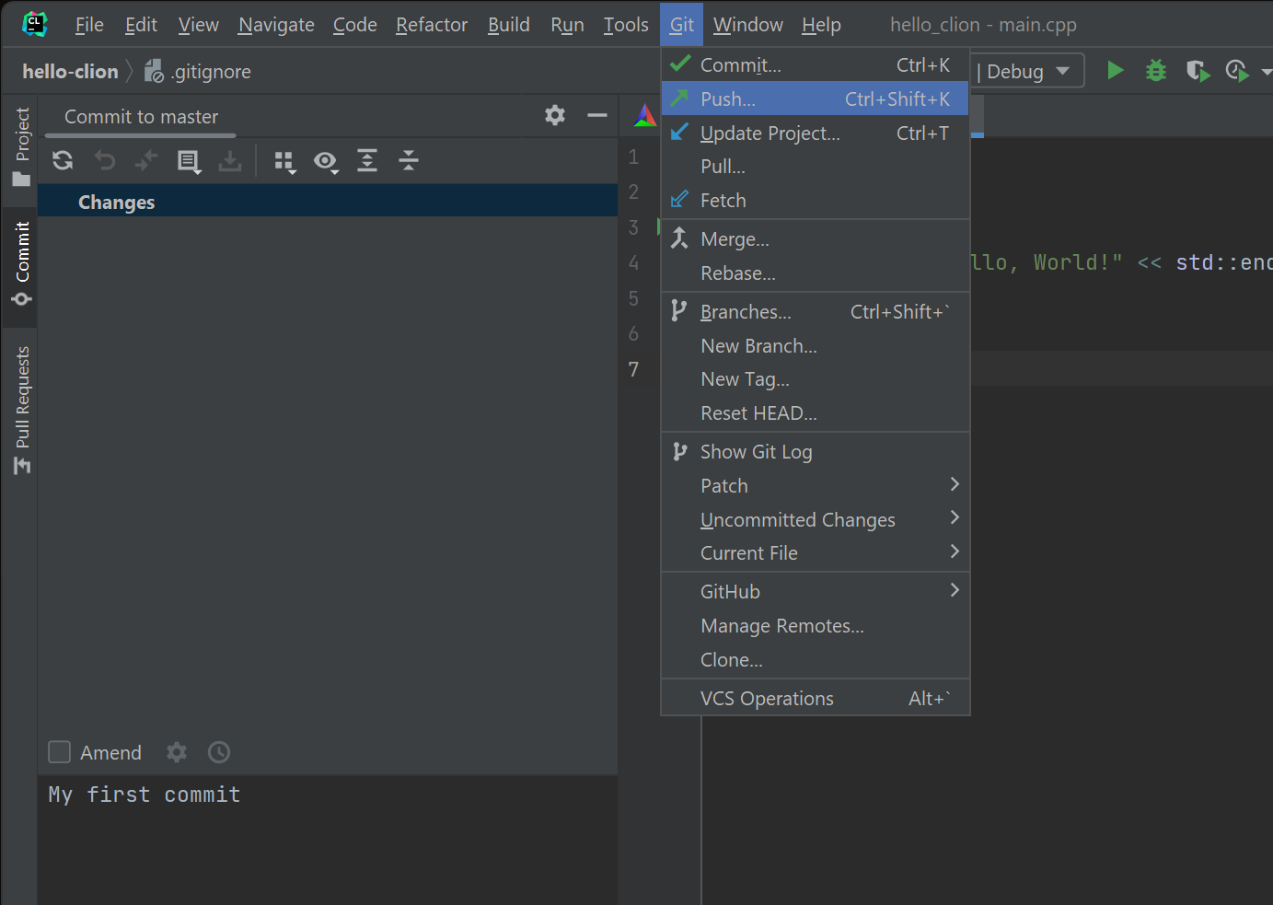
Push local commits to remote

Slide 16
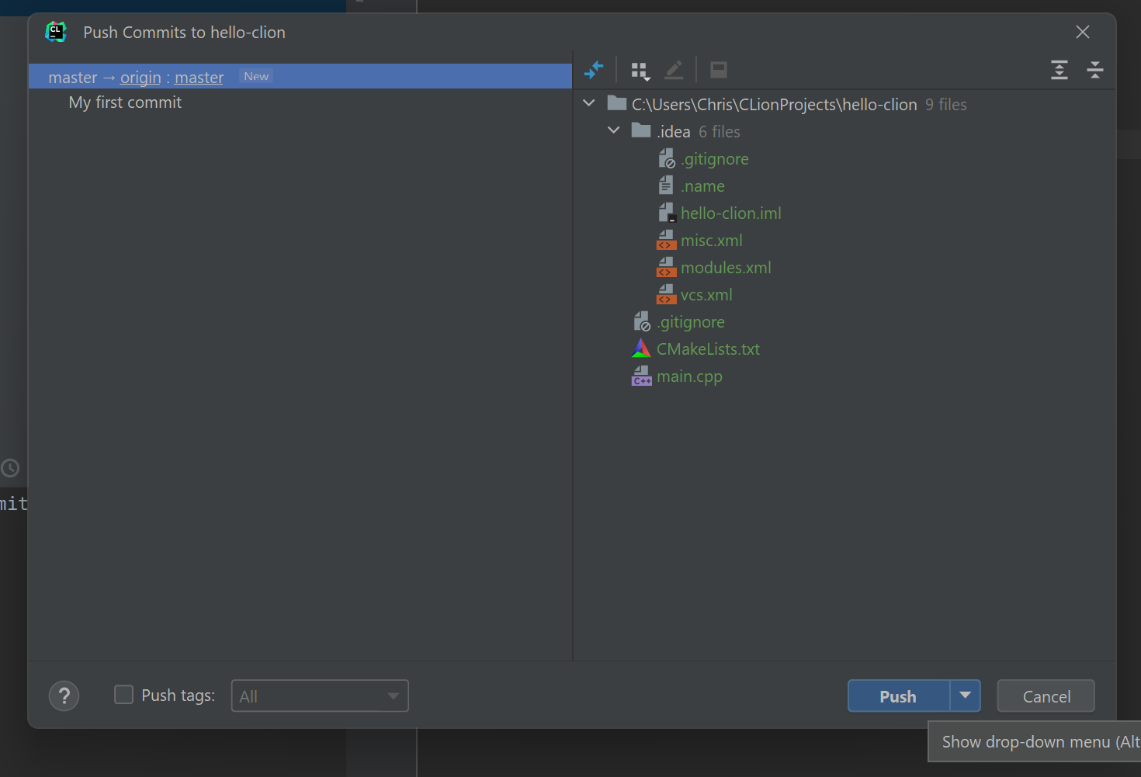
Push local commits to remote

Slide 17
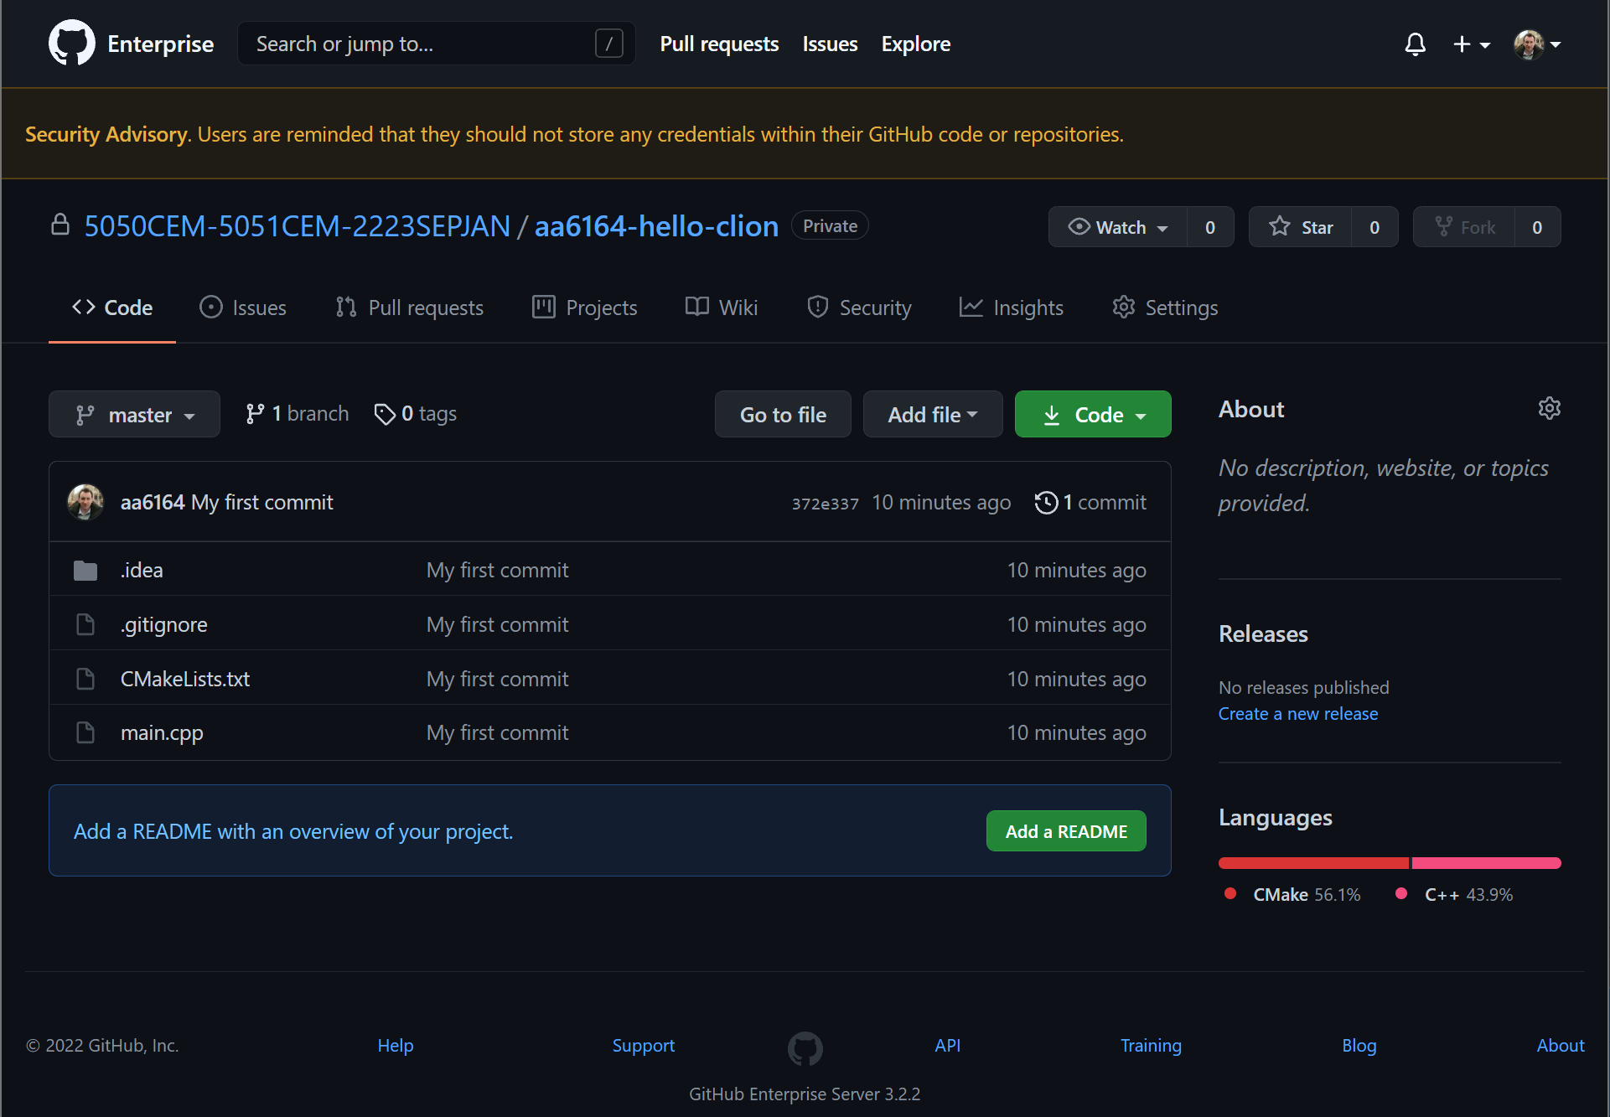
Refresh your remote and check it is updated with the committed source code files

Slide 18
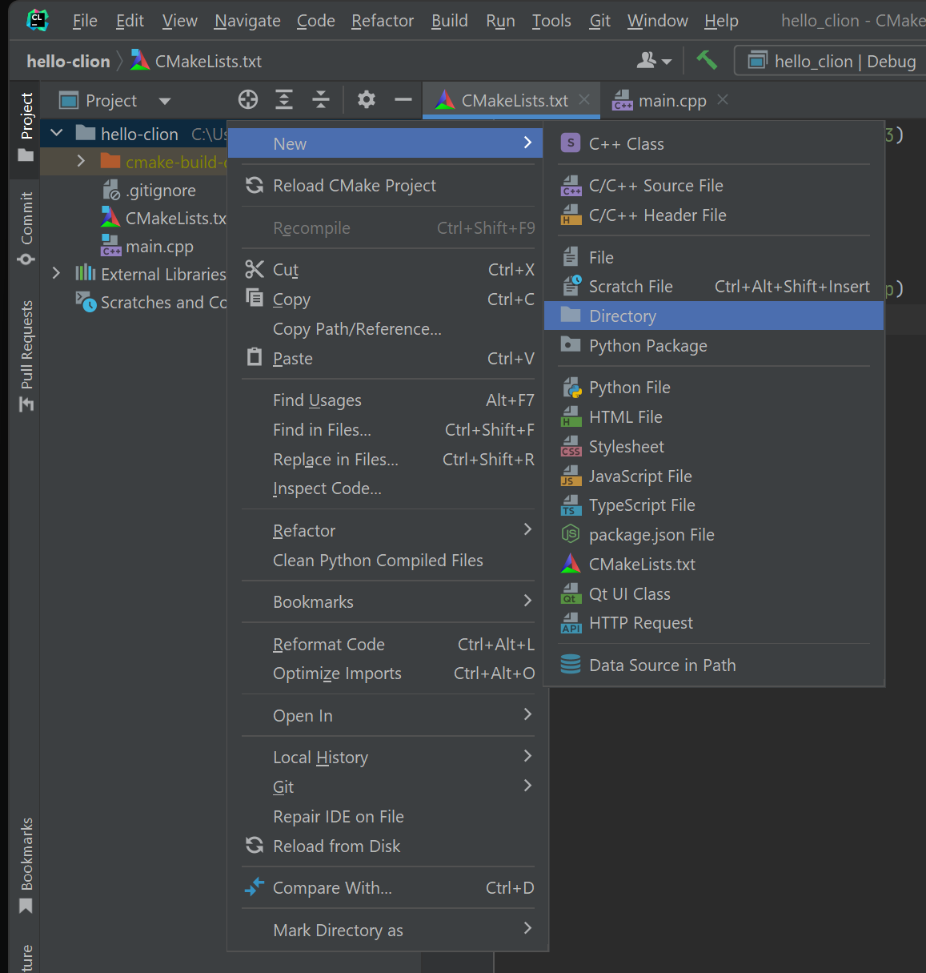
Create a new directory

Slide 19
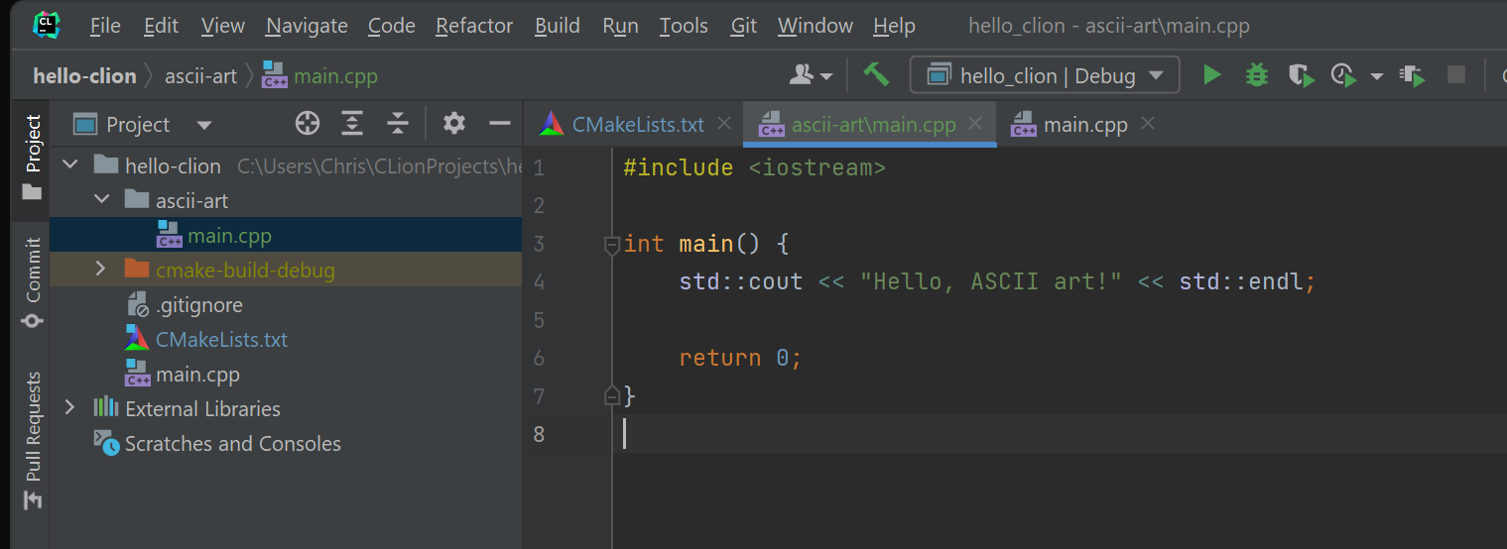
Add a main.cpp

Slide 20
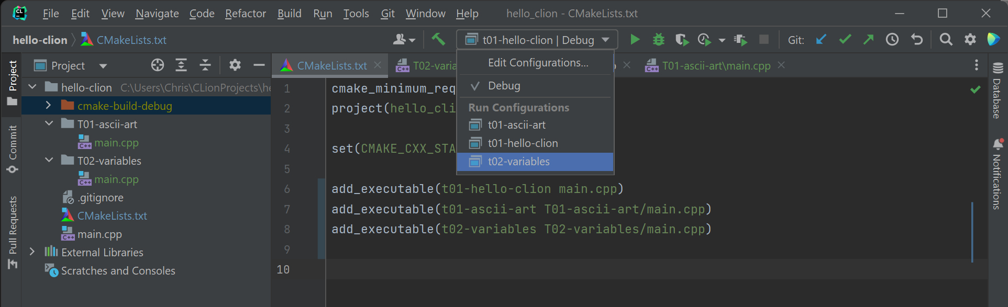
You can switch between building executables by adding lines to your CMakeLists.txt file and using the edit run configurations drop down.
We can create a simple folder structure, like above, for different tutorial activities each week.
(Auto-reload of CMake project is helpful to turn on if the button appears).

Slide 21
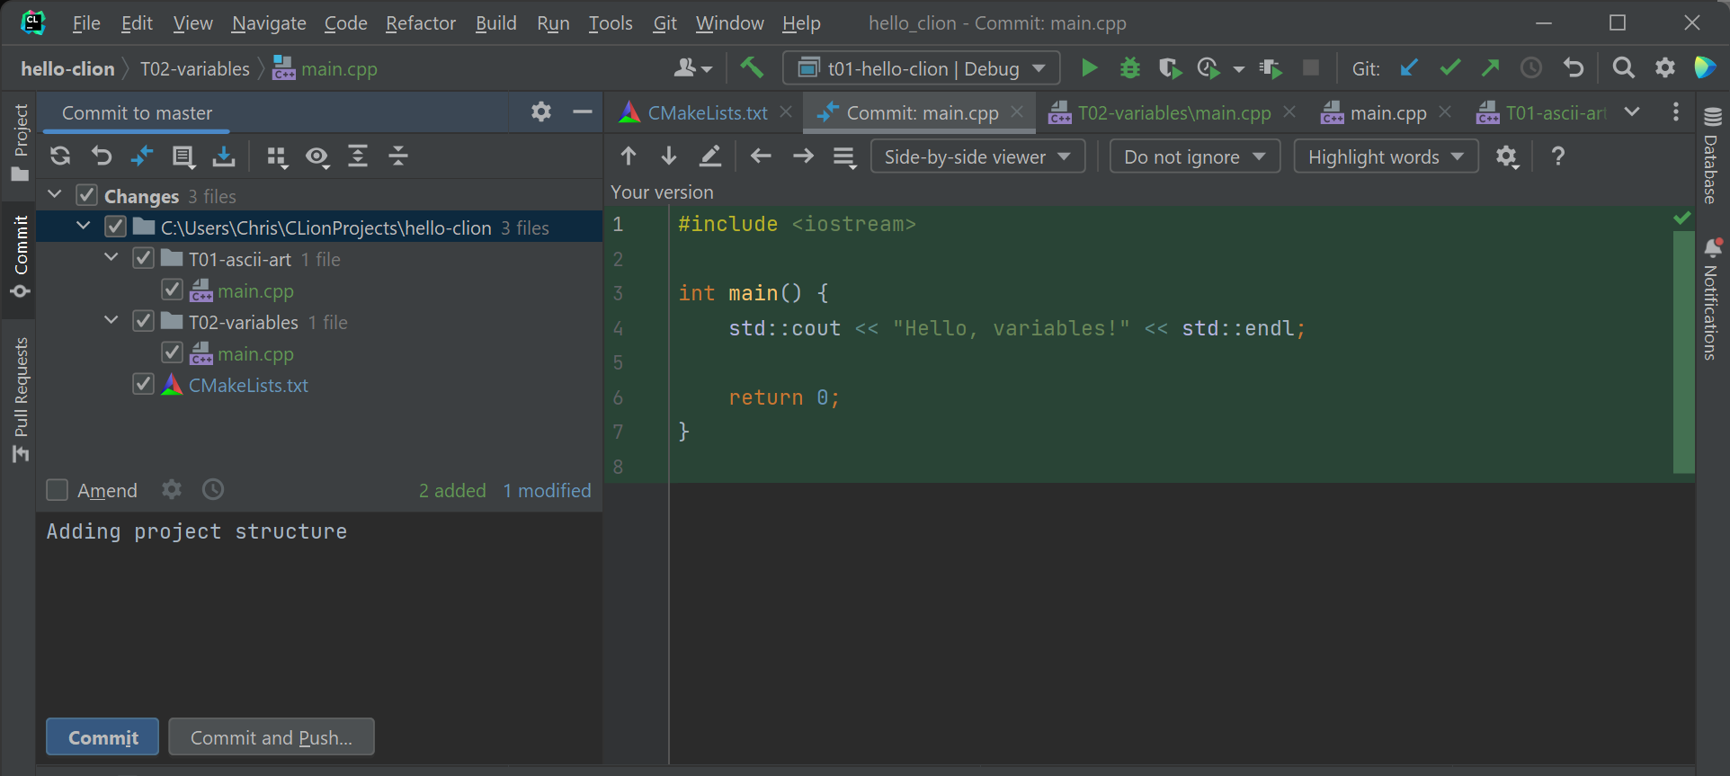
Make another local commit with the new project structure and then push

Slide 22
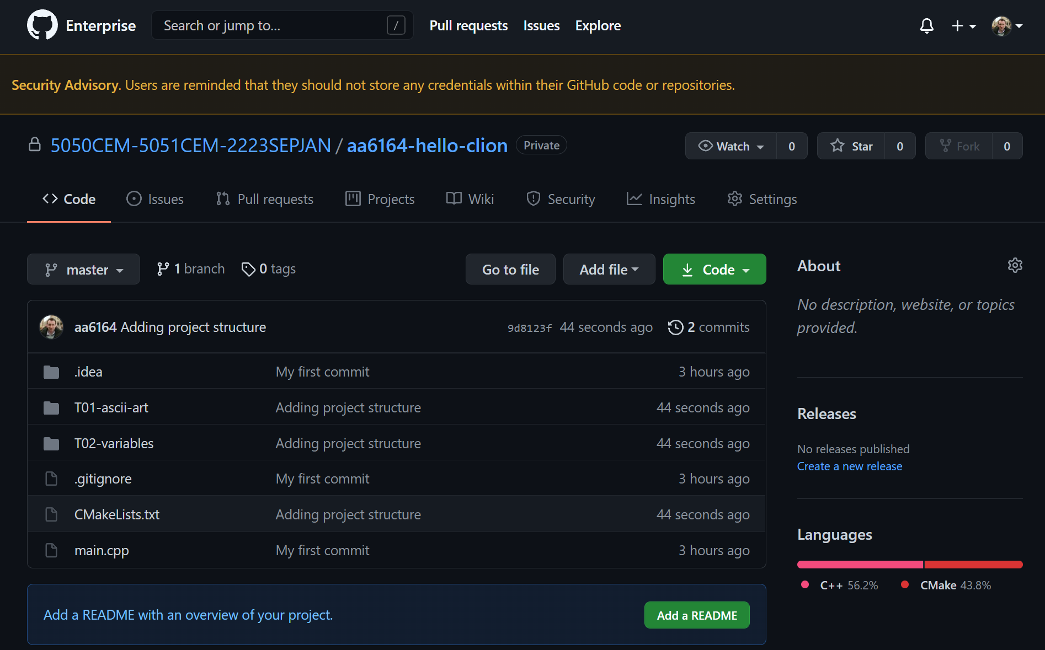
Refresh your remote again and check the changes.

Slide 23
Version control
So we have seen how to do local commits and push those commits to a remote repository on the cloud.
Now lets assume we want to change to a different PC, or maybe we just want to download someone else repository and work on that.
We can do this by cloning a repository.

Slide 24
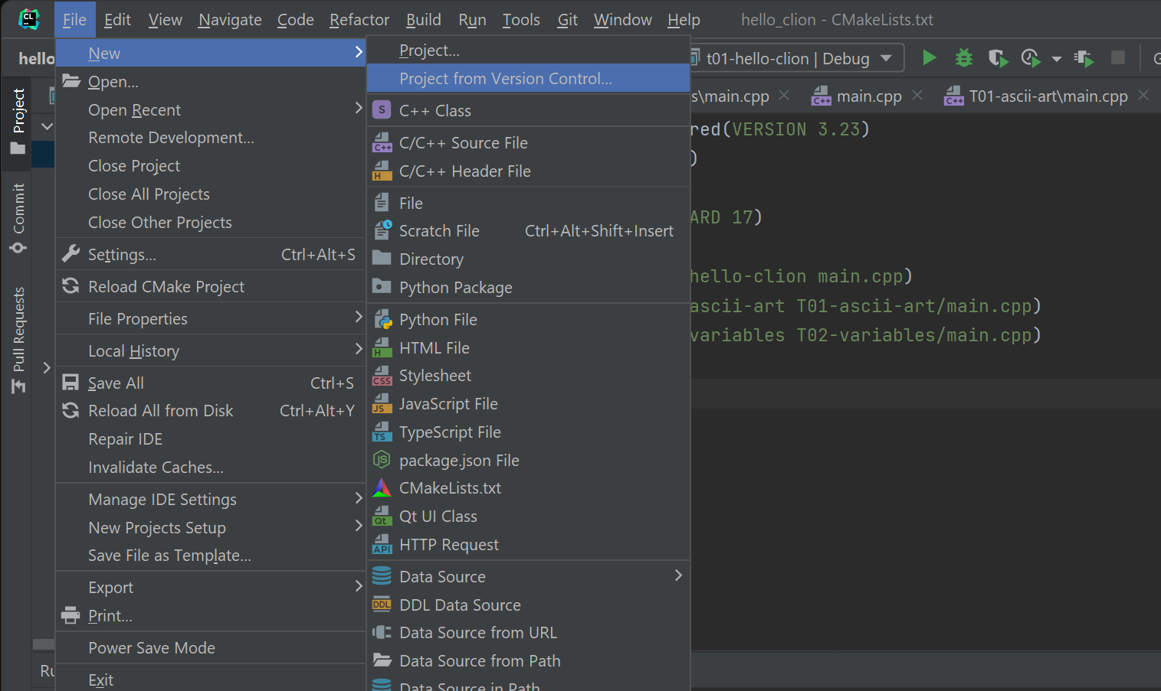
Lets pretend we have changed PC and we want to continue working on our project from where we left off from.

Slide 25
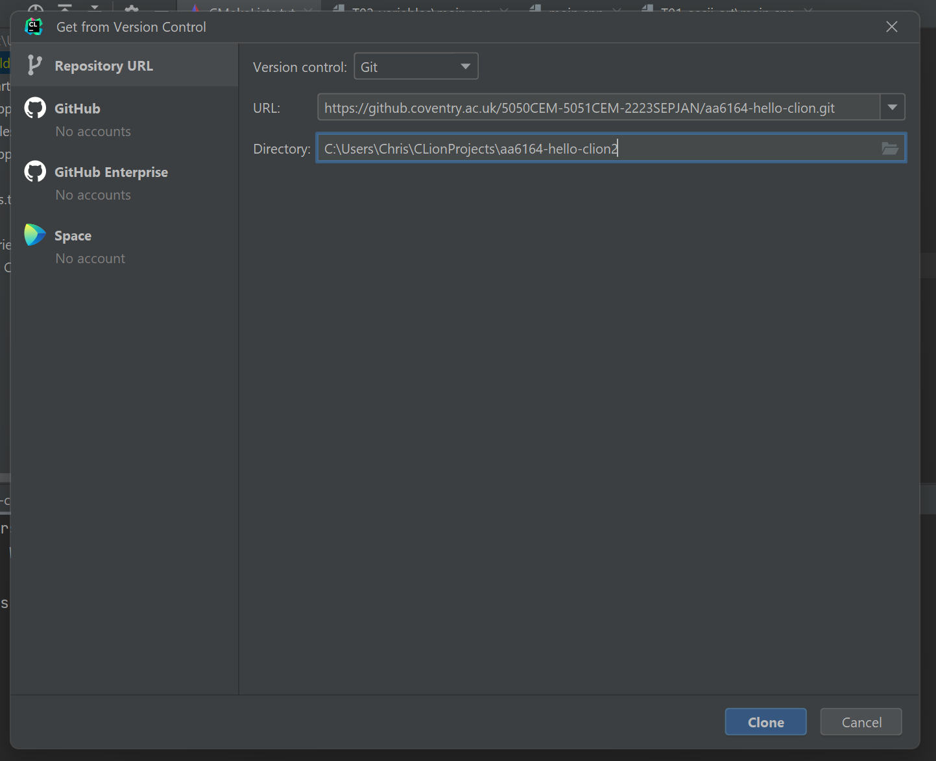
When you get from version control (clone) you need to specify your remote URL and a local directory to store the files in.

Slide 26
Regular commit and push
Now you should see that you have a clone of the project in a new directory on your local system.
You can continue to make edits to the source code, then commit and push to save your progress and version control.
Version control systems allow you to switch between PCs, and work in a team of developers on a single project.
Hopefully you are starting to see the benefits of using a version control system already, but we are only scratching the surface of its capabilities.
Get into a habit of regularly committing and pushing your changes to your remote repository. Your teammates / future self will be glad you did.
We will use this version control system for the rest of the module.

Slide 27
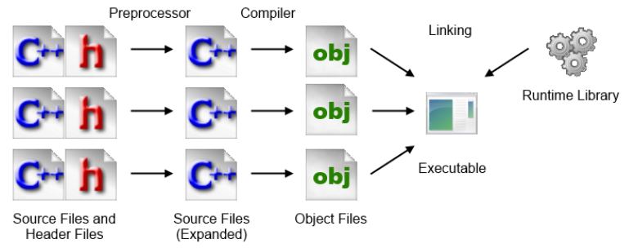
Building C++ code in CLion
C++ compilation process – see document on Moodle for more details:
Editing source files (.cpp .h)
Building
  Preprocessor
    creates expanded source files (expanded .cpp)
  Compiler (and Assembler)
    creates machine code stored in object files (.o or .obj)
  Linking
    creates executable (.exe for Windows)
Load and Execute
In CLion .obj files can be found in the cmake-build folder e.g.:
C:\Users\Chris\CLionProjects\aa6164-hello-clion2\cmake-build-debug\CMakeFiles\t01-ascii-art.dir\T01-ascii-art

Slide 28

Activity 1 – using cout
cout is the standard output stream object in C++ (in this case the windows console). Using the cout object:
Make a change to the source code so that it will print hello world, then an empty line and then your name on another separate line
Make a change to the source code so that it will print hello world and your name inside separate boxes of star characters i.e.
***************
* Hello World *
***************
* Chris *
***************
Hint:
std::cout << std::endl;
can be used to print a new line.
You can test your output by building and running your code again.
Once you have the correct output, use Team Explorer to commit the changes to the local repository and then push the changes to the remote repository.
Check CU GitHub has your code uploaded correctly, drill down to find source.

Slide 29

Activity 2 – ASCII Art
In Team Explorer, switch to your ‘T1-ASCIIArt’ solution
Search online and find some ASCII art
Can use Moodle link to ASCII text generator
Write a console program to output the ASCII art to the console window!

Slide 30
Examples of ASCII Art:
db .d88b. .d88b 888 888 db w
dPYb YPwww. 8P 8 8 dPYb 8d8b w8ww
dPwwYb d8 8b 8 8 dPwwYb 8P 8
dP Yb `Y88P' `Y88P 888 888 dP Yb 8 Y8P
---------------+---------------
___ /^^[___ _
/|^+----+ |#___________//
( -+ |____| ______-----+/
==_________--'
~_|___|__

Slide 31


Reflection on Activity 2
Did anyone notice that some characters like the backslash did not print out in the console window as expected?
Why do you think that is?
Check out the link on Moodle ‘Escape sequences’
Fix the program for any characters that are not printing correctly
Once you have the correct output, commit the changes to the local repository and then push the changes to the remote repository.
Check CU GitHub has your code uploaded correctly, drill down to find source.

Slide 32
Working with an existing GitHub repository
Now what happens when we want to switch PC and carry on working on our existing GitHub repository?
GitHub can be fussy sometimes, in that we must start from the latest version of our source code (stored on the remote), before we are able to push further changes to the remote
When switching to a new PC we need to git clone a GitHub repository before we can work on it (or if we just have an older version, we can pull any changes to update our local repository to match the remote)

